Slide 1


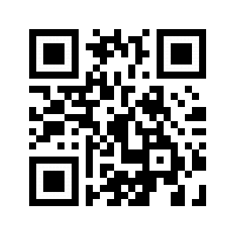


Key takeaway of your study in a short, plain-language “headline”.
Use you title headers more effectively. Insert your main ideas or take-aways here.
Background: Maat is the village along the Nile in South Sudan. Population varies between 6200 and 12810. Access to clean water is limited (river is the only source of water). Locals acknowledge bad water quality.
Impactful statement about how your study was “novel”. Takeaway from the figure below
Impactful statement about how your study was “novel”. Takeaway from the figure/picture below
METHODS: Baseline survey & how we measured the effect of the study
Short few lines about how you performed your research/study: To create a new template, I identified strengths of the BSP template and the traditional format. BSP strengths: clear take-away message, minimal text, QR code. Traditional format strengths: room for figures, reasonable text size on sides, large title to make finding posters in poster session easy, web link and email for people who don’t like QR codes
Key takeaway from figure/picture below
Key takeaway from figure/picture below
Key takeaway from figure/picture below
Key takeaway from figure/picture below
Use this area from any follow-up discussion or highlight limitations or future work
Poster template: https://osf.io/ayjzg/
smithar3@appstate.edu
FIRST & LAST NAME, FIRST & LAST NAME2, FIRST & LAST NAME3
ACKNOWLEDGEMENTS: Special thanks to John Doe, Jane Doe, Spot Doe, Johnny Doe.
Insert correct college or department logo

