Slide 1

CAEP Charges and Timeline for APAC 2025-2026
Dr. Mary Elizabeth Spence
CAEP Coordinator
mspence@astate.edu

Slide 2
25-26 CAEP Charges for APAC
Major charge(s) of this subcommittee regarding CAEP:
  Create a process of analysis of Site Mentor Surveys EPP-wide and establish Baseline Data [Standard RA1.1]

Slide 3
CAEP Annual Report Requirements
By April 10, 2026:
Submit annual report on the CAEP Subcommittee Annual Report Template. This is an executive summary of the committee’s past year and should include the following:
  Subcommittee Name
  Subcommittee Charge
  Number of times the committee met and dates of meetings
  Summary of Actions (including any deliverables)
  Challenges (or proposed changes for the coming year)
  Engagement with EPP Leadership
  If the subcommittee has any changes to suggest regarding its own charge, composition, or size, etc.
  Attachments to be included:
    ALL Meeting Minutes for the Subcommittee during the Academic Year
    Any data, instruments, correspondence or other relevant documents referenced in the Subcommittee’s Annual Report

Slide 4
Site Mentor Surveys
Create a process of analysis of Site Mentor Surveys EPP-wide
  What does this look like with 3+ instruments?!
    Not guiding programs to alter their individual instruments, but how can we analyze EPP-wide?
      “Buckets” of questions covering a single subject, i.e. planning, supervision, etc.
      Any other analysis ideas?

Slide 5
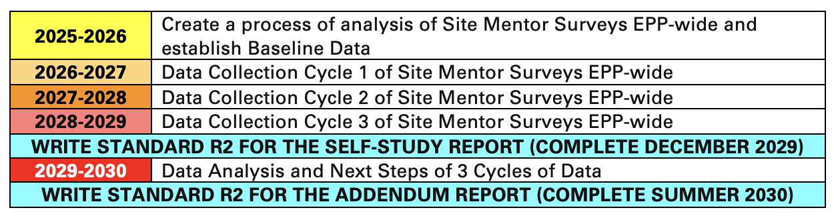
CAEP Cycle Assignment Charges, Deliverables and Timeline
The chart below outlines charges, deliverables and their timeline for the next CAEP Cycle:

Slide 6

Q & A
Please email me or bring any questions and concerns to IPAC in October!

