Slide 1

Curriculum Mapping in Teacher Education Programs
Dr. Mary Elizabeth Spence
Director of Professional Education Programs, CAEP Coordinator
mspence@AState.edu

Slide 2
Agenda
Curriculum Mapping Overview
Mapping Uses
Mapping Best Practices
How do Curriculum Maps fit into Student Learning Assessment?
Q & A

Slide 3
What is Curriculum Mapping?
Curriculum maps incorporate program learning outcomes and should reflect a coherent plan of study.
A curriculum map is a tool used to record curriculum-related inter-connections that identifies program-level student learning outcomes, the courses in which the content is taught, and level at which the content is taught.
Additionally, a curriculum map can show how student learning outcomes are addressed in modules and/or experiences that make up the academic program's curriculum at the course-level.
Curriculum maps can also detail how an academic program is related to Institution-level outcomes.

Slide 4
Curriculum Mapping Purpose and Function
Detail the relationship between the academic program’s student learning outcomes and the program’s required courses
Demonstrate progression of student learning in the academic program
Communicate expectations to students
Promote discussion among the faculty
Identify gaps in the curriculum
Pinpoint exactly where to address opportunities for course or program improvement
Inform students of where each course, course objectives and required activities and assignments fit within the program as a whole.

Slide 5
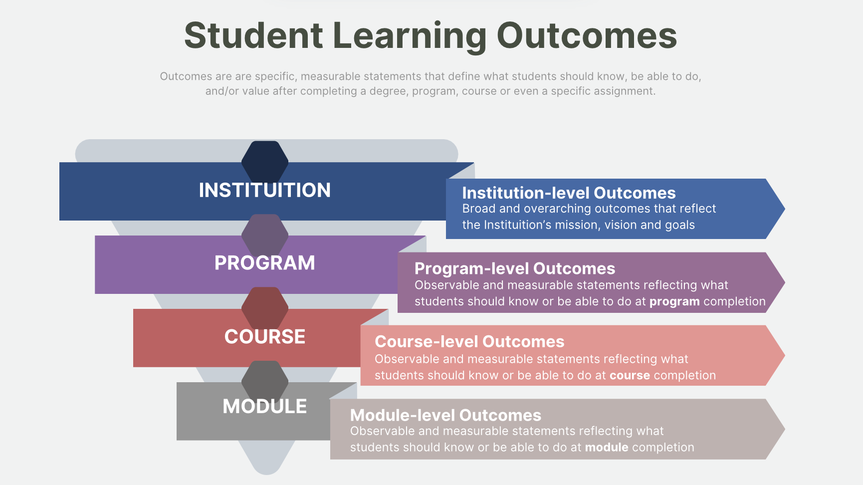
Scaffold

Slide 6
Student Learning Outcomes Mapping
Module-level curriculum mapping involves creating a detailed plan for a specific module or unit of study within a larger curriculum, ensuring alignment with broader learning objectives and assessment methods.
Course-level curriculum mapping is a tool that visually illustrates how courses within a program align with and contribute to program learning outcomes.
Program-level curriculum mapping is a structured approach to planning and assessing how courses within a program align with program learning outcomes (PLOs). It involves creating a visual representation, often a matrix or table, that shows which PLOs are addressed in each course and how they are developed and assessed throughout the program. This process helps ensure that all PLOs are adequately addressed, that learning is scaffolded appropriately across courses, and that the curriculum is coherent and aligned with program goals.
Institutional-level outcomes are broad and overarching outcomes that reflect the Institution’s mission, vision and goals. Institutional level outcome mapping can be considered within the context of the academic programming or more conceptionally when aligning or mapping program outcomes to these broader statements.

Slide 7
Curriculum Mapping Best Practices And Questions To Consider
Best Practices:
  Measurable Learning Outcomes at all levels
  Keep in mind Accreditation needs
  Involve ALL Faculty
Common Questions:
  Who did this curriculum map? Why are my courses on it?
  If you/we mark “my” class, am I required to asses the course?
  If you/we mark “my” class, am I required to report the data?
  How do faculty see their course(s) aligning with program and institutional level outcomes?
  What rating (I,R, or M) would faculty give the course(s) in relation to the program learning outcome achievement?
  What are best course-embedded measures that will provide evidence of students’ development or achievement of the program learning outcome?

Slide 8
Using Curriculum Maps in Syllabi
There are numerous ways to communicate mapping of program and course curriculum in a syllabus.
One example is to create a PDF version of a map, add the map as an appendices in the syllabi and state that a course’s alignment can be found in the map.
Next are two more examples of curriculum mapping communication. The chart on the left is mapping for a course to prescribed program standards, while the mapping on the right is for outcomes written by program faculty.

Slide 9
CAEP R1.1 The Learner and Learning
“The provider ensures candidates are able to apply their knowledge of the learner and learning at the appropriate progression levels. Evidence provided should demonstrate that candidates are able to apply critical concepts and principles of learner development (InTASC Standard 1), learning differences (InTASC Standard 2), and creating safe and supportive learning environments (InTASC Standard 3) in order to work effectively with diverse P-12 students and their families.”

Slide 10
CAEP R1.1 The Learner and Learning
CAEP Charge for Initial Programs Faculty:
  Traditional Curriculum Mapping scaffolding including Courses, Outcomes and Levels for each Initial Program
CAEP Annual Report will include progress on this work

Slide 11
CAEP R1.1 The Learner and Learning
Maps will satisfy:
  Office of Accreditation and Assessment
  CAEP
  SPAs
  State Review
  Program Improvement
  Communication to Stakeholders

Slide 12
Standards Crosswalk

Slide 13
Standards Crosswalk
Other Standard Sets to include:
  HQIM
  ISTE
  SPA (by program)
  Any others?

Slide 14
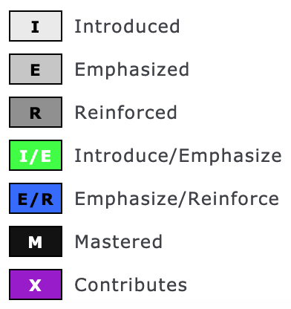
Example Curriculum Map
Traditional Curriculum Mapping “Marking Scheme:”

Slide 15
“Levels of Learning”
“I” – Introduced:
  Student is not familiar with content/skill/behavior. Instruction concentrates on introducing students to the content area/skill and brings them to some predetermined entrance benchmark.
“E” - Emphasized:
  Student should have brought basic content/skill to the class. Instruction concentrates on enhancing content/strengthening skill, adding new content material, and building more complex skills based on entrance benchmark.
“R” - Reinforced:
  Student brings reasonable knowledge and skill to the situation as a result of knowledge/skill being introduced and/or emphasized at some previous point in their educational career. Instructional activity continues to build upon previous benchmarks and reinforce knowledge/skill.

Slide 16
“Levels of Learning” (con’t)
“M” – Mastered:
  Student brings substantial knowledge and skill to the situation as a result of knowledge/skill emphasized at some previous point in their educational career. Instructional activity continues to build upon previous benchmarks to master knowledge/skill.
“A” - Assessed:
  Students should have developed a sufficient level of competency in the skills associated with the program outcome to have mastered them. This is where the assessment of the program learning outcome is done (or the artifact for analysis is collected). (University of Northern Colorado)

Slide 17
Next Steps:
Relevant standard sets need to be added to Crosswalk document
Each program will create a curriculum map (to include SPA standards)
Work with the OAA to translate Excel maps to Nuventive
Spring 2026 and beyond: use maps to inform Syllabi PLOs and Assessment sections to best reflect what is going on program-wide

