Slide 1
An Introduction to PBIS
Positive Behavioral Interventions and Supports
Module 4
Notes:
Images in this module were obtained at google.com/images unless otherwise specified.
Trainer Notes:
This module will give an overview of PBIS and the benefits that can be gained from implementing this framework. In subsequent modules, we will talk in more detail about each of the components.

Slide 2
Why Implement PBIS?
Notes:
Trainer Notes:
Before diving in with a new initiative, it’s important to understand what the goals are and how it will improve outcomes at your school.

Slide 3
What Is Your Goal?
Do you want to…
change student behavior?
improve school climate?
increase consistency among teachers?
Notes:
Trainer Notes:
Have trainees think about what their purpose is in thinking about changing their school. If there is no goal, something new may not be helpful, and there is no clear way of developing and measuring objectives. If things are going well already, change may not be warranted. Educators undoubtedly have big goals and want to make a difference, but sometimes the environment and student behavior don’t make it easy. Unwanted behavior can be distracting for everyone and cuts into valuable teaching time. PBIS can help make the school environment more conducive to learning and helping students succeed.

Slide 4
What Is Your Status Quo?
The behavior of students is (bad/average/good).
Grades and test scores are (bad/average/good).
Attendance is (bad/average/good).
There (are/aren’t) common behavior expectations.
Classroom management (is/isn’t) consistent.
Staff response to student behavior is (consistent/inconsistent).
(No/few/many) students are receiving interventions.
Morale is (bad/average/good).
School climate is (bad/average/good).
There (is/isn’t) a common purpose or philosophy.
Notes:
Trainer Notes:
Have attendees take a minute and see how they would answer these questions right now. (We can narrow this list – just want the audience to know that we understand they have barriers; we understand their current reality.)

Slide 5

What Hasn’t Worked?
Zero tolerance policies & exclusion…
  may lead to worse behavior.
  result in loss of learning time.
  don’t help the student.
How many things have you tried?
Notes:
Trainer Notes:
Beginning in the 1990’s, zero tolerance was adopted by schools all over the country, but this led to students being suspended or expelled for behavior that didn’t require this extreme consequence. This takes the responsibility away from administrators and teacher in trying to work with the student on improving. Now compare that to a student doing something wrong academically. Do we exclude the student?

Slide 6

Schools That Are Doing Well…
It’s NOT because they care more….
It’s NOT because they have more advantages…
It’s BECAUSE they have the right tools!
Notes:
Trainer Notes:
The good news is that there are schools that are doing well! It’s not because they care more or because their students have more advantages, or more technology, or better facilities. It’s because they have the right tools to guide them through the process of creating a positive school environment.

Slide 7
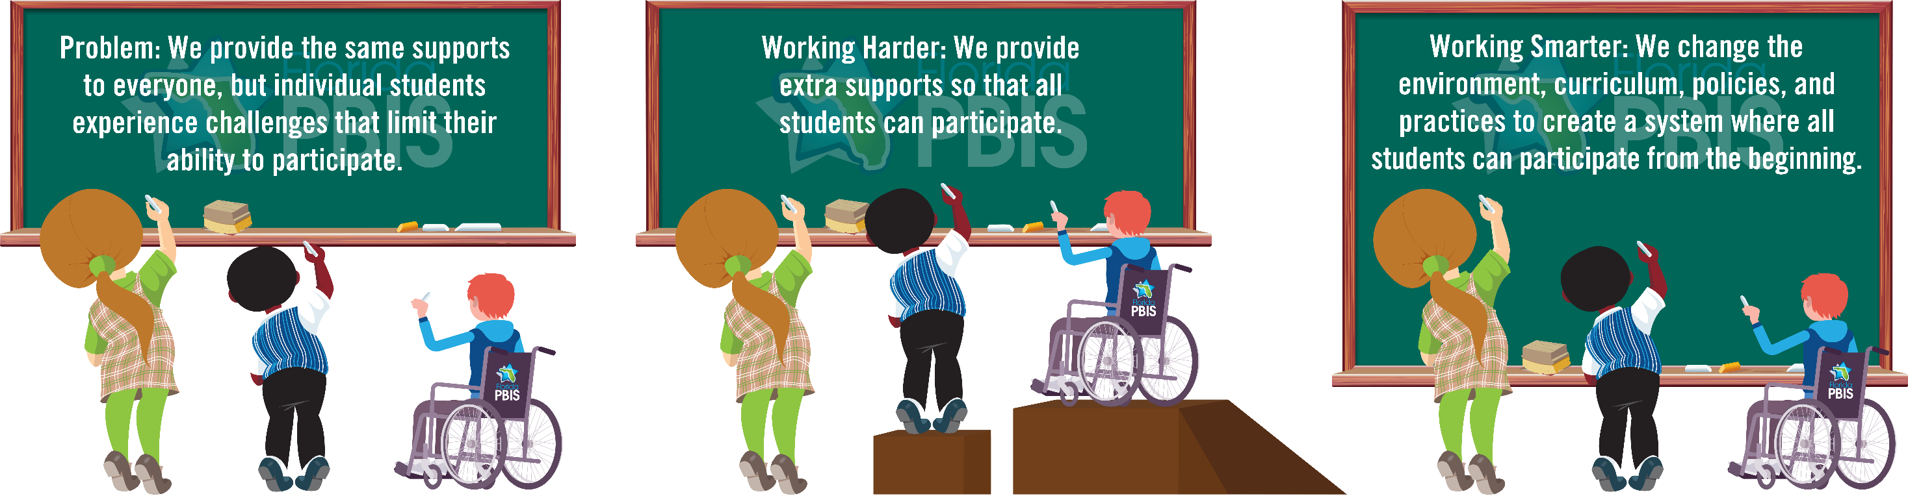
PBIS Is A Useful Tool
https://flpbis.cbcs.usf.edu/other/success.html
Notes:
Trainer Notes:
PBIS is a tool that will guide schools through the process of creating the environment that they want.

Slide 8
What Can You Gain?
Clear, common behavioral expectations
Clear, consistent responses to behavior
Appropriate supports for all students
Collaborative data-driven problem solving
More time for teaching
More positive environment
Better grades, test scores
Notes:
Trainer Notes:
When the PBIS framework is fully implemented, schools will gain consistency in the way behavior is taught and how the students’ behavior – both appropriate and inappropriate behavior – is addressed by all staff. Data will be used to determine needs and develop appropriate supports. By addressing behavior in a more positive and proactive way, schools gain more time for teaching and working toward better grades and test scores.

Slide 9
Try A New Philosophy
Implementing PBIS requires a change in philosophy;
PBIS is a proactive and positive approach to discipline.
Where do you start?
Notes:
Trainer Notes:
PBIS starts with a change in the way adults approach discipline. Instead of just giving students a handbook of rules and a list of things “not to do” and waiting for them to make mistakes, PBIS is about having expectations for behavior, teaching and modeling that behavior, and encouraging that behavior.

Slide 10
Organize Your Environment
Put systems and practices into place to support all students.
Notes:
Trainer Notes:
The process of organizing the school environment involves putting systems in place to support staff as they put practices into place to support the students.

Slide 11
Guiding Questions
  What student outcomes do we want?
  What supports will help reach these outcomes?
  How will we deliver supports?
  How will we know if they are working?
Notes:
Trainer Notes:
Here are some questions for schools to keep in mind as they go through the process of implementing PBIS. The critical one is the outcomes question — PBIS needs to start with goals and outcomes, not processes.

Slide 12
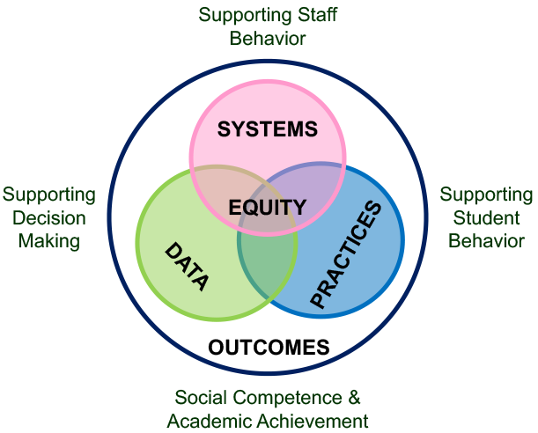
How will you support staff so they can
support students?
How will you know if
things are working?
What practices will
support students?
https://www.pbis.org/pbis/what-is-pbis
Notes:
Trainer Notes:
This is an illustration of what we discussed in the last couple slides. It shows how everything works together.

Slide 13
Tiers Of Interventions
PBIS is for all students!
PBIS starts with PREVENTION for all students.
  Everyone receives instruction in appropriate behavioral expectations.
  Some students may need more support.
Notes:
Trainer Notes:
The PBIS framework provides three levels of interventions, which is optimal for giving students the best opportunity to succeed. Not all students that are making mistakes need individual interventions. PBIS provides a continuum of interventions matched to the needs of the students.

Slide 14
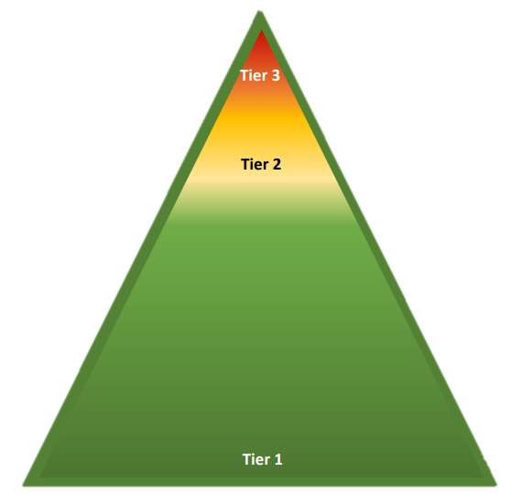
A Continuum Of Practices: 3 Levels of Prevention
Tier III: Individualized supports for students engaging in dangerous or threatening behaviors.
Tier II: Targeted supports for students with non-serious repetitive behaviors.
Tier I: Universal tier. Core instruction (general education) for all students.
Notes:
Trainer Notes:
This illustration describes the three tiers of intervention for PBIS (same for RTI, in general). This pyramid has become an iconic symbol in PBIS implementation. We call these levels of prevention because the goal is to prevent students from making more mistakes or escalating in behavior. Note how the tiers overlap – they are not separate. Students receiving Tier II or Tier III interventions are still receiving Tier I support.

Slide 15
Why Have A Universal Tier I?
  Do students know expected behavior?
    Or do they just know what not to do?
  Is there planned behavioral instruction?
  Is there consistency in procedures?
    How do you know?
Notes:
Trainer Notes:
A universal tier for behavior will give the school predictability and consistency. It’s important to have consistency in how behavior is addressed with ALL students. Think of Tier I of PBIS as general instruction in behavior for all students.

Slide 16
Consistency Matters
If different teachers have different expectations, how do students know what to do?
If the expectations at home are different from school, how do students know what to do?
Notes:
Trainer Notes:
Sometimes we assume that students ought to know the behavioral expectations, especially at the secondary level; however, if expectations vary from location to location, and if they are vastly different from the expectations at home, then we can’t assume students know what the expectations are. This is why consistency and teaching the expectations are important.

Slide 17
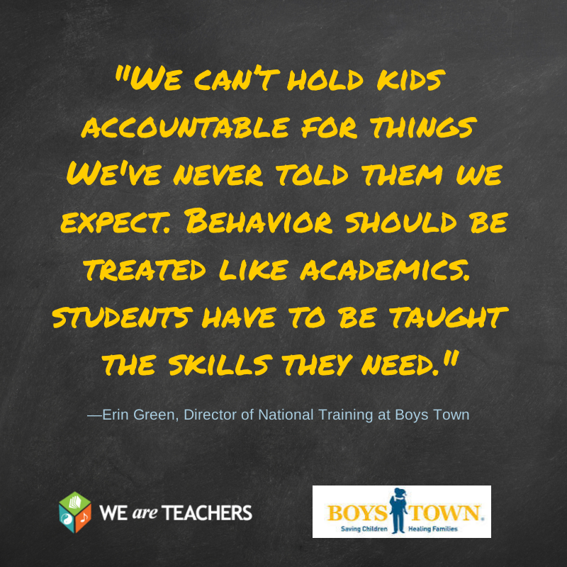
Why Teach Behavioral Expectations?
Notes:
Trainer Notes:
This is a quote from Erin Green. We can’t just expect students to know what behavior to use if we don’t teach them first.

Slide 18
Core Elements of the Universal Tier: Tier I
Notes:
Trainer Notes:
Now we will look at the core elements that make up Tier I of the PBIS framework. We will go into more detail about all of these components in future modules.

Slide 19
What Is Required?
  A common purpose/philosophy
  Leadership team
  Expected behaviors defined, modeled, taught, & reinforced
  Students’ behavior addressed consistently
  Decisions/actions based on data
Notes:
Trainer Notes:
School staff have to commit to change before they can expect students to change. The school will have a representative leadership team that will collaborate to determine what behavior is expected, how it will be taught to the students, and how student behavior will be addressed (both appropriate and inappropriate). The team will be using data to action plan and progress monitor.

Slide 20
Make A Commitment
Positive, inclusive, collaborative environment
Preventive, proactive discipline
Consistency in procedures and practices
Notes:
Trainer Notes:
For any organization to be successful, everyone has to be on board with the same goals. Schools need to have these conversations among all staff and decide what EVERYONE will be committed to achieving. This is the first step in beginning to develop the PBIS action plan.

Slide 21

Leading The Process
The PBIS Team…
  Represents ALL
  Drives implementation process
  Uses data
  Does regular evaluation
  Provides staff support and professional development
Notes:
Trainer Notes:
The key to successful, sustained implementation of any initiative is a great leadership team!!! It’s important to make sure that the team reflects the school’s makeup and includes people with diverse skills that will keep the efforts spread out instead of putting the burden on one or two people.

Slide 22
Tier I Focus
Be consistent and predictable
    Teach expected behaviors
    Prevent inappropriate behaviors
    Improve classroom strategies
    Maximize student achievement
Focus on the entire school (and classrooms), NOT individual children.
Notes:
Trainer Notes:
As with academics, schools need a universal tier where core education takes place. By educating and reinforcing all students, they will make fewer mistakes and teachers will spend less time on office referrals.

Slide 23

Teaching Behavior
Make it clear and simple.
Define & clarify behavior expectations
Teach & model expectations in all settings
Let students practice & give them feedback
Notes:
Trainer Notes:
This is the heart of Tier I – the behavior education curriculum you will implement. The behavior education begins with deciding what behaviors you WANT to see from your students. You will be creating common language that describes how you want students to behave (tell students what TO DO) in all areas of the school, and you will teach and model this behavior. Don’t just give students a handbook and wait for them to make a mistake. Teach first!

Slide 24
Addressing Students’ Behavior
How do you let students know…
  if they did understand their math lesson?
  if they didn’t understand their math lesson?
  if their behavior IS or ISN’T correct???
Notes:
Trainer Notes:
Giving feedback is critical if you want students to continue to do something correctly or if you want them to know that they have made a mistake and need to make a correction.

Slide 25
Responding To Behavior
Preventive, proactive practices:
Acknowledge appropriate behavior
Use “teaching moments” for misbehavior
Use consistent, appropriate consequences
Notes:
Trainer Notes:
The PBIS framework not only emphasizes teaching appropriate behavior, but also emphasizes using consistent responses to student behavior, both appropriate and inappropriate. Teams will be developing practices that encourage students to follow the expectations, as well as consistent consequences that will discourage them from not following the expectations.

Slide 26

Data-Based Decision Making
Don’t guess or assume!
  Record & analyze discipline data
  Define precise problems
  Set goals
  Evaluate progress
Notes:
Trainer Notes:
It is important to have accurate, regularly reported discipline data to make decisions about student behavior and how to address it. It is also important to know if your action plan is showing success and is being carried out the way you intended. Examples of ways to evaluate progress include the following: discipline data; surveys for staff, students, and parents; and student success indicators (grades, test scores, etc.).

Slide 27
Evaluation Is Key!
Tiered Fidelity Inventory (TFI)
  Used over time to guide implementation
  Improves sustainability
Self Assessment Survey (SAS)
Behavioral infractions
Notes:
Trainer Notes:
Introduce teams to the TFI, as this is what will be used to guide implementation. The TFI is a valid, reliable, efficient measure of PBIS implementation. Introduce the SAS as staff survey of how things are working in school. Remind them that there are data they already likely monitor.

Slide 28
PBIS Is School-wide AND Classroom
  Focuses attention on all school areas
  Increases consistency across all areas of school
  Gives teachers tools to create classroom environments with…
    Consistent expectations
    Consistent rules & procedures
    Learning encouraged
    Distractions minimized
    Inappropriate behaviors minimized
Notes:
Trainer Notes:
Because students spend so much time in the classroom, it’s essential that the same philosophy used school-wide is used at the classroom level.

Slide 29

Notes:
Trainer Notes:
Begin to wrap up – give attendees encouragement and instructions for next steps.

Slide 30

PBIS Takes Time
Implementing Tier I PBIS can take up to three to five years.
Notes:
Trainer Notes:
Schools/districts can spend the first year planning for implementation of PBIS. Full implementation of Tier I practices can take between three to five years.

Slide 31
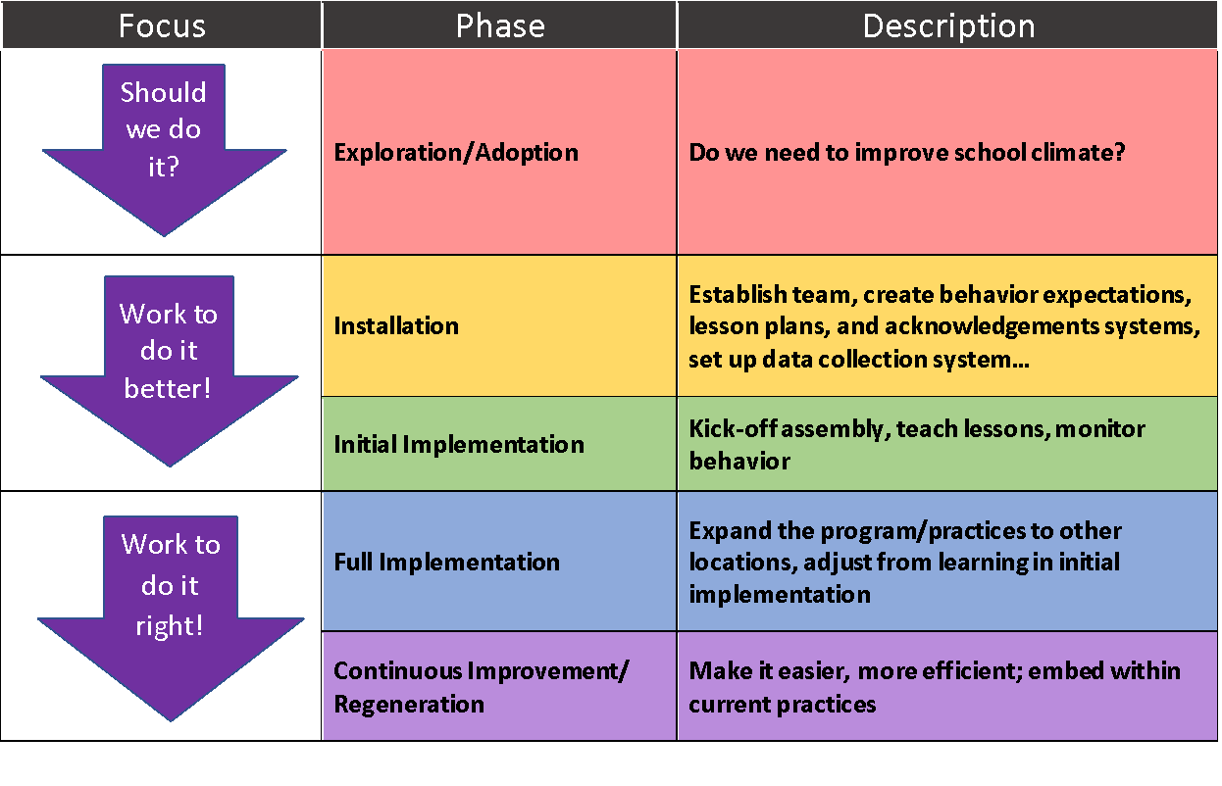
PBIS Takes Time: Implementation Phases
For more information on implementation, see https://www.pbis.org/resource/pbis-implementation-blueprint
Notes:
Trainer Notes:
PBIS implementation is done in phases. This is an ongoing process, so schools will always be looking for ways to improve to make things easier for staff.

Slide 32
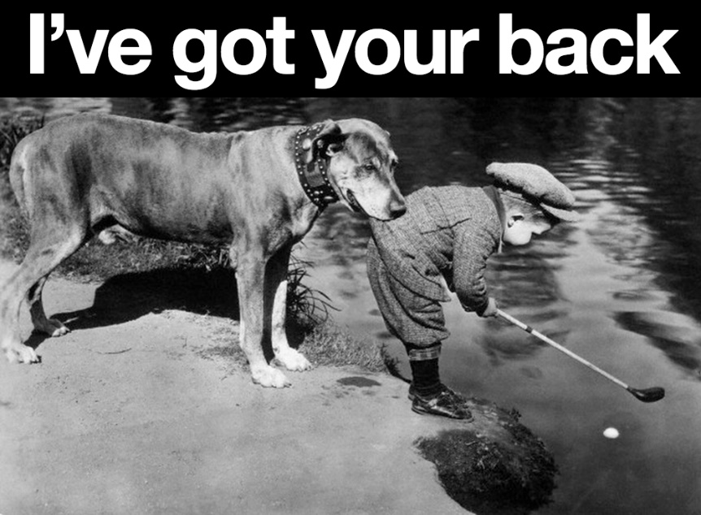

1st Step: Get Training
Arkansas has resources
PBIS mentors, networks, National Center, etc.
Notes:
Trainer Notes:
PBIS is a framework being implemented in schools across the country, and there are regional networks, state teams, and a national organization that support schools in this process. The national and regional organizations are always looking for ways to improve and will continue to offer strategies as they are developed. There are state, regional, and national conferences and forums offered yearly as well.

Slide 33
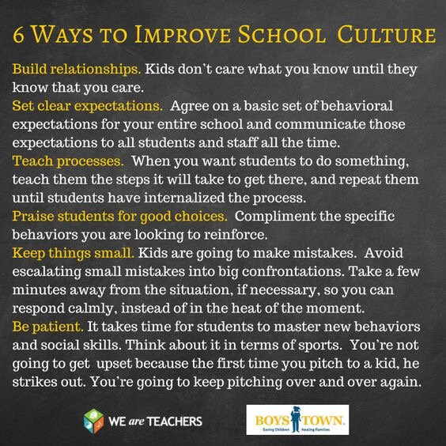
A Little Inspiration…
Notes:
Trainer Notes:
A little inspiration now! There are additional modules that will give more in-depth information.

