Slide 1
Creating a PBIS School
Leadership Team
Module 3
Notes:
Images in this module were obtained at google.com/images unless otherwise specified.
Trainer Notes:
In this module, we will take trainees through the roles and responsibilities of local school teams.

Slide 2
Context
The school leadership team must oversee PBIS implementation.
  Any initiative has to fit into the school context.
  Any initiative has to have the support of school (and district) leadership.
A PBIS team will lead the implementation.

Slide 3
Purpose Of The PBIS Team
Customize PBIS implementation
Develop processes, procedures, & tools
Create organizational structures
Collect and collate data
Develop and provide staff supports
Notes:
Trainer Notes:
The PBIS team serves an important role in implementing PBIS in a way that meets the specific needs of the individual school. This will be an ongoing process and the team will be tasked with coordinating and managing implementation with fidelity.

Slide 4
A Representative School Team
Grade levels
Areas of school
Various skills & abilities
Various positions & roles
Family & student voice
Notes:
Trainer Notes:
To ensure that the best decisions are made for ALL the students in the school, ALL the students need to be represented through the members of the team. This means you should represent all grade levels and physical areas of the school (e.g., for large high school, make sure someone on the team can represent the various departments and share information to staff in those departments, i.e., cafeteria, transportation, etc.). Important members include the following: administrator, someone with behavioral expertise, someone comfortable with data analysis, and someone skilled at communication. It is also advisable to have family representation on the team, and — at the secondary level — student representation as well. This will increase the likelihood of student buy-in.

Slide 5
PBIS Team Responsibilities
Develop and monitor PBIS action plan
Hold regular meetings
Communicate with stakeholders
Report outcomes
Notes:
Trainer Notes:
The most important role of the PBIS school team is to develop and continually monitor the progress of their PBIS Action Plan. They should meet at least monthly, keep staff informed of progress, and report progress and plans to stakeholders regularly (staff, parents, students, school board, district, community, etc.).

Slide 6
Take Stock First
Start with the concept of “Work smarter, not harder!”
Take inventory of what your school already has and streamline.
Notes:
Trainer Notes:
Before starting on something new, it is good practice to take inventory of what is already happening in your school. Schools need to look at teams or committees that are already addressing school climate or student behavior. Are there groups that overlap in their purpose or goal? How can you streamline things or build on what is already in place?

Slide 7
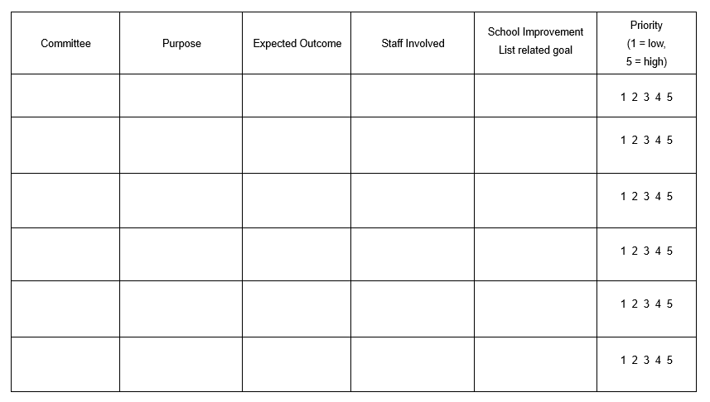
Committee Audit Worksheet
https://pbis.astate.edu/resources/tier-i-resources/pbis-leadership-teams/
Notes:
Trainer Notes:
This template is a tool that can be used to collect information on the teams and committees that are currently meeting in the school. Schools can use this to create a big picture of what is already in place and which staff are involved. Look for opportunities to have the biggest impact without over-working.

Slide 8
Where Do You Begin?
Develop…
  Behavioral expectations
  System for teaching expectations
  System for acknowledging appropriate behavior
  System for addressing inappropriate behavior
Get feedback from staff along the way!
Notes:
Trainer Notes:
The PBIS team will begin by creating a school-wide action plan that involves developing these major components. The PBIS framework is centered on teaching expected behaviors, reinforcing the practice of these behaviors, and consistently addressing inappropriate behavior.

Slide 9
Ongoing Leadership
Continuous Improvement
Collect and use data to monitor…
  Student outcomes
  Fidelity of PBIS implementation
Notes:
Trainer Notes:
Once the PBIS Action Plan is created and implemented, the function of the PBIS team is to collect and use data to engage in an ongoing improvement process. The team will be looking at both improvement in student outcomes and fidelity of implementation of PBIS.

Slide 10
Assigned Team Roles
Facilitator
Minute taker
Data analyst
Active team members
Notes:
Trainer Notes:
These are the critical team roles. The following slides will detail the responsibilities of each role, but in general, the facilitator keeps the meeting on track; the minute taker records and communicates the minutes; the data analyst looks at discipline and other data and brings their results to the meetings; and the other team members will use the data to problem solve, monitor progress of action plans, and provide input and feedback. See the next slides for descriptions of each of these.

Slide 11
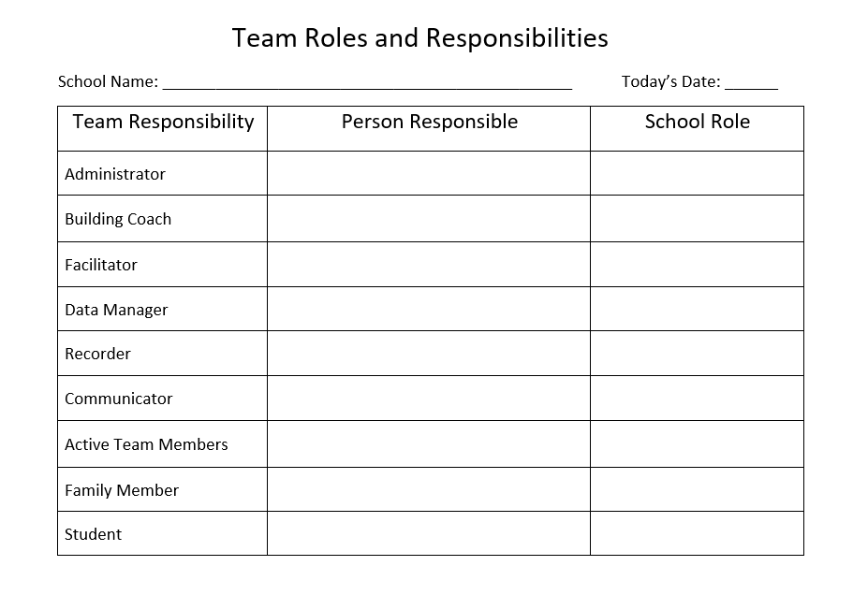
Team Roles and Responsibilities Template
https://pbis.astate.edu/resources/tier-i-resources/pbis-leadership-teams/
Notes:
Trainer Notes:
This is a team activity – teams should pause here to assign roles. The next four slides give detailed info on the four critical assigned team roles in previous slide.

Slide 12
Facilitator Responsibilities
Before meeting, provides agenda items to minute taker
Starts meeting on time
Manages the “flow” of meeting by adhering to the agenda
Lead the team through the problem solving process
Notes:
Trainer Notes:
These are the responsibilities of the facilitator. Agenda is bolded because it is the responsibility of the facilitator to get the agenda items to the minute taker ahead of the meeting. The facilitator basically is the person who keeps the meeting on time and on topic by providing prompts as needed.
PBIS also has a problem solving model called TIPS (Team-Initiated Problem Solving). This model can be found at https://www.pbis.org/resource/tips-meeting-minutes-template

Slide 13
Minute Taker Responsibilities
Before meeting
  Collects agenda items from Facilitator
  Prepares meeting minutes form
  Share meeting minutes and problem-solving action plan form
At meeting, asks for clarification of tasks/decisions to be recorded in meeting minutes, as necessary
After meeting
  Share completed meeting minutes to all team members within 24 hours
  Maintains electronic file of team documents
Notes:
Trainer Notes:
The minute taker has the responsibility for collecting and distributing accurate information from team meetings.

Slide 14
Data Analyst Responsibilities
Before meeting, reviews student discipline data
  Identifies potential new problems with precision (what, who, where, when, why)
  Asks Facilitator to add potential new problems to list of agenda items
At meeting, makes the following available, as appropriate
  Report on ODRs per day per month and core discipline reports
  Other discipline data reports that
    Identify/show potential new problems at precise/micro level
    Show progress data for current action plan
Notes:
Trainer Notes:
The data analyst is responsible for providing the team with current behavior data trends.

Slide 15
Team Member Responsibilities
Before meeting, recommends agenda items to Facilitator
At meeting, responds to agenda items and
  Discusses/selects solutions for new problems
  For problems with existing solution actions
    Reports on implementation status (Not started? Partially implemented? Implemented with fidelity? Completed?)
    Suggests how implementation of solution actions could be improved
    Determine whether implemented solution actions are working (i.e., reducing the rate/frequency of the targeted problem to our Goal level)?
  Is active participant in meeting
Notes:
Trainer Notes:
The remaining team members are expected to be involved in the problem solving process, and may be tasked with providing updates on items from the action plan.

Slide 16
The Administrator’s Roles
Maintain standards
Make statements of support
Establish and support PBIS team
Serve as spokesperson
Take leadership role in problem solving
Attend and participate in team meetings
Provide recognition to team & faculty
Provide feedback to staff
Adapted from Colvin, G. (2007). 7 Steps for developing a proactive school-wide discipline plan, 17
Notes:
Trainer Notes:
The administrator is the public face of PBIS for the school. He or she is a cheerleader, a guide, and a communicator. If the administrator is not promoting PBIS, staff will not take it seriously. The administrator makes sure that the team and staff have proper support and recognition.

Slide 17
The Team Meeting
Main focus: Problem Solving
Use data to improve outcomes for students.
Notes:
Trainer Notes:
The main focus of PBIS team meetings is problem solving. (There will be a module specifically about the team meeting.) Teams regularly and consistently collect and use data with the overarching goal of continually improving outcomes for students. (We will be exploring data-based decision making in a separate module.)

Slide 18
Team Meeting Agenda Items
Progress monitoring
Identifying new problems
Problem solving
Action planning
Setting goals
Assigning tasks
Planning celebrations
Notes:
Trainer Notes:
It is important to have a detailed agenda for meetings in order to make them more efficient and effective. The Arkansas Division of Elementary and Secondary Education (DESE) recommends using Judy Elliott’s four-step problem solving process model for RTI. The meetings will always be focused around using data to problem solve and progress monitor.

Slide 19

Communication
The PBIS Team must communicate with other staff regularly.
Share data
Update school board annually
Provide newsletters
Conduct surveys
Provide info on website
Involve local media
Notes:
Training Notes:
It’s important for the team to develop a communication plan. Staff often see a very narrow view of what is happening in the school, so show them data reflective of the whole school and show them the progress on action plans – let them see that their efforts are paying off. The school board is also more likely to be supportive when they see what the team has accomplished. Informed parents will be more likely to encourage their kids. Surveys can give you valuable input, such as perceived climate of the school, what motivates students and staff, how would parents like to be involved, etc.

Slide 20
Evaluation Is Valuable
The PBIS Team is responsible for evaluating implementation and progress.
Improvement of outcomes
Sustainability
Notes:
Trainer Notes:
Schools need an accurate reading on whether they are benefitting from PBIS. Evaluation will keep schools on the right path, make them more efficient and effective, and help them sustain PBIS. This is especially important for surviving a turnover in administrator – it provides documentation showing the commitment to PBIS, the progress made, and the plans for being even better.

Slide 21
Do It With Fidelity!
Tiered Fidelity Inventory (TFI) – team assessment
Efficient, valid index of extent to which PBIS core features are in place
For the PBIS Team assessment section…
  Section 1.1 Team Composition
  Section 1.2 Team Operating Procedures
Notes:
Trainer Notes:
The TFI is an important team tool in the PBIS implementation process. It can be used in the development stage, and then used in an ongoing manner to ensure all core features are in place. The TFI highlights each critical component of PBIS. Section 1.1 covers the composition of the team, and section 1.2 covers the operation of the team. See the next two slides.

Slide 22
1.1 Team Composition
Subscale: Teams
Feature | Data Sources | Scoring Criteria
 |  | 0 = Not implemented 1 = Partially implemented 2 = Fully implemented
1.1 Team Composition: Tier I team includes a Tier I systems coordinator, a school administrator, a family member, and individuals able to provide (a) applied behavioral expertise, (b) coaching expertise, (c) knowledge of student academic and behavior patterns, (d) knowledge about the operations of the school across grade levels and programs, and for high schools, and (e) student representation. | School organizational chart Tier I team meeting minutes | 0 = Tier I team does not exist or does not include coordinator, school administrator, or individuals with applied behavioral expertise. 1 = Tier I team exists, but does not include all identified roles or attendance of these members is below 80%. 2 = Tier I team exists with coordinator, administrator, and all identified roles represented, AND attendance of all roles is at or above 80%.
Main Idea: Teams need people with multiple skills and perspectives to implement PBIS well.

Slide 23
1.2 Team Operating Procedures
Subscale: Teams
Feature | Data Sources | Scoring Criteria
 |  | 0 = Not implemented 1 = Partially implemented 2 = Fully implemented
1.2 Team Operating Procedures: Tier I team meets at least monthly and has (a) regular meeting format/agenda, (b) minutes, (c) defined meeting roles, and (d) a current action plan. | Tier I team meeting agendas and minutes Tier I meeting roles descriptions Tier I action plan | 0 = Tier I team does not use regular meeting format/agenda, minutes, defined roles, or a current action plan. 1= Tier I team has at least two but not all four features. 2 = Tier I team meets at least monthly and uses regular meeting format/agenda, minutes, defined roles, AND has a current action plan.
Main Idea: Specific features are necessary to ensure meetings are effective for action planning and tracking progress.

Slide 24
Summary
The PBIS team
Customizes PBIS
Develops and updates action plan
Supports staff
Uses data for decision making
Does regular evaluation
Communicates with stakeholders

