Slide 1
The PBIS Team Meeting
Module 10
Notes:
Images in this module were obtained at google.com/images unless otherwise specified.

Slide 2
Context
The PBIS team
Meeting foundations
Problem solving
Evaluation
Communication
Notes:
Trainer Notes:
In this training, we will begin by discussing the role of the team and the team members, as well as the foundational components that will make meetings more efficient and effective. Then, we will spend a large chunk of this training discussing the problem-solving process that will be the main focus of the meeting. Also included in the problem-solving process is evaluating the implementation and impact of action plans that are developed. We will also talk briefly about communicating to stakeholders, and we will view a video example of a PBIS team meeting.

Slide 3
School Team Responsibilities
School-wide PBIS action plan
Regular team meetings
Communication with staff & coach
Reporting outcomes to stakeholders
Notes:
Trainer Notes:
The responsibilities of the school or building-level PBIS team are to: develop a school-wide PBIS action plan; hold regular team meetings (monthly, optimally) where they monitor and evaluate behavior data, develop action plans based on data, and monitor and evaluate progress; maintain communication with staff and the coach; and report outcomes to stakeholders (staff, students, parents, community, district, school board, etc.).

Slide 4

The PBIS Team
The PBIS team represents:
  Grade levels across the school
  Different cultures across the school
  Specialty and special education classes
  The school community
Notes:
Trainer Notes:
School teams should be representative of: grade levels and/or regions of school (there could be one representative from each grade, or one person could represent two or three grades), various cultures (each school needs to define the major cultures of the school), and school community (consider including a student, a parent, someone from the community, non-faculty staff such as bus driver, librarian, cafeteria worker, custodian, etc.).

Slide 5
Parent/Community Involvement
Consider having parent representation on the team.
Consider having a community member on the team.
Get input/feedback from parents and community.
Share action plans and outcomes.
Notes:
Trainer Notes:
If possible, try to have parent and community representation on the team. Teachers and staff don’t always live in the communities where they work, so it’s good to have local perspective and input to make sure there is understanding and relevancy in problem solving and action planning. At the very least, reach out to your parents and community for input and feedback, and always share your data, action plans, and outcomes.

Slide 6
Student Voice
At the secondary level, consider having at least one student on the team.
Student representation increases likelihood of student buy-in.
Students can help with both planning and implementation.
Notes:
Trainer Notes:
At the secondary level, students can be enlisted to help with PBIS implementation. They can help choose incentives/rewards that will appeal to their peers, make sure that behavioral expectations are stated in student-friendly language, and help with developing (and teaching) behavior lessons.

Slide 7
Other Considerations
Team members must:
Be respected in the school
Be good communicators
Have positive attitude
Be relationship builders
Notes:
Trainer Notes:
Besides being representative of the school’s makeup, it’s important to have these types of skills and abilities in your team members.

Slide 8
Assigned Team Roles
Facilitator – keep meeting on topic, on task
Minute taker – record & distribute minutes
Data analyst – bring data reports to meetings
Active team members – problem solve; input, feedback
Notes:
Trainer Notes:
These are the main roles of the team members. Everyone participates and problem solves together. More specific descriptions are provided on the next four slides.

Slide 9
Facilitator Responsibilities
Before meeting, provides agenda items to minute taker
Starts meeting on time
Manages the “flow” of meeting by adhering to the agenda
Lead the team through the problem solving process
Notes:
Trainer Notes:
These are the responsibilities of the facilitator. Agenda is bolded because it is the responsibility of the facilitator to get the agenda items to the minute taker ahead of the meeting. The facilitator basically is the person who keeps the meeting on time and on topic by providing prompts as needed.

Slide 10
Minute Taker Responsibilities
Before meeting
  Collects agenda items from Facilitator
  Prepares meeting minutes form
  Share meeting minutes and problem-solving action plan form
At meeting, asks for clarification of tasks/decisions to be recorded in meeting minutes, as necessary
After meeting
  Share completed meeting minutes to all team members within 24 hours
  Maintains electronic file of team documents
Notes:
Trainer Notes:
The minute taker has the responsibility for collecting accurate information from team meetings. The minute taker is tasked with contemporaneous clarification of the information they are recording in the official minutes. The minute taker is also responsible for getting a copy of the minutes to all team members within one day of the meeting and keeping copies of all meeting minutes.

Slide 11
Data Analyst Responsibilities
Before meeting, reviews student discipline data
  Identifies potential new problems with precision (what, who, where, when, why)
  Asks Facilitator to add potential new problems to list of agenda items
At meeting, makes the following available, as appropriate
  Report on ODRs per day per month and core discipline reports
  Other discipline data reports that
    Identify/show potential new problems at precise/micro level
    Show progress data for current action plan
Notes:
Trainer Notes:
The data analyst is responsible for providing the team with current behavior data trends. We will go into more detail about precision problems later in this presentation. The current discipline data need to be given to the facilitator before the meeting so they can be added to the agenda. Also, the data analyst needs to be prepared to show or generate other data reports as needed during the meeting. Data need to be available to show the current progress of action plans.

Slide 12
Team Member Responsibilities
Before meeting, recommends agenda items to Facilitator
At meeting, responds to agenda items and
  Discusses/selects solutions for new problems
  For problems with existing solution actions
    Reports on implementation status (Not started? Partially implemented? Implemented with fidelity? Completed?)
    Suggests how implementation of solution actions could be improved
    Determine whether implemented solution actions are working (i.e., reducing the rate/frequency of the targeted problem to our Goal level)?
  Is active participant in meeting
Notes:
Trainer Notes:
Active team members are expected to be involved in the problem-solving process, and may be tasked with providing updates on items from the action plan. There may be items that they want to put into the agenda, so they need to get those to the facilitator ahead of the meeting. All team members need to respond to the data reports and determine if there is a problem around which they need to action plan. Plans that are already in action need to be monitored, so team members need to look at progress data and make determinations about the continuation of those action plans.

Slide 13

The PBIS Team Meeting
Foundations
  Purpose & agreements
  Membership
  Meeting schedule (including location)
  Agenda
  Data collection & data entry schedule
  Data reporting schedule
Notes:
Trainer Notes:
In order to conduct efficient and effective meetings, it’s important to have a good foundation. Agree on a purpose for your team, and agree on things like when and where you’ll meet, what your meeting norms will be, and attendance requirements. Make sure your team represents your school well, and members have specific roles outlined. It’s important to always have an agenda and to stick to it. Have a schedule for when data will be collected and entered into your data system, and when you will generate reports for your team meetings, or to progress monitor.

Slide 14
Tier I Team Purpose | Team Agreements
Coordinate implementation of Tier I systems and supports Monitor fidelity of implementation and overall status of progress towards goals | Inform facilitator of absence/tardy before meeting Avoid side talk Stay focused and active Start and end on time
Notes:
Trainer Notes:
This slide and the next two are examples of team purpose, agreements, meeting schedule, and data schedule.

Slide 15
Team Meeting Schedule
When | Where | Start/End Time | Meeting Minute Location
3rd Thursdays, monthly | Room 103 | 2:45-3:45 | Tier I Meeting Minute folder on shared drive

Slide 16
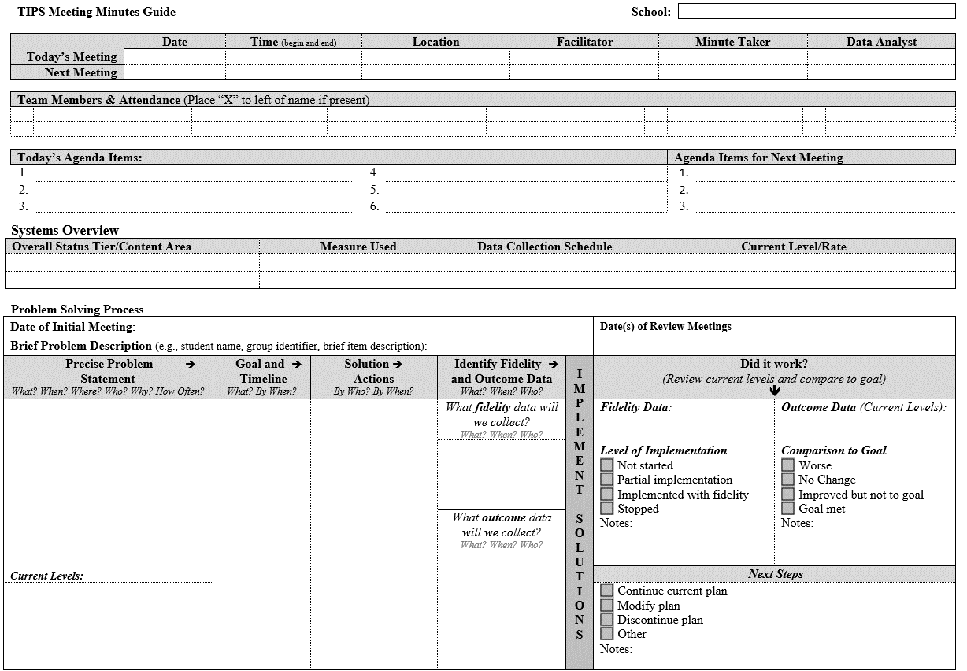
Example:
Meeting Minutes Template
https://www.pbis.org/resource/tips-meeting-minutes-template
Notes:
Trainer Notes:
Here is an example of an agenda form (called TIPS, or Team-Initiated Problem Solving) that includes locations for taking minutes, with all relevant information – meeting info, member info, agenda items, and a current systems overview.

Slide 17
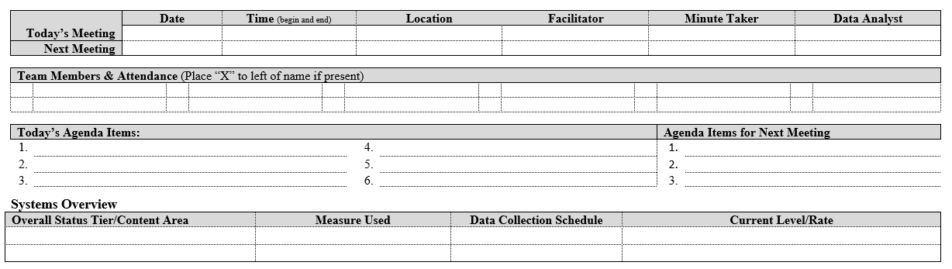
Notes:
Trainer Notes:
The first section gives the minute taker an efficient way to note both today’s meeting info and info for the next meeting. The team member area can be pre-filled so that only an x by each name is necessary. Substitute members can be added as needed. The agenda items will be filled before the meeting (facilitator will provide these), and next meeting’s agenda items will be filled during the course of the meeting.

Slide 18
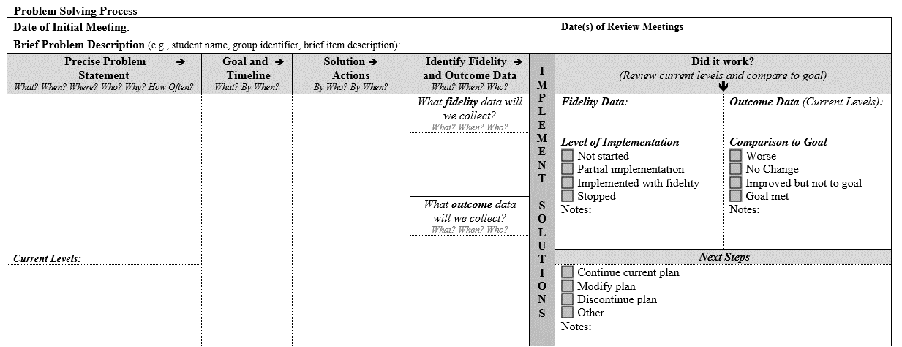
Notes:
Trainer Notes:
The bottom section of page one. This is where the team can see an update on progress of previous problems and action plans. From time to time, teams will do a fidelity check (we will discuss a tool for that later – the Tiered Fidelity Inventory or TFI), and the current status will be recorded here. The data analyst can provide current data using SmartData Dashboard or alternatively, School-wide Information System at www.pbisapps.org.

Slide 19

The Main Focus of the
PBIS Team Meeting
Notes:
Trainer Notes:
The main focus, the biggest chunk of time in the meeting, will be on team problem solving using current behavior data.

Slide 20
Examples:
Data & Reporting Schedules
Question | Data Collection & Data Entry Schedule What, Who & When | Report Generation What, Who & When
Fidelity of Implementation | TFI Nov, Feb, April - Tier I Team completes during meeting Teacher surveys as needed | Use sub-scale Reports and raw data to determine implementation plan Tier I team reviews
Student Outcomes | SmartData Attendance Data DIBELS | Quarterly Fall Winter Spring
Notes:
Trainer Notes:
The Tiered Fidelity Inventory (TFI) is a PBIS Assessment used for determining fidelity of implementation of all three tiers of PBIS. ADE Data Center provides access to the SmartData Dashboard that serve as an early warning system, helping teachers and administrators ensure every student reaches his/her potential (more info at https://dese.ade.arkansas.gov/Offices/public-school-accountability/data-integration/smartdata-dashboard). An alternative to ADE Data Center is School-wide Information System (SWIS), a data collection and analysis system created by the PBIS national center, which can be found at https://www.pbisapps.org/products/swis. The Dynamic Indicators of Basic Early Literacy Skills (DIBELS) is a set of procedures and measures for assessing the acquisition of early literacy skills from kindergarten through sixth grade.

Slide 21

Meeting Goals
  Identify, address, and resolve students' social and academic behavior problems.
  Use data to inform decision making.
Notes:
Trainer Notes:
Again, the main goal with PBIS is to help students be more successful, academically and behaviorally/socially. So the main focus when meeting will be to identify and address any problems that are barriers to that success. Data are used to address the problems and make decisions.

Slide 22

Step 1. Identify A Precise Problem
What is the behavior?
Where is it happening?
When is it happening?
Who is involved?
Why? What is the motivation?
Notes:
Trainer Notes:
The main thing to remember is that you want to look at a precise problem – a focused problem that can be addressed that will make a big impact without requiring a lot of resources and time invested. Just start with one of the above questions and dig down! WHY is it happening? Motivation is important in developing effective solutions. You want to make it more rewarding to use appropriate behavior.

Slide 23
Example Of A Precise Problem Statement
There are many referrals for fighting on the playground. Most of these referrals are happening between 9:15 and 10:15 am among 3rd and 4th graders. The motivation appears to be wanting to obtain sports equipment.
Notes:
Trainer Notes:
This is an example of a precise problem that was obtained by digging into data. It started by looking at only referrals for fighting; within that group, we looked only for those on the playground, and from those, only the ones between 9:15 and 10:15, then only those from 3rd and 4th grade. A good thing to note here is that the motivation might spark additional observation to see if something can be done to the environment, such as adding more equipment or changing the schedule, in addition to re-teaching students the expectations. You want to find lasting solutions. Getting into the practice of looking at motivation will help teams build function of behavior assessment skills that will be increasingly used in Tiers 2 and 3.

Slide 24
Identify A Goal For Change
Goal: definition of success
  Detailed, with timeline
    At what point is the identified problem no longer a concern?
    At what point are the frequency and duration of the behavior at acceptable levels?
Notes:
Trainer Notes:
You know what the data look like now. So where do you WANT the data to be? What is an acceptable level? When will it cease to be a concern? The goal needs to include a time period – how soon do you feel the goal should be achieved?

Slide 25

Have A SMART Goal
Notes:
Trainer Notes:
Besides being specific, make sure the goal is something you can measure with data, and make sure it is actually achievable. Also, it needs to be something relevant – something that will actually create an impact that you can see. Always have a timeline; make sure it is reasonable, but not too lengthy.

Slide 26
Example Of A Goal With Timeline
Using the precise problem statement from earlier:
Goal: 75% reduction in referrals for playground fighting within one month.
Notes:
Trainer Notes:
Does it seem achievable to see a 75% reduction in playground fighting? If we look at all playground fighting, what percent fall into the category we defined in our precise problem statement? If we address those students only, is it reasonable to expect a reduction this large in a month’s time?

Slide 27
Step 2. Analyze The Problem & Develop Hypothesis
Developing informed statements about why the desired behavior(s) is not occurring
The (desired behavior) is not occurring because…
Elliott, 2015
Notes:
Trainer Notes:
Your team will want to identify possible root causes of the problem and gather more data to analyze and validate their hypothesis. Supplemental data will either support or refute each hypothesis.

Slide 28
Step 3. Identify A Solution, Create A Plan
Guiding questions:
What are you going to do to bring about the desired change?
What will remove the barriers to success?
Notes:
Trainer Notes:
Basically, your solution needs to include strategies for bringing about change, as well as changing anything that might currently be a barrier to success. The next slide goes into more detail.

Slide 29
Creating A Plan
Solution strategies:
  Prevention
  Teaching
  Recognition
  Extinction
  Consequences
Also, plan should include
  WHO will do WHAT by WHEN
  Evaluation plan
Notes:
Trainer Notes:
In your plan, you want to keep the behavior from happening (remove barriers such as crowded areas at certain times, not enough equipment on playground, etc.), teach or re-teach expectations and behaviors, and increase acknowledgements around a certain behavior you want students to learn. Extinction = prevent the problem behavior from being rewarded; consequences should be efficient and consistent. Evaluation plan = when and how you will monitor progress.

Slide 30
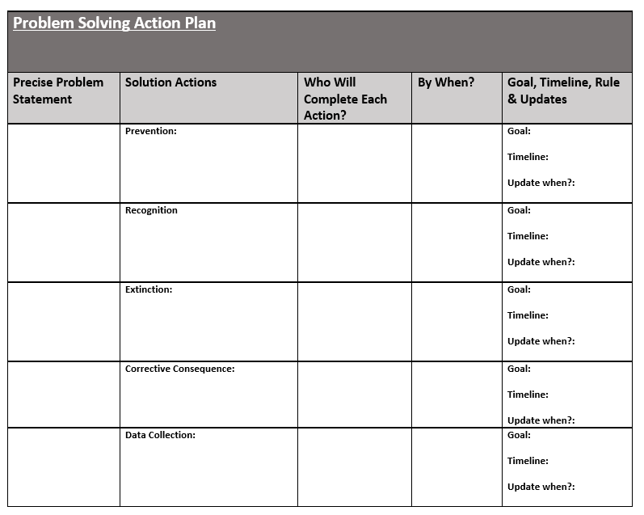
Problem Solving Action Plan
https://pbis.astate.edu/resources/tier-i-resources/pbis-leadership-teams/

Slide 31

Step 4. Monitor The Impact
Evaluate your plan:
Did it work? Are we solving the problem?
Has the desired goal been achieved?
Use data to determine the impact.
Notes:
Trainer Notes:
Go back to your data to see if you are seeing results. At the end of the determined timeline have a data report ready to discuss with team members. The team will then decide whether this problem has been solved or if the plan needs revising.

Slide 32
Make A Decision
What next?
  Modify strategy?
  Maintain the goal? How?
  Revise the goal?
  Reconsider feasibility?
  Redefine the precise problem?
Notes:
Trainer Notes:
Now that you have implemented your plan, done a fidelity check, and looked at data to monitor progress, what is the next step? Did you make progress, but not quite hit your goal? What can you change?

Slide 33
Implement With Integrity
Was the plan implemented correctly?
Use data from previously determined sources (e.g., checklist)
Notes:
Trainer Notes:
The plan should always include a method for checking the fidelity of implementing the plan. If you are going to ask people to carry out tasks, have a method for them to report what they have done. For example, if you ask all classroom teachers to re-teach an expectation daily for two weeks, give them a simple way of reporting back to you that they did this – maybe a checklist that they will return to someone’s mailbox at the end of the two weeks.

Slide 34

Communication
Share data with staff & district coach
Provide annual update to school board
Conduct surveys to gain input
Provide info on website
Involve local media
Provide newsletters to parents & others
Notes:
Trainer Notes:
The team is also tasked with keeping others informed of what is happening with PBIS, what action plans are being implemented, and what impact they’re having.

Slide 35

Example Of An Effective Team Meeting
https://www.pbis.org/video/tips-training-meeting-1
Notes:
Trainer Notes:
This is a 12 minute video showing all of the procedures learned in the PowerPoint. It would be optimal to pause the video at various places to point out some of the key elements in conducting an effective meeting. Team meeting examples at: https://www.pbis.org/video-examples/video#tips.

Slide 36
Do It With Fidelity!
Tiered Fidelity Inventory (TFI)
Efficient, valid index of extent to which PBIS core features are in place
Section 1.2 Team Operating Procedures
Notes:
Trainer Notes:
The TFI is an important tool in the PBIS implementation process. It can be used in the development stage, and then used in an ongoing manner to ensure all core features are in place. The TFI highlights each critical component of PBIS.

Slide 37
1.2 Team Operating Procedures
Subscale: Teams
Feature | Data Sources | Scoring Criteria
 |  | 0 = Not implemented 1 = Partially implemented 2 = Fully implemented
1.2 Team Operating Procedures: Tier I team meets at least monthly and has (a) regular meeting format/agenda, (b) minutes, (c) defined meeting roles, and (d) a current action plan. | Tier I team meeting agendas and minutes Tier I meeting roles descriptions Tier I action plan | 0 = Tier I team does not use regular meeting format/agenda, minutes, defined roles, or a current action plan. 1= Tier I team has at least two but not all four features. 2 = Tier I team meets at least monthly and uses regular meeting format/agenda, minutes, defined roles, AND has a current action plan.
Main Idea: Specific features are necessary to ensure meetings are effective for action planning and tracking progress.

Slide 38
Summary
Create a good foundation for efficient/effective meetings
Focus on data-based, precise problem solving
Develop complete action plans
Monitor and evaluate progress of action plans

