Slide 1
Identifying Students for Individualized Support
Module 3
Notes:
Images in this module were obtained at google.com/images unless otherwise specified.

Slide 2
Purpose
To help schools develop a system for identifying students for Tier III interventions

Slide 3
Objectives
Participants will learn about…
Entry criteria for Tier III
Referrals from staff and family members
Universal screening

Slide 4
The Tiered Fidelity Inventory (TFI)
Tier III Planning Tool
TEAM 3.1 Team Composition 3.2 Team Operating Procedures 3.3 Screening 3.4 Student Support Team RESOURCES 3.5 Staffing 3.6 Student/Family/Community Involvement 3.7 Professional Development | SUPPORT PLANS 3.8 Quality of Life Indicators 3.9 Academic, Social, and Physical Indicators 3.10 Hypothesis Statement 3.11 Comprehensive Support 3.12 Natural and Formal Supports 3.13 Access to Tier I and Tier II Support EVALUATION 3.14 Data System 3.15 Data-Based Decision Making 3.16 Level of Use 3.17 Annual Evaluation
Notes:
The TFI will be used throughout PBIS modules. Each module aligns with one or more of the TFI items, denoted by the yellow arrows. The TFI is a tool that can be used for PBIS implementation planning, PBIS progress monitoring, and evaluation of PBIS implementation. In this module, items 3.3, 3.14 and 3.15 will be addressed.

Slide 5
Introduction to the Case Study
In each Tier III module, we are going to follow a Case Study to illustrate the process of Tier III.
In this module, the Case Study will focus on how a particular student was identified for Tier III interventions.
Notes:
The school and people presented in this case study are fictional. The purpose of the case study is to provide a concrete example of Tier III processes to enhance participant understanding.

Slide 6

Introducing Aiden…
7-year-old 2nd grader at University Heights
Behaviors: throwing classroom materials, cussing at teacher, and shouting at peers
Referred for Tier II interventions
Received Big Buddy social skills mentoring three days/week for six weeks, with negative results
Is now being referred for Tier III interventions
Notes:
We will be following Aiden’s journey throughout the remaining Tier III modules. Aiden is a 7-year-old 2nd grader at University Heights Elementary School who was first identified for interventions due to aggressive behaviors and disengagement in the classroom. Due to the severity of the behavior problems Aiden displayed, he was referred to the school building level committee for Tier II interventions. Based on data decision rules, Aiden met the threshold for Tier II supports. After determining the probable function of behavior (an FBA was not conducted), it was decided by the team that Aiden would begin Big Buddy mentors for three days per week for social skills training. After six weeks of participating in this training, Aiden continued to display the same behaviors, and the classroom behaviors generalized and intensified to the cafeteria, school bus, and at home. At this point, the team may want to revisit the data decision rules and determine if it is now time to refer Aiden for Tier III interventions to determine the cause of the behaviors.

Slide 7
Entry Criteria for Tier III

Slide 8
Establishing Entry Criteria for Tier III
In order to keep students from being overlooked, entry criteria for Tier III interventions need to rely on multiple sources. Those sources may include the following:
  Existing School Data
  Nominations from staff and family members
  Universal Screening
Lane, Oakes, Ennis, & Hirsch (2014)
Notes:
Each of these sources will be discussed in more depth in the rest of this module. “Existing school data” could include data from outside agencies that have been provided in the student’s records.
Kathleen Lynne Lane, Wendy Peia Oakes, Robin Parks Ennis & Shanna Eisner Hirsch (2014) Identifying Students for Secondary and Tertiary Prevention Efforts: How Do We Determine Which Students Have Tier 2 and Tier 3 Needs?, Preventing School Failure: Alternative Education for Children and Youth, 58:3,171-182, DOI: 10.1080/1045988X.2014.895573

Slide 9
Identifying Students Using School Data
  Non-response to Tier II intervention
  Chronic behavior
  Intense behavior
Notes:
These are the three main entry criteria for Tier III intervention. Chronic and intense behaviors will be defined later in the module.

Slide 10

Myth: All students who don't succeed at Tier II MUST move to Tier III
Consider:
    Was the best intervention match identified?
    Would the student benefit from more than one intervention?
    Does the student have a behavioral profile that warrants more intensive intervention?
Notes:
Discuss adaptations to Tier II interventions to make them more effective.

Slide 11
What Was the Response to Tier II?
Review Tier II intervention data after at least four weeks and eight data points.
Use the same data sources for review.
Possible responses:
  Positive response
  Questionable response
  Poor response to intervention
Sprague, Cook, Wright, and Sadler (2008, p. 77). Lembke (2010).
Notes:
Interventions implemented a minimum of four weeks with eight data points allow time for the student to demonstrate response to intervention and for teams to determine the trend.
It is important to use the same data sources for the data review to determine response to intervention.
As the data are reviewed, results can be separated into three basic categories of performance:
Positive response
Questionable response
Poor response to intervention
When data indicate the student is making progress toward the goal and will reach the goal within a reasonable amount of time, the team should determine how long the student is expected to maintain success before interventions are removed.
For more in-depth content around using data at Tier II, please refer to Tier II Module 8.

Slide 12
Review of Tier II Data
What is the student’s level of performance?
What is/was the desired level of performance?
Graph the above, showing a trend line (rate of progress).
Notes:
These are questions to ask when reviewing data from Tier II interventions. For more on Tier II data, review Tier II Module 8: Collecting and Using Data for Tier II Decision Making.

Slide 13
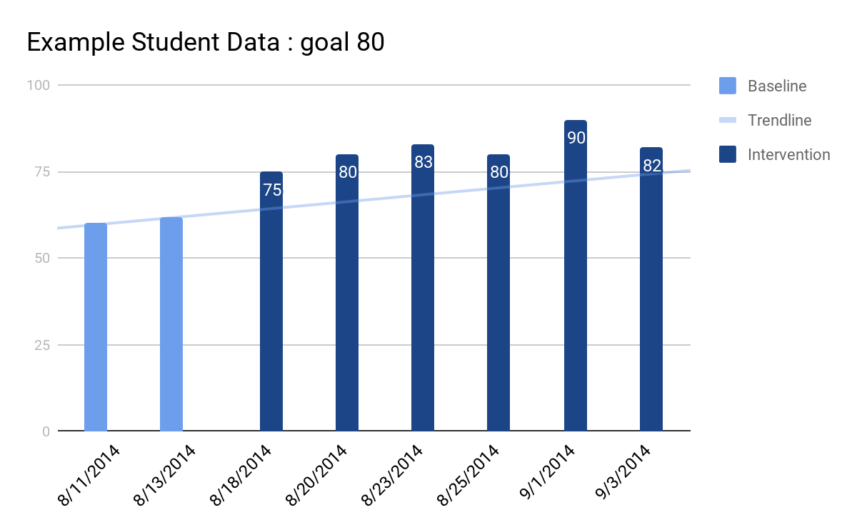
Monitoring Student Progress
Goal Line
Phase Change Line
Notes:
This is an example of graphed student data that include eight data points over four weeks with an identified goal of 80.
The point of intervention is marked as the phase change line.
Also marked is the goal line and trend line.
The trend line is drawn through a series of data points to represent the student’s actual rate and level of progress. An increasing (positive response), flat (questionable response), or decreasing (poor response) trend signifies the level of progress.
This particular student’s data were entered twice weekly; the level of performance can be entered daily or summarized weekly.
The desired level of performance is determined by the student’s behavioral goal and is indicated by the goal line.
When there is a positive response the team can choose:
Continue the intervention with the current goal.
Continue the intervention with an increased goal.
Teach self-management and begin fading to determine functional independence. Before deciding to teach self-management, the student should demonstrate a consistently positive response.

Slide 14
Was Tier II Intervention Implemented With Fidelity?
Was intervention implemented with fidelity?
Yes
Unsure or No
Student Response Positive
Student Response Questionable
Student Response Poor
Problem solve possible barriers to staff implementation
Notes:
When reviewing the data, consider the fidelity of the interventions and procedures as well as the data collection.
If the team is unsure or cannot assure fidelity, first examine if all components of the intervention were delivered consistently and accurately.
An example of common fidelity checks include the use of an observation checklist and/or self-report of intervention implementation.
If it is determined that the intervention may not have been implemented with fidelity, the team should problem solve possible solutions to help their staff fully implement all features of the intervention.
The next slide gives an example of an intervention implementation fidelity checklist.

Slide 15
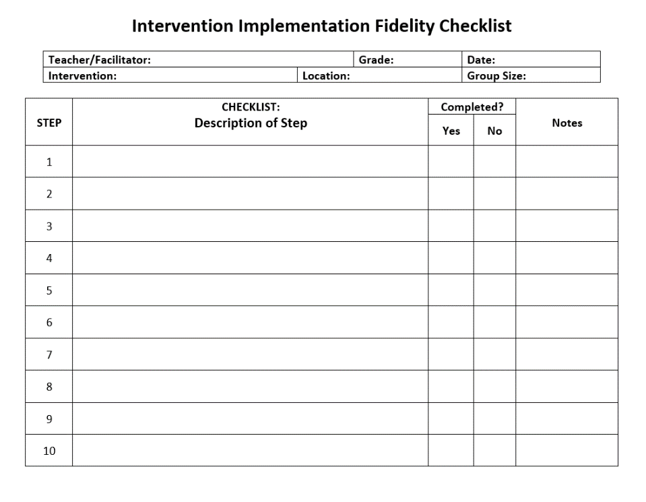
Intervention Implementation Fidelity Checklist
Notes:
The facilitator guide gives the full checklist, a sample for at least one intervention, and complete instructions on how to list all the steps or components. Group size means the number of students that teacher is facilitating for that intervention (for example, 10 kids in CICO, or 6 kids in a social skills group, etc.).

Slide 16

Questionable Response: Problem Solving
If the data indicate questionable response to intervention:
Check for fidelity of implementation of intervention
Reconsider the function
Reconsider the goal
Modify/adapt the intervention
Notes:
If the intervention isn’t making a difference (the trend line is flat), then we say the student’s response is questionable.
Determine fidelity in intervention delivery and implementation.
The team will reconsider the function was identified, confirm that the intervention aligns with the function, and review all features of the implemented intervention.
Further, the team will reconsider the goal making certain it was appropriately established based on the baseline data.
Take time to review current daily percentages on performance reports and adjust goals as needed to ensure student success.
If the data indicate questionable response to intervention and fidelity has been assured, then the Tier II team may decide to modify or intensify the intervention while collecting more data.
When modifying or adapting an intervention, make only one change at a time.

Slide 17
Concept of Adaptations
A continuum with movement between tiers
A continuum within each tier
Notes:
When we look at student outcomes or progress, we need to consider next steps. With multi-tiered systems of support we can move students to other interventions within a tier or consider moving them into an intervention in another tier (higher or lower, depending on their progress).

Slide 18
Adaptations to Tier II Interventions
Adaptations are modifications or changes to the standard protocol
    Increase or decrease the dosage of intervention components
    Add supplemental supports or interventions
    Modify the format of a core component
Timing of adaptations
    At onset
    Due to non-responsiveness
Notes:
The next slide shows examples of how you can modify an intervention.

Slide 19
Modifying an Intervention
How can an intervention be modified or intensified?
  Provide more frequent feedback
  Individualize feedback
  Add a self-monitoring component
  Individualize the reinforcer
Notes:
Modify the intervention when progress is being made at an unacceptable rate.
Modify or intensify the intervention while continuing to take data.
The intervention facilitator can provide more frequent feedback with more frequent interactions between the student and his or her teachers.
The team can choose to individualize the feedback procedure by allowing the student to select the adult with whom he or she will regularly meet to review progress or provide alternate means for contacting the adult.
Add a self-monitoring component or individualize the reinforcer based on the student’s behavior.

Slide 20
Poor Response: Problem Solving
If the data indicate a poor response to Tier II intervention:
Review daily progress reports and fidelity of implementation checklists.
Review Tier II interventions and assure that they are aligned with behavior concerns and goals.
If fidelity, goals, and primary problem behavior focus are assured…
  Discuss changing or intensifying the Tier II intervention.
  Consider the student for Tier III intervention.
Notes:
When the response is poor, the distance between trend line and goal line widens (negative trend).
The first step is to again verify fidelity of implementation and, if necessary, address possible barriers to staff implementation.
Document the decision made and steps to take in meeting minutes.
If fidelity is assured determine if the primary problem behavior has been correctly identified, refer back to the behavior concerns for more intense intervention or consider moving to Tier III.
Should new interventions be introduced, a new phase line would be indicated and more data points will be necessary.
By establishing consistent decision-making systems and basing next steps decisions on reliable and valid data, teams are more likely to increase the number of students who successfully progress from identification, through positive response to fading and graduation.

Slide 21
Data Decision Rules
When reviewing existing school data, Tier III teams should use established data decision rules to identify students who meet the entry criteria for Tier III interventions.

Slide 22
What are Data Decision Rules?
Rules that help you determine if students are eligible for receiving Tier III interventions
Rules that help you determine next steps for students in Tier III interventions (e.g., maintaining the intervention, graduating, modifying, etc.)
Notes:
There will be more examples in a few slides, but a very common data rule is that students with six or more office referrals are considered for Tier III supports.
Rules for determining next steps would include data that indicate if the student is responding positively or negatively to the intervention. This will guide teams in deciding if the student should start fading from or graduating from an intervention (positive response) or if they need to modify or change the intervention.

Slide 23
Developing Data Decision Rules:
Where Do You Begin?
Decide what concerns about students should be considered.
  DISCUSSION QUESTION: What concerns might lead a teacher to refer a student for an intervention?
Decide what data thresholds signify no current risk, at-risk, or high-risk concern.
  DISCUSSION QUESTION: At what point would the concern be enough to justify individual interventions?
Notes:
Generate some discussion here; what concerns would lead a teacher or the PBIS team to consider referring a student for an individual intervention?
Schools are already looking at school-wide data. These data can also help reveal students with a high number of infractions so that teams can consider if those students need additional supports. We will discuss this more in the next sub-section on “procedures for referring students”.
Teams will be tasked with determining parameters for students to be eligible for Tier III interventions. Once the various concerns are determined, teams will decide what data indicate that a student needs individual supports.

Slide 24
Some Things to Consider
Concerns about students:
    Discipline referrals
    Academics
    Attendance/tardiness
    Time out of classroom
    Withdrawal from social situations
What is acceptable or proficient for these? What is considered at-risk? What is considered high-risk?
Notes:
School teams should decide what range or combination of “red flags” warrant consideration for Tier II and Tier III interventions. Think of these rules as “gates” for getting into Tier II/Tier III interventions.
Above are some concerns that teams may want to consider. (Discussion from the last slide may add to this list.)
By creating data decision rules that define what is acceptable, what is at-risk, and what is high risk (e.g., how many referrals, how many absences, how many low grades, etc.), schools can efficiently identify students and get them into Tier III interventions swiftly.

Slide 25
Chronic Behaviors
Behaviors that are persistent over a period of time (and possibly in multiple locations).
Students with chronic behaviors that do not respond to Tiers I and II may need to be referred for Tier III interventions.
Schools need data decision rules to determine when chronic behaviors fall into the “high-risk” category.
Notes:
Chronic behaviors, such as those that cause a student to receive a high number of classroom minors or office discipline referrals, may indicate a need for Tier III interventions, especially if the student has not responded to Tier II. Slide 29 contains a sample “data decision rules” chart.

Slide 26
Intense Behaviors
Intense behaviors are those that significantly impact the learning of the entire class or those that create concerns for the safety of the student or others.
Students with intense behaviors may need to be referred for Tier III supports even if they have not received Tier II supports.
Because intensity can be subjective, schools will have to decide which behaviors are always intensive and consider others on a case by case basis.

Slide 27
Behavioral Intensity Is Subjective
Examples of possible intense behaviors:
Throwing objects
Yelling at school personnel, “You’re not the boss of me!”.
Leaving the school campus
Examples of intense behaviors:
Display of weapons
Assault on others
Self-injury
Notes:
Consider context when deciding if a behavior is intense (e.g., throwing a chair at the teacher as opposed to throwing paper airplanes in class).

Slide 28
Some Other Considerations
Students that were in interventions in the previous year or at a previous school
Students re-entering school from an alternative setting (e.g., alternative high school, mental health facility, etc.)
Notes:
Students that were being supported the previous year will need follow up to determine if they still need support.
Students new to the school that were being supported at their previous school will need support, especially when they first enter the school.
Students that are re-entering school after being placed in an alternative setting will need support as they get accustomed to being in a school setting again.

Slide 29
EXAMPLE: DATA DECISION RULES FOR STUDENT SUPPORT
Measure | No or Low-Risk | At-risk | High-risk
Classroom minors | 0-4 | 5-9 | 10 or more
Office Discipline Referrals | 0-1 | 2-5 | 6 or more
Absences | 0-2/semester | 3-5/semester | >5/semester
Tardiness | 0-3/semester | 4-9/semester | >10/semester
In-School Suspension | 0-1 | 2-3 | >3
Out-of-School Suspension | 0 | 1 | 2
Course Grades | C or above in all | D or F in any | Multiple Ds or Fs
Reading Assessment | Proficient | Basic | Below Basic
Visit to Nurse (non-medication) | >1/month | 1/week | >1/week
Out of Class - Other | >1/month | 1/week | >1/week
Notes:
Classroom minors refer to behaviors that are managed by the teacher in the classroom, as opposed to office referrals.
This is an example showing the data guidelines that a fictional school uses to identify students for Tier II and III interventions (at-risk and high risk). Note that they also have a column showing what is considered not a risk or very low risk for each measure. Share and ask for feedback as time allows.
If possible, steer discussion towards looking at all of these student data to get a snapshot, or “big picture”.
Remind schools to consider the context and culture of their own schools when developing their data decision rules.

Slide 30

Table Talk
Based on Aiden’s behaviors and his response to Tier II, do you think he meets the criteria for Tier III interventions?
Why or why not?
Notes:
Remind participants of Aiden’s behaviors:
Behaviors: throwing books, cussing at teacher, and shouting at peers
Aiden participated in a Big Buddy Mentoring Group for three days per week for social skills training.
After six weeks of participating in this training, Aiden continued to display the same behaviors, and the classroom behaviors generalized and intensified to the cafeteria, school bus, and at home.

Slide 31
Referrals from Staff and Family Members
Notes:
The terms nomination and referral are used interchangeably in PBIS literature and evaluation (e.g., TFI). We will use the term referral in this section but note that there are examples of referral forms that use the word nomination.

Slide 32
Purpose of Referrals
Encouraging Tier III referrals from staff and family members makes it less likely that students with internalizing behaviors will “slip through the cracks.”
Notes:
Here are some examples of internalizing behaviors: cuts on skin, excessive nail biting, pulling out hair, avoiding contact with peers, excessive or frequent crying, etc.
Because students with internalizing behaviors are often not disruptive, they may not receive classroom minors or office discipline referrals. Therefore, they may not be referred for interventions based on existing school data.
Having a procedure for teachers, staff, parents, and other family members to refer students for additional supports makes it more likely that these students will receive the help they need.

Slide 33
Guiding Questions
Who can refer a student for Tier III interventions?
What will be the procedures for referring a student?
What professional development is needed to ensure all staff understand the purpose of Tier III and the procedures for referring students?
Notes:
These are some guiding questions to consider when developing procedures for Tier III nominations or referrals.

Slide 34
Determine Who Can Refer a Student
Consider this as a team, and then get input from teachers.
Examples:
  Tier II team – based on Tier II data reviews
  Classroom teachers – based on classroom concerns, office referrals, internalizing behaviors, etc.
  Parents – based on concerns at school, home, other locations (educational or behavior concerns)
Notes:
This could be an activity, if time permits. See the facilitator guide for more information.

Slide 35
Develop Procedures for Referring a Student
Establish procedures for referring a student to Tier III:
  What type of form or process will you use? Paper or digital?
  Where will teachers access the forms?
  To whom will teachers give the form?
  How will others, such as parents, access Tier III resources or forms?
Notes:
What type of form will you use? Paper or digital? Where will the teacher access the forms? To whom will the teacher give the form? How will others, such as parents, access Tier III resources or forms? Many schools implementing Tier III have a standard form for nominations, e.g., a Teacher Referral or a Nomination for Assistance form (examples on slides 37 and 38).

Slide 36
Collect Supporting Data
Develop a process for collecting supporting data:
  In order to determine the appropriate intervention, how will you collect the data you need? For example:
    Type of behavior
    Where behavior is happening
    How behavior is maintained (consequence)
    What happens right before the behavior
    What strategies have been tried
    Other info that might be useful for the problem-solving team (e.g., grades, out of classroom time, etc.)
Notes:
It is important to collect additional data to determine the appropriate intervention for a student. Although an FBA will be conducted, it is useful for the person doing the referral to collect supporting data that can help the team complete the FBA.

Slide 37
Example of Process for Teacher Referral
Teacher fills out Request for Assistance form.
Teacher collects information that includes the following:
  The behavior (observable, measurable)
  The context (where, when, possible motivation, etc.)
  The strategies that have been tried
  The screener data that have been collected
The teacher then submits the form and the above supporting information as part of a formal request for assistance to the PBIS team.
Notes:
The idea is to create a process for referrals that everyone will be able to follow consistently.
The teacher example above includes information the teacher needs to make available to the PBIS team when they submit a request.
The next slide shows a sample Request for Assistance form that can be used to record all of the data and information that need to be submitted with the request.

Slide 38
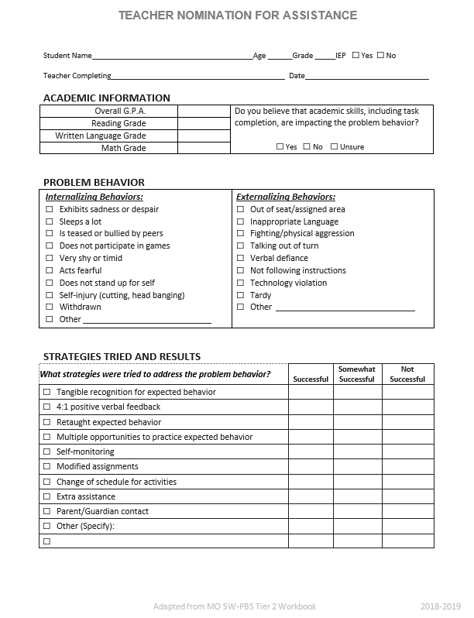
Teacher Nomination for Assistance
TEACHERS ARE EXPECTED TO COLLECT DATA TO ACCOMPANY THE FORM
Notes:
The terms Nomination and Referral are used interchangeably in PBIS literature and evaluation (e.g., TFI).
A teacher nomination form is something teams will need to decide on; either create their own, use this one, or adapt another one. Also, schools may decide to have forms for parents or others to nominate students.
This form is included in the accompanying facilitator guide or can be downloaded here: https://pbis.astate.edu/wp-content/uploads/2019/11/Tier-II-Teacher-Nomination-for-Assistance-adapted-from-MO.docx

Slide 39
Universal Screening

Slide 40
Purpose of Universal Screening
Screening may help detect emotional disorders.
Screening may help students at risk get early intervention.
Early intervention often leads to better outcomes for students.
Rose and Owens, Illinois PBIS Network
Notes:
Universal screeners can help detect emotional disorders and may help students at risk to get early intervention (Tier II or Tier III supports).
Screeners can help identify behavior concerns that wouldn’t be otherwise identified, e.g., internalizing behaviors.
Students with emotional and behavioral disorders who experience a delay in intervention often experience worse outcomes than those who receive early intervention.

Slide 41
Advantages of Universal Screening
Quick, efficient, respectful process that includes all children and youth
More accurate identification of students in need
Informs school of student’s needs
Evidence-based practice supported by highly noted groups with educational policy and practice
Notes:
There are several advantages in using a standardized screening tool to assist in the identification process in Tier III (MO PBS, 2017).

Slide 42
Universal Screening Instruments
Screener | Pros | Cons
Systematic Screening for Behavior Disorders (SSBD; Walker & Severson, 1990) | Well-validated (Endorsed in 1990 by the Program Effectiveness Panel of the U.S. Department of Education) Efficient (Screening process can be completed within 45 minutes to 1 hour) Most effective instrument for identifying internalizers (Lane et al., 2009) Meets AERA/APA instrument selection criteria Inexpensive (Manual= $ 134.49; includes reproducible screening forms) | Normed for grades 1-6 Dated norms (normed in 1990) Normative sample skewed to western U.S. region
BASC-2/BESS (Kamphaus & Reynolds, 2007) | Measures behaviors associated with internalizing and externalizing problem behaviors and academic competence Meets AERA/APA instrument selection criteria Incorporates three validity measures to rule out response bias Utilizes large (N= 12,350 children & youth), nationally-representative sample Web-based screening capacity available via AIMSewb | Can be expensive for districts/schools that don’t have access to a scantron machine $26.25 for 25 hand-scored protocols Online access via AIMSweb: Additional $1.00 per student for subscribers and $4.00 per student for non-subscribers) Hand-scoring is time-consuming and reduces access to validity measures Computer software is expensive ($620)
Notes:
This table, developed by the Illinois PBIS Network, compares a selection of evidence-based screeners that districts may consider using.
When choosing a screener, districts need to consider what they want to measure (e.g., internalizing problem behaviors) and choose a screener accordingly.
Other considerations districts may want to take into account are time required to administer the screener, ease of use, and cost.
This is continued on the next slide. The entire spreadsheet is in the facilitator guide.
Link to resources for screening: https://www.pbis.org/resource/screening-resources

Slide 43
Universal Screening Instruments
Screener | Pros | Cons
Strengths and Difficulties Questionnaire (SDQ; Goodman, 2001) | Measures internalizing/externalizing behaviors Free Option of completing pencil and paper, or online version Can be scored online Technically sound: Large, representative normative group | Perceived length of administration time Items skewed toward externalizing behaviors
Student Risk Screening Scale (SRSS; Drummond, 1993) | Measures internalizing/externalizing behaviors Free Quick to administer (less than 5 minutes per student; 15 minutes for entire class, depending upon number of students) Easy to understand and interpret score results Technically-adequate | Not as accurate as the SSBD regarding identification of internalizers
Social Skills Improvement System (SSIS; Gresham & Elliott, 2008) | Measures problem behaviors, social and academic competence Computer and web-based (AIMSweb) administration and scoring available | Expensive: Technical manual=$105.60; Rating forms= $43.75 for package of 25 hand-scored forms; scoring software= $270.00; Scanning software= $640 Can be time-consuming. It takes 10-25 minutes per student to complete the screening instrument
Notes:
SDQ here: http://www.sdqinfo.org
Info on SRSS here: https://mimtsstac.org/evaluation/student-assessments/student-risk-screening-scale
SSIS here: https://www.pearsonassessments.com/store/usassessments/en/Store/Professional-Assessments/Behavior/Social-Skills-Improvement-System-Performance-Screening-Guide/p/100000356.html

Slide 44
Developing Procedures for Universal Screening
Before implementing universal screening, districts need to consider the following:
  Which screener will be used?
  Who will do the screening?
  What training is required?
  When will students be screened?
  How will the results be used?
  How will parental consent be obtained?
  With whom will results be shared?
Notes:
Districts should develop a standard procedure for universal screening.

Slide 45
Parental Consent
Review state and district policies for conditions under which parental consent is necessary.
If you are collecting new data for an individual student for the purpose of determining disability, an assessment plan and parental consent are necessary.
If you are reviewing existing data for an individual student or administering an assessment to all students, then no assessment plan and no parental consent are necessary.
Notes:
During a student’s observation, interview, or testing it is important that parents provide informed consent.
IDEA 2004 permits “screening” procedures without parental consent.
If universal screening surveys are being completed by students, a school should seek parental consent and student assent.
If universal screening surveys are being completed by teachers about students, a school should seek to inform the parents/guardians.
Examples of review of existing data include:
A response to behavior supports or academic instruction or instructional methods.
The speaker will field questions and answers regarding hypothetical situations and the question of whether consent is needed in that case.
Refer to state and district policies.

Slide 46
Case Study
Notes:
The slides in this section provide a case study example of a student who is referred for Tier III support.

Slide 47
Aiden is Nominated
Before Mr. Jones, Aiden’s teacher, fills out a Request for Assistance form to nominate Aiden for Tier III interventions, he tries these strategies:
  Reteaching the expected behavior
  Increasing positive, specific praise when Aiden was following expectations
  Contacting Aiden’s mother
Despite these strategies, Aiden’s behavior continues to intensify.
Mr. Jones fills out the Request for Assistance and submits it, along with the required data.

Slide 48
The Core Team Evaluates the Behaviors
The Core Team receives the Request for Assistance form from Mr. Jones.
The Core Team determines that the target (problem) behaviors described by Mr. Jones on the Request for Assistance form are both chronic and intense.
  Chronic—they persist over a period of time
  Intense—they negatively impact the learning of Aiden and his classmates

Slide 49
The Core Team Uses Data
Using existing school data, the team evaluates whether Aiden meets the entry criteria for Tier III interventions, using the data-decision rules previously agreed upon. Aiden meets these criteria:
  10 or more minor behaviors
  6 or more office discipline referrals
  More than 3 in-school suspensions
  2 visits to the school nurse each week
These data suggest that Aiden may benefit from Tier III interventions.
Notes:
Existing school data are used both to evaluate whether a student meets the entry criteria for Tier III interventions and to determine the function of a student’s behavior. If it is determined that a student meets Tier III entry criteria, an Action Team (also called a Problem-Solving Team) will be formed to complete the Functional Behavior Assessment and Behavior Intervention Plan.

Slide 50
The Core Team Considers Aiden’s Response to Tier II Interventions
Mr. Robinson, the Tier II Coach and crossover member of the Tier III team, shares Aiden’s Tier II data with the Core Team so that they can evaluate his response to Tier II interventions.
The graph of Aiden’s Tier II progress monitoring data shows a negative response to the Big Buddy Social Skills program.
Fidelity data collected from the Tier II team indicate that the Big Buddy Social Skills group of which Aiden is a part is being implemented with fidelity.
Aiden’s nonresponse to Tier II indicates he may need individualized Tier III interventions.

Slide 51
A Universal Screener Is Used
Before making their final decision about Aiden, the Core Team decides to use a universal screener, the Strengths and Difficulties Questionnaire (SDQ).
They obtain Aiden’s mother’s consent before screening Aiden.
Results of the screening confirm that Aiden struggles with prosocial behaviors and could benefit from Tier III interventions.

Slide 52
Aiden Is Found Eligible
Based on all of the objective criteria, the Core Team decides to move forward with establishing an Action (problem-solving) Team for Aiden.
The Action Team will be composed of individuals who are familiar with Aiden and his behaviors.
The Action Team will complete a Functional Behavior Assessment to determine if a Behavior Intervention Plan or other services are needed for Aiden.

Slide 53
An Action Team Is Formed
The following people are asked to serve as Aiden’s Action Team based on their knowledge of Aiden:
  Mr. Jones, Aiden’s teacher
  Mrs. Kelly, the school nurse who has good rapport with Aiden
  Linda Hendricks, Aiden’s mother
  Ms. Jackson, the guidance counselor; she will guide the team in the FBA/BIP process
The Action Team decides to meet on Wednesdays at 8:15 a.m. A sub is provided for Mr. Jones.
Notes:
This Action Team will be responsible for completing a Functional Behavior Assessment to determine the function of Aiden’s behavior. The Action Team will use the FBA to complete a Behavior Intervention Plan for Aiden. In the modules on FBA and BIP, we will follow the story of this Action Team as they work together to help Aiden meet the school’s behavioral expectations.

Slide 54
Do It With Fidelity!
Tiered Fidelity Inventory (TFI)
Section 3.3: Screening
Section 3.14: Data Systems
Section 3.15: Data-Based Decision Making
Notes:
Use TFI item 3.3 to measure your use of data decision rules for identifying students for Tier III. Use TFI item 3.14 to measure how you use and share data for Tier III systems. Use TFI item 3.15 to measure how action teams use data to make decisions for individual students in Tier III interventions.

Slide 55
3.3 Screening
Feature | Data Sources | Scoring Criteria
 |  | 0 = Not implemented 1 = Partially implemented 2 = Fully implemented
3.3 Screening: Tier III team uses decision rules and data (e.g., ODRs, Tier II performance, academic progress, absences, teacher/family/student nominations) to identify students who require Tier III supports. | School policy Team decision rubric Team meeting minutes | 0 = No decision rules for identifying students who should receive Tier III supports 1 = Informal process or one data source for identifying students who qualify for Tier III supports 2 = Written data decision rules used with multiple data sources for identifying students who qualify for Tier III supports, and evidence the policy/rubric includes option for teacher/family/student nominations
Main Idea: Timely selection of students for Tier III supports improves the effectiveness of Tier III implementation.

Slide 56
3.14 Data System
Feature | Data Sources | Scoring Criteria
 |  | 0 = Not implemented 1 = Partially implemented 2 = Fully implemented
3.14 Data System: Aggregated (i.e., overall school-level) Tier III data are summarized and reported to staff at least monthly on (a) fidelity of support plan implementation, and (b) impact on student outcomes. | Reports to staff Staff meeting minutes Staff report | 0 = No quantifiable data 1 = Data are collected on outcomes and/or fidelity but not reported monthly 2 = Data are collected on student outcomes AND fidelity and are reported to staff at least monthly
Main Idea: Teams need the right information in the right form at the right time to make effective decisions.

Slide 57
3.15 Data-based Decision Making
Feature | Data Sources | Scoring Criteria
 |  | 0 = Not implemented 1 = Partially implemented 2 = Fully implemented
3.15 Data-based Decision Making: Each student’s individual support team meets at least monthly (or more frequently if needed) and uses data to modify the support plan to improve fidelity of plan implementation and impact on quality of life, academic, and behavior outcomes. | Three randomly selected Tier III behavior support plans created in the last 12 months (see TFI Tier III Support Plan Worksheet) | 0 = Student individual support teams do not review plans or use data 1 = Each student’s individual support team reviews plan, but fidelity and outcome data are not both used for decision making or not all teams review plans 2 = Each student’s individual support team continuously monitors data and reviews plan at least monthly, using both fidelity and outcome data for decision making
Main Idea: Teams need to regularly review fidelity/outcome data to identify how Tier III supports should be altered.

Slide 58
Summary
Use existing school data to develop data decision rules.
Develop a system to determine nonresponse to Tier II interventions.
Develop a system for nominating students (process, documents, etc.).
Decide if and how you will use universal screeners.

Slide 59
Resources
SWPBIS Tiered Fidelity: https://www.pbisapps.org/resource/tfi
National Center on Intensive Intervention: https://intensiveintervention.org/special-topics/mtss
Missouri SW-PBIS Tier III Team Workbook: https://pbismissouri.org/wp-content/uploads/2018/05/MO-SW-PBS-Tier-3-2018-04.24.18.pdf
Mental Health, Social-Emotional, And Behavioral Screening And Evaluation Compendium (2nd Ed): https://pbis.astate.edu/wp-content/uploads/2019/01/Screening-considerations-Compendium-Version-2.pdf

