Slide 1
Tier III Leadership
Module 2
Notes:
Images in this module were obtained at google.com/images unless otherwise specified.

Slide 2
Purpose
Provide information that will help schools develop strong Tier III leadership through structuring their teams and team meetings
Notes:
Refer to the PBIS tiers of intervention and have participants review Tiers I and II.

Slide 3
Objectives
Participants will learn about…
How to plan for implementing Tier III
Leadership at Tier III
Core (systems) and action teams
  Learn the roles and responsibilities of the core (systems) leadership team
  Learn how to develop action teams for individual students

Slide 4
The Tiered Fidelity Inventory (TFI)
Tier III Planning Tool
TEAM 3.1 Team Composition 3.2 Team Operating Procedures 3.3 Screening 3.4 Student Support Team RESOURCES 3.5 Staffing 3.6 Student/Family/Community Involvement 3.7 Professional Development | SUPPORT PLANS 3.8 Quality of Life Indicators 3.9 Academic, Social, and Physical Indicators 3.10 Hypothesis Statement 3.11 Comprehensive Support 3.12 Natural and Formal Supports 3.13 Access to Tier I and Tier II Support EVALUATION 3.14 Data System 3.15 Data-Based Decision Making 3.16 Level of Use 3.17 Annual Evaluation
Notes:
The TFI will be used throughout PBIS modules. Each module aligns with one or more of the TFI items, denoted by the yellow arrows. The TFI is a tool that can be used for PBIS implementation planning, PBIS progress monitoring, and evaluation of PBIS implementation. In this module, items 3.1, 3.2, 3.4, 3.5 , 3.16, and 3.17 will be addressed.

Slide 5
Introduction to the Case Study
In each of the Tier III modules, we are going to follow a Case Study to illustrate the process of Tier III.
In this module, the Case Study will focus on the process a school took to create their Core Team and an Action Team for a particular student who had been referred for Tier III services.

Slide 6

University Heights Elementary
University Heights Elementary School has 500 students in grades 1-4.
They are in the early stages of Tier III implementation.
They have a Core Team assembled for Tier III and have acquired the necessary training for those involved.
The Core Team is ready to begin meeting to fulfill their initial and ongoing team responsibilities.

Slide 7

Follow Aiden’s Journey
7 year old, 2nd grader at University Heights
Behaviors: throwing classroom materials, cussing at teacher, shouting at peers
Referred for Tier II interventions
Received Big Buddy social skills mentoring three days/week for six weeks, with negative results
Because of negative response and intensifying of behaviors, being referred for Tier III interventions
Notes:
We will be following Aiden’s journey throughout the Tier III modules.
Aiden is a 7-year-old 2nd grader at University Heights Elementary School who was first identified for interventions due to aggressive behaviors and disengagement in the classroom.
Due to the severity of the behavior problems Aiden displayed, he was referred to the school building level committee for Tier II interventions.
Based on data decision rules, Aiden met the threshold for Tier II supports.
After reviewing data and teacher referral to determine probable function of behavior (an FBA was not conducted), it was decided by the team that Aiden would begin Big Buddy mentors for three days per week for social skills training.
After six weeks of participating in this training, Aiden continued to display the same behaviors, and the classroom behaviors generalized and intensified to the cafeteria, school bus, and at home.
Because he was unsuccessful at Tier II, the team followed their PBIS procedures and data decision rules and referred him for Tier III interventions.

Slide 8
Planning for Tier III

Slide 9

Planning for Tier III
What practices are currently in place to support individual students?
How many students do you expect to be supporting at Tier III?
What are your goals for Tier III?

Slide 10
Tracking Access to Tier III
Schools need a written process for tracking the proportion of students participating in Tier III supports.
  Should monitor whether all students needing Tier III supports have access to those supports
  Should monitor the proportion of students who have Tier III plans in place (should fall between 1-5% of student population)
Notes:
It’s important to ensure that all students who need Tier III supports have access to those supports. Tier III supports are meant to serve 5% or less of the student body.

Slide 11
Leadership at Tier III

Slide 12
Leadership at Tier III
Tier III systems, data, and practices are led by a core team.
This intensive system could include the following:
  Personnel who are trained in the basic principles of behavior, functional assessment, and behavior support planning
  Personnel with administrative authority
  A system for early identification and referral
  An organizational structure that allows for flexible teaming and planning
Notes:
Team composition in Tier III could include five aspects:
1. Applied behavioral expertise
2. Administrative authority
3. Multi-agency support
4. Knowledge of students
5. Knowledge about the operations of the school across grade levels and programs
The core team deals with the overall implementation of Tier III. Individual action teams are formed to design and implement individual student plans. The action teams should include those adults who are typically involved with the student on a daily basis.

Slide 13

Team-based Processes
“In a review of FBA studies, Goh and Bambara (2012) found that out of all variables they analyzed, teaming had the most significant effect on the success of the FBA implementation.”
Deanne Crone, Leanne Hawkin, & Rob Horner, 2015
Notes:
Below is the abstract of Individualized Positive Behavior Support in School Settings: A Meta-Analysis, Goh, A. E., & Bambara, L. M. (2012).
“This meta-analysis examined school-based intervention research based on functional behavioral assessment (FBA) to determine the effectiveness of key individualized positive behavior support (IPBS) practices in school settings. In all, 83 studies representing 145 participants were included in the meta-analysis. Intervention, maintenance, and generalization effects were measured by computing the percentage of nonoverlapping data points (PND). Overall, FBA-based interventions were found to be equally effective across diverse student populations and educational settings, including inclusive classrooms. In terms of key IPBS practices, results indicated that team decision making during intervention planning led to significantly larger PNDs. Descriptive analysis revealed that there has been an increase in the use of IPBS practices in school-based FBA-based intervention research; however, some deficiencies were noted. Implications and recommendations for future research are discussed.” (PsycINFO Database Record (c) 2016 APA, all rights reserved)

Slide 14
Teaming Is Critical in Tier III
  Content specialists
Representative school-based
teams
School-based teams that include content specialists
Benazzi, Horner, & Good, 2006
Notes:
Content specialists are important to developing technically adequate plans.
School-based teams with diverse representation are more likely to develop and implement plans that are contextually relevant.
School-based teams that include content specialists are more likely to develop technically adequate plans that are also contextually relevant!
Not everyone on the team needs to be an expert in behavior or multi-tiered systems of support.

Slide 15
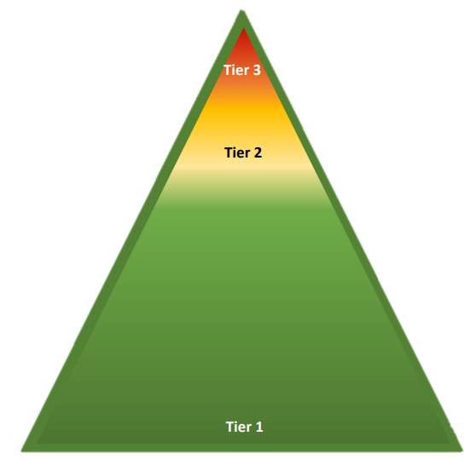
Education Experts
Child/Teen Experts
Intervention Experts
Implement Tier III strategies
Inform & support Tier III
Collaborate to develop Tier III
Enhance communication with home to support Tier II
Enhance communication with school to support Tier II
Support education and child experts in Tier II
Differentiate Tier I (classroom instruction and intervention)
Support Tier I (classroom instruction and intervention)
Support Tier I (classroom instruction and intervention)
Notes:
Different experts can provide different input and support throughout the tiers, contributing to the overall success of PBIS implementation.

Slide 16

Resources Needed
Team members working with individual students will need time for the following:
Attending trainings to develop expertise
Conducting the FBA
Developing, implementing, and monitoring the resulting BIP
Notes:
Adequate time will be needed for the development of Tier III systems, data, and practices, which is why it is crucial to have a team member with administrative authority. The development of supports, collaboration as a team and with the student, professional development, staff release time, and availability of service professionals all require a time commitment.
Refer to the SWPBIS Tiered Fidelity Inventory (TFI) Tier III Intensive Features Resources subscale as a guide for thinking about allocated time demands for this level.
Reference link (beginning on page 17 of the tool): https://www.pbisapps.org/resource/tfi

Slide 17

Schedule Regular Meetings
Tier III teams need to meet regularly to have systems discussions, review data, and action plan.
Notes:
Tier III individualized supports are resource intensive. If teams are to be successful, they must be given the time to meet on a regular basis. The team must be provided detailed information regarding team roles and responsibilities.

Slide 18

Action Planning
Provides a framework for assessing how to complete a task effectively.
Process typically contains these elements:
  Goals
  Measures of success
  Activities/steps
  Timelines
  Resources
  Person(s) responsible
Notes:
Just as in Tier I or Tier II, action planning continues for Tier III. This assures the process is efficient.

Slide 19
Goals and Measuring Success
Establish goals by asking, “What things do we need to do to move our work forward?”
Measure your success by asking, “What completed products, data or processes are in place after the work is finished?”
Notes:
Goals—goals and/or needs will emerge, drawn from items within the Tiered Fidelity Inventory (TFI).
The objective of the TFI is to provide an efficient means for teams to self-assess implementation fidelity at each tier.
Results from the TFI can be used to monitor overall implementation fidelity, to monitor progress toward short or long-term goals, and to determine action steps that address areas of concern.
Measures of success—measures of whether you have reached your goal successfully through completed products, data, or processes; in other words, how will we know we met our goals?

Slide 20
Activities and Steps
After identifying the goal and what “success” looks like, list ideas in a rational sequence needed to achieve the goal, for example:
  What is the first action that needs to take place?
  What happens next?
  Any activities that are prioritized to meet deadlines?
Notes:
Activities/steps—This comes after you identified the goal and have a clear vision of what success would look like.
Starting from the beginning, the team brainstorms a list of ideas in a rational sequence needed to achieve the goal, asking, “What is the first action that needs to take place? What happens next? Are there any activities that are prioritized to meet deadlines?”
Design in a logical manner to reach the goal. Ask, “What do we need to do to reach our goals?”

Slide 21
Timelines and Resources
Partner the timeline with outlined activities and steps.
  What can realistically be done in a specified amount of time?
  What assistance or resources will be needed to complete the tasks?
Notes:
Timelines—Can be changed/adapted as the plan moves forward and helps maintain accountability.
Resources—Helps with thinking in advance and preparing the framework.

Slide 22
Persons Responsible and Deadlines
The team delegates a person to complete each task.
The action plan includes dates when activities should and have been completed.
Notes:
Persons(s) Responsible—This is also an accountability measure to assure the work gets accomplished by each stakeholders within the timeline assigned. In the next section, we will talk about agendas for use in team meetings.

Slide 23
Core and Action Teams

Slide 24
Teaming at PBIS Tier III
Core Team (systems) conversations:
  Monitor effectiveness of complex FBA/BIP and wraparound supports.
  Review aggregate Tier III data to make decisions about any improvements needed for the interventions themselves.
Action Team (problem solving) examples:
  FBA/BIP team developed for each student
  Wraparound team for each student
Notes:
In PBIS, there is always a systems (Core) team and a problem-solving (Action) team. At Tier III, there are a core group of people that look at Tier III in more general terms, and they help convene the action teams for each individual student.
The Core Team is a small, fixed group that develops the PBIS Tier III systems and manages requests for the interventions. This ensures consistency and fidelity across interventions.
Once the Core Team determines that a student meets the criteria for Tier III individualized intervention, the team develops an Action Team for that particular student.
ONE Core Team member participates as a member of the Action Team.
This Core Team liaison contacts the required Action Team members, including staff and family, and conducts student interviews.
This is the point where the Action Team takes over the responsibilities from the Core Team.
The Action Team will be smaller and more focused (talking about individual students).
Problem-solving conversations need to take place more often than systems conversations.
Team members involved in problem solving will have to be able to commit to meeting at least every two weeks.

Slide 25
Core (Systems) Teams
Notes:
The Core Team builds the Tier III Systems. Action Teams support individual students. Depending on the school situations (e.g., the size of the school), these teams might include the same people. For example, in big schools, each student needs an individualized Action Team because Core Team members may not know or have a connection with the student.

Slide 26
Initial Core Team Responsibilities
Develop standardized processes:
  Identifying students for Tier III support
  Conducting FBAs
  Developing and monitoring BIPs
  Identifying and prompting participation of action team members, including family members and student (if applicable)
  Updating team, staff, and others involved with student supports
Create a model for offering staff professional development and training.
Notes:
As schools begin to implement Tier III, the Tier III Core Team will be tasked with creating standardized processes and procedures.
For example, the Tier III Core Team would have a standardized process for identifying students that includes regular school-wide data review, a standard form and process for teacher nominations, and a detailed plan for screening.
The Core Team builds the Tier III Systems. Action Teams support individual students. Depending on the school situations (e.g., the size of the school), these teams might include the same people.
For example, in big schools, each student needs an individualized Action Team because Core Team members may not know or have a connection with the student.

Slide 27
Annual Evaluation
At least once a year, the Tier III Core Team will conduct a fidelity assessment (e.g., TFI).
This annual assessment will be used for action planning.
Notes:
At least once a year, the Tier III Core Team will assess the extent to which Tier III Supports are meeting the needs of students, families, and school personnel. This annual review will be used for action planning around ways to increase the fidelity and usefulness of Tier III supports.

Slide 28
Core Team Membership
Administrator (or someone with administrative authority)
Member with behavioral expertise
Member with academic expertise
Crossover member (if there are separate Tier II and III core teams)
Notes:
Crone and Horner (2003) suggest that membership be at a minimum of one year; frequently, members serve for two or more years. This builds the stability of the core team. Steady, consistent participation in ongoing training impacts the team’s ability to develop a high-quality, sustainable system.

Slide 29
Core Member Roles
Four team roles are needed as the Tier III systems are developed:
Facilitator- prepares agenda, facilitates meeting, follows-up on assigned tasks
Recorder- takes notes (including decisions, assigned tasks, and deadlines set during the meeting) and distributes this information to all stakeholders
Administrator- supports process with attendance, restructures resources as needed, and shares updates with staff
Crossover Member - provides direct line of communication between Tier II and Tier III teams (can be a member listed above or a fourth member)
Notes:
Once the systems are established, the focus of the core team shifts to student problem-solving. Roles and responsibilities are evenly distributed across the members.

Slide 30

Table Talk
Brainstorm who at your school might have the expertise needed for your Tier III core team:
  Administrative Authority
  Behavioral Expertise
  Academic Expertise
  Tier II Expertise

Slide 31

Scheduling Considerations
It is essential that the core team has a scheduled meeting time and an effective meeting format.
Administration provides release time for core team members; for example:
  Paraprofessionals/aides covering classes
  Staff members with unassigned duties covering a class
  Utilizing specialists (art, P.E., music, media) for coverage
  Flex time before/after school for team members
Notes:
The meeting time and day should be consistent each week to foster attendance. Crone and Horner (2003) suggest that regularly scheduled meetings are held on the same day of the week and at the same time to support all team members in attendance. Determine your core team calendar for a regular meeting time.
What are the options at your school for flex time for the core team members – if they come in early, can they leave early that day?
With administrative support and colleagues’ assistance, the core team has the opportunity to effectively collaborate.

Slide 32
Core (Systems) Team Meeting Format
The next slide contains a sample agenda template that can be used for systems-level discussions at Tier II or Tier III.
The four slides following the agenda contain a sample agenda template that can be used for problem-solving discussions at Tier II or Tier III.
Notes:
The core team can use the agenda on the following slides to assign students to interventions and to progress monitor students receiving interventions.

Slide 33
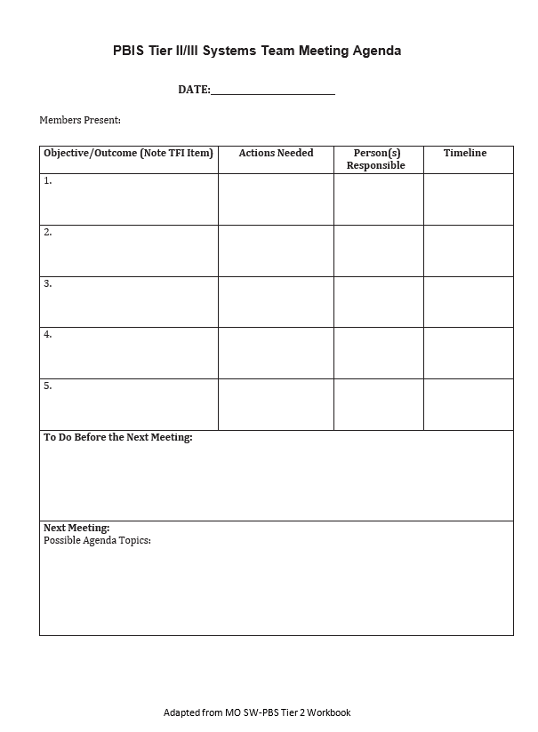
Tier III Systems Team Meeting Agenda (for Systems Conversations)
Notes:
This agenda (adapted from MO-SWPBS workbook) can be used for the systems conversations at Tier II and Tier III. No individual students are reviewed here, just overall progress and outcomes for ALL Tier III interventions. The intervention coordinator(s) can update the team on overall progress.
Template can be downloaded here: https://pbis.astate.edu/wp-content/uploads/2019/07/Tier-II_III-Systems-Team-Meeting-Agenda-Template-adapted-from-MO-1.docx

Slide 34
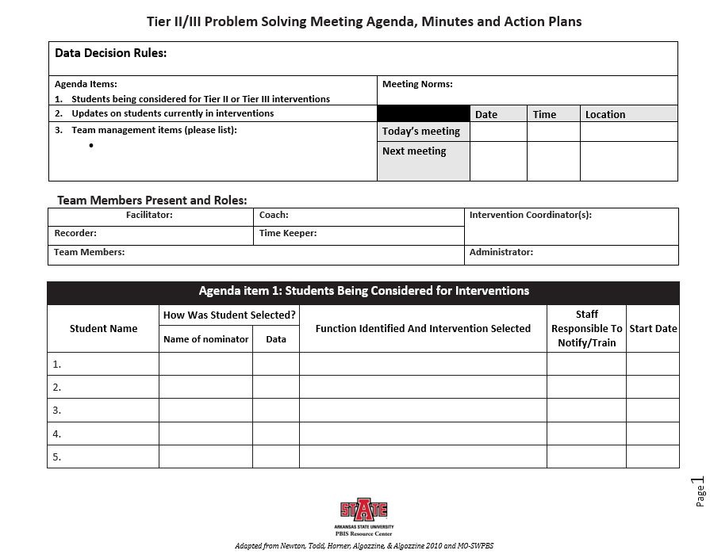
Problem Solving Meeting Agenda
Notes:
This is a four-page agenda that can be used for the problem-solving conversation in both Tier II and Tier III. Individual student progress is discussed and decisions are made. The first page contains “housekeeping” items as well as a space for listing students that are being considered for Tier II interventions.
Template can be downloaded here: https://pbis.astate.edu/wp-content/uploads/2019/07/Tier-II_III-Problem-Solving-Team-Meeting-Agenda-Minutes-Action-Plan-FINAL-EDIT-7-27-19.doc

Slide 35
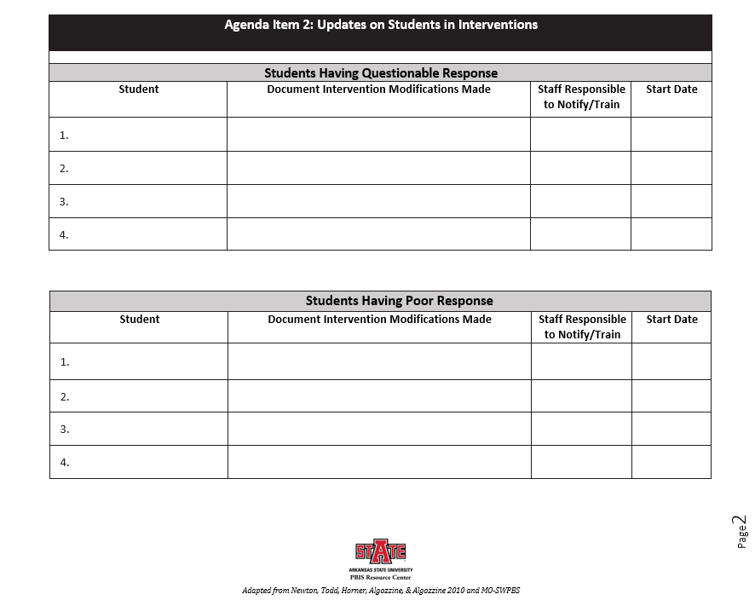
Notes:
On page two, there are spaces to list students that aren’t having a positive response to their interventions and any information that will help the team problem solve and make decisions. Data collection and problem solving will be discussed in depth in later modules.

Slide 36
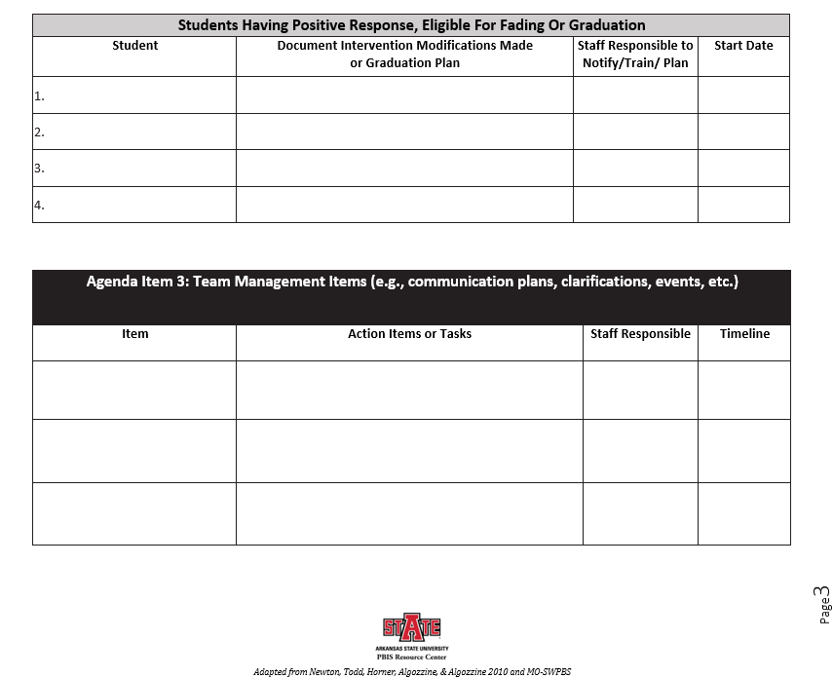
Notes:
Page three has a space for listing students that may be ready for fading or graduating, along with information that will help the team make decisions. The agenda also allows for adding additional items as needed after discussing student data. Later modules will discuss the specific processes in these agenda items.

Slide 37
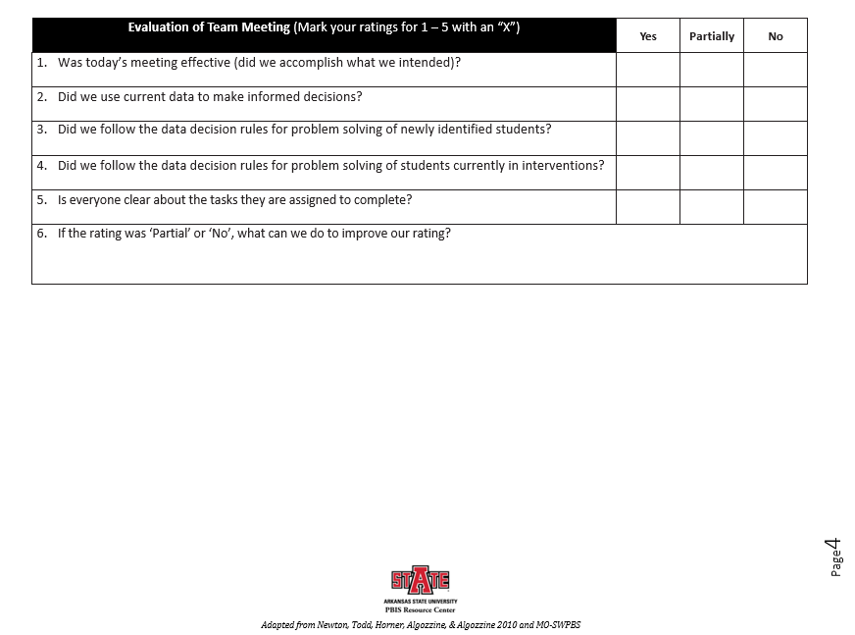
Notes:
The document ends with an evaluation of the meeting. This gives the team an opportunity to make sure the meeting was conducted efficiently, and everyone knows their role going forward.

Slide 38
Action (Problem Solving) Teams

Slide 39
Developing Action Teams
Once the Tier III process is established, the core team’s focus shifts:
Receive referrals for students to receive Tier III support
Determine whether referred students meet the criteria for Tier III interventions
Contact action team members and assign tasks
Notes:
The core team follows an outlined criteria to determine Tier III eligibility for students. Once a student is found eligible, the one core team member who will be on the action team for that student will contact the other action team members and assign tasks (complete record review, interview student/teachers/staff/family members).

Slide 40
Supporting Action Teams
Core Team member(s) support the Action Team initially.
  Provide professional development
  Support in completing functional behavior assessment
  Support in creating a behavior intervention plan
Core Team member(s) will fade support and the Action Teams will begin functioning independently.
Notes:
When first formed, the Action Team will require significant support in the FBA/BIP process. Until the Action Team has developed knowledge and understanding through professional development, it is suggested that the Core Team members still actively participate in the initial Action Team to model and support the Action Team. Once the Action Team is experienced, the Core Team will then resume regular responsibilities (e.g., systems conversations, fidelity checks, etc.), and the Action Team will conduct the FBA and develop the BIP.

Slide 41
Examples of Action Teams
Wraparound team
  The family of the child invites all relevant stakeholders.
  Wraparound facilitators engage families to ensure that the team is created by and for the family.
  Relevant school staff are also invited to participate.
Individual youth FBA/BIP team
  Uniquely created for each individual child.
  Families are critical members of the team.
  All relevant individuals and staff are invited.
Notes:
Depending upon the student’s needs and the school’s resources, decide which type of action team is needed. Here are two examples:
1. Wraparound team
In the wraparound process, the family of the child invites all relevant stakeholders to participate and drives the process. Wraparound facilitators are trained to effectively engage families to ensure that the team is created by and for the family. This will increase the likelihood that the family will want to actively participate. Relevant school staff who are uniquely important for this youth are also invited to participate.
Information on Wraparound: https://nwi.pdx.edu/wraparound-basics/
2. Individual youth FBA/BIP team
Similar to the wraparound team, the FBA/BIP team is uniquely created for each individual child in need of comprehensive planning and the families are critical members of the team. All relevant individuals and staff are invited.

Slide 42
Guiding Questions
Who should be a member of the action team (based on each student)?
How will release time be provided to attend weekly action team meetings?
Who will be responsible for contacting potential action team members?
How will the potential action team members be contacted?
Notes:
Use these guiding questions to develop your system to assemble an action team.

Slide 43
Case Study

Slide 44
Core Team
In order to have all the expertise required on a Tier III Core Team, the following people were asked to join:
  Mr. Criswell, the Assistant Principal (Administrative Authority)
  Ms. Jackson, the Guidance Counselor (Behavioral Expertise)
  Mr. Poole, a Special Education Teacher (Academic and Behavioral Expertise)
  Mrs. Liddell, a Regular Education Teacher (Academic Expertise)
  Mr. Robinson, the Tier II Coach (Tier II Expertise)

Slide 45
Core Team Initial Responsibilities
Ms. Jackson volunteers to be the Core Team’s Facilitator. The team decides to meet every Tuesday at 3:30 in Mr. Poole’s room. Ms. Jackson creates the agenda and sends it out ahead of time.
During their first few meetings, the team creates a standardized referral process for identifying students for Tier III interventions. This process includes the forms that will be used, the data decision rules that they will use to determine whether students qualify for Tier III interventions, and what training will be needed for faculty, staff, and parents regarding this process.
Notes:
The process for identifying students for Tier III interventions is discussed in depth in PBIS Tier III Module 3.

Slide 46
Core Team Initial Responsibilities
The team creates a standardized process for conducting Functional Behavior Assessments and writing Behavior Intervention Plans. Because Mr. Poole has some experience with these processes, the team decides he will train the action teams.
The team also creates a written process for providing ongoing Professional Development around Tier III.
Notes:
The processes for conducting Functional Behavior Assessments and writing Behavior Intervention Plans are discussed at length in Tier III Modules 4 and 5.

Slide 47
Core Team Ongoing Responsibilities
After Tier III implementation is underway and all processes have been put into place, the Tier III Core Team begins to receive referrals for individual students to receive Tier III interventions.
The Core Team reviews each referral to see if each student meets the previously established criteria for Tier III interventions.
When a student meets the criteria, the Core Team delegates one of its members to create an Action (Problem-Solving) Team for that student.

Slide 48
Core Team Reviews a Referral
Mr. Jones, the 2nd grade teacher, refers 7-year-old Aiden for Tier III interventions based on the following behaviors: throwing classroom materials, cussing at teacher, and shouting at peers.
Aiden has been receiving Tier II Social Skills interventions (Big Buddy Mentoring) for the past 6 weeks. His behavior, which began in the classroom, has intensified and spread to the cafeteria, school bus, and at home.
After reviewing the data, the Core Team decides to put together an Action Team to conduct an FBA to determine if a Behavior Intervention Plan or other services are needed for Aiden.
Notes:
Based on data decision rules, Aiden met the threshold for Tier II supports. After reviewing data and teacher nomination to determine probable function of behavior, it was decided by the team that Aiden would begin Big Buddy mentors for three days per week for social skills training. After six weeks of participating in this training, Aiden continued to display the same behaviors, and the classroom behaviors generalized and intensified to the cafeteria, school bus, and at home. Because he was unsuccessful at Tier II, the team followed their PBIS procedures and data decision rules and referred him for Tier III interventions.

Slide 49
Action Team Created
Mr. Criswell volunteers to put together an Action Team for Aiden.
He asks the following people to serve as Aiden’s Action Team based on their knowledge of Aiden:
  Mr. Jones, Aiden’s teacher
  Mrs. Kelly, the school nurse who has good rapport with Aiden
  Linda Hendricks, Aiden’s mother
  Ms. Jackson, the Guidance Counselor. She will guide the team in the FBA/BIP process
The Action Team decides to meet on Wednesdays at 8:15 a.m. A sub is provided for Mr. Jones.
Notes:
The Core Team will ensure that the Action Team has the training they need to complete the FBA/BIP process. In this example, a member of the Core Team has actually joined the Action Team for Aiden. We will follow the story of Aiden and his Action Team in more depth in the modules on FBA and BIP (Tier III Modules 4 and 5).

Slide 50
Ongoing Action Planning
The Core Team continues to meet each week.
In addition to evaluating referrals and creating Action Teams, the Core Team reviews aggregate data on the interventions being put into place. They ask the following questions:
  Are the interventions working?
  Are they being implemented with fidelity?
  Is any additional training needed?
  How successful is our Tier III system as a whole?
  Are any improvements needed?

Slide 51
Annual Review
At least once a year, the Core Team uses the Tiered Fidelity Inventory to evaluate their Tier III system.
They use the possible data sources suggested by the TFI to objectively evaluate how well each TFI item is being implemented.
An action plan is created and implemented based on the items that need more improvement.
Notes:
The Tiered Fidelity Inventory is a fidelity tool teams can use to measure how well they are implementing all three tiers of PBIS. Each module in this series aligns with items on the TFI. One way these modules can be used by your team is to help you action plan how to improve your TFI scores. Find the modules that align with the items on which you wish to improve and use them as professional development around those topics.

Slide 52
Do It With Fidelity!
Tiered Fidelity Inventory (TFI)
Section 3.1: Team Composition
Section 3.2: Team Operating Procedures
Section 3.4: Student Support Team
Section 3.5: Staffing
Section 3.16: Level of Use
Section 3.17: Annual Evaluation
Notes:
Sections 3.1, 3.2, 3.4, and 3.5 will help you assemble the appropriate personnel for your Tier III systems team; hold efficient, effective team meetings; convene support teams for individual students; and ensure the appropriate staff are available to support students at Tier III. Sections 3.16 and 3.17 will help your teams assess the effectiveness of your Tier III implementation.

Slide 53
3.1 Team Composition
Feature | Data Sources | Scoring Criteria
 |  | 0 = Not implemented 1 = Partially implemented 2 = Fully implemented
3.1 Team Composition: Tier III systems planning team (or combined Tier II/III team) includes a Tier III systems coordinator and individuals who can provide (a) applied behavioral expertise, (b) administrative authority, (c) multi-agency supports (e.g., person centered planning, wraparound, RENEW) expertise, (d) knowledge of students, and (e) knowledge about the operations of the school across grade levels and programs. | School organizational chart Tier III team meeting minutes | 0 = Tier III team does not include a trained systems coordinator or all five identified functions 1 = Tier III team members have some but not all five functions, and/or some but not all members have relevant training or attend at least 80% of meetings 2 = Tier III team has a coordinator and all five functions and attendance of these members is at or above 80%
Main Idea: Tier III teams need individuals with specific skills and perspectives to effectively provide and implement Tier III supports.

Slide 54
3.2 Team Operating Procedures
Feature | Data Sources | Scoring Criteria
 |  | 0 = Not implemented 1 = Partially implemented 2 = Fully implemented
3.2 Team Operating Procedures: Tier III team meets at least monthly and has (a) regular meeting format/agenda, (b) minutes, (c) defined meeting roles, and (d) a current action plan. | Tier III team meeting agendas and minutes Tier III meeting roles descriptions Tier III action plan | 0 = Tier III team does not use regular meeting format/agenda, minutes, defined roles, or a current action plan 1 = Tier III team has at least two but not all four features 2 = Tier III team meets at least monthly and uses regular meeting format/agenda, minutes, defined roles, AND has a current action plan
Main Idea: Tier III teams need meeting foundations in order to operate efficiently and to implement effective supports.

Slide 55
3.4 Student Support Team
Feature | Data Sources | Scoring Criteria
 |  | 0 = Not implemented 1 = Partially implemented 2 = Fully implemented
3.4 Student Support Team: For each individual student support plan, a uniquely constructed team exists (with input/approval from student/family about who is on the team) to design, implement, monitor, and adapt the student-specific support plan. | Three randomly selected Tier III student behavior support plans created in the last 12 months (see TFI Tier III Support Plan Worksheet) | 0 = Individual student support teams do not exist for all students who need them 1 = Individual student support teams exist, but are not uniquely designed with input from student/family and/or team membership has partial connection to strengths and needs 2 = Individual student support teams exist, are uniquely designed with active input/approval from student/family (with a clear link of team membership to student strengths and needs), and meet regularly to review progress data
Main Idea: Each student receiving Tier III supports benefits from having an individualized team comprised of relevant stakeholders.
Notes:
Although the TFI refers to “student support teams,” we refer to these teams as Action Teams.

Slide 56
3.5 Staffing
Feature | Data Sources | Scoring Criteria
 |  | 0 = Not implemented 1 = Partially implemented 2 = Fully implemented
3.5 Staffing: An administrative plan is used to ensure adequate staff is assigned to facilitate individualized plans for the students enrolled in Tier III supports. | Administrative plan Tier III team meeting minutes FTE (i.e., paid time) allocated to Tier III supports | 0 = Personnel are not assigned to facilitate individual student support teams 1 = Personnel are assigned to facilitate some individual support teams, but not at least 1% of enrollment 2 = Personnel are assigned to facilitate individualized plans for all students enrolled in Tier III supports
Main Idea: Each Tier III student support team needs a person responsible for coordinating implementation efforts.

Slide 57
3.16 Level of Use
Feature | Data Sources | Scoring Criteria
 |  | 0 = Not implemented 1 = Partially implemented 2 = Fully implemented
3.16 Level of Use: Team follows written process to track proportion of students participating in Tier 3 supports, and access is proportionate. | Student progress data Tier 3 team meeting minutes | 0 = No students have Tier 3 support plans. 1 = Fewer than 1% of students have Tier 3 plans. 2 = All students requiring Tier 3 supports (and at least 1% of students) have Tier 3 support plans.
Main Idea: Tier 3 supports that are used with too few students (e.g. fewer than 1% of enrollment) or by too many students (e.g. more than 5% of enrollment) are not sustainable.

Slide 58
3.17 Annual Evaluation
Feature | Data Sources | Scoring Criteria
 |  | 0 = Not implemented 1 = Partially implemented 2 = Fully implemented
Annual Evaluation: At least annually, the Tier 3 systems team assesses the extent to which Tier 3 supports are meeting the needs of students, families, and school personnel, and this information is used to guide action planning. | Tier 3 team meeting minutes Tier 3 team Action Plan Team member verbal reports | 0 = No annual review takes place. 1 = Review is conducted but less than annually, or the review is done without impact on action planning. 2 = Written documentation of an annual review of Tier 3 supports with specific decisions related to action planning.
Main Idea: Any strategy or procedure needs to be reviewed at least annually and revised to remain current and to match changes in the school.

Slide 59
Next Steps

Slide 60
Looking Ahead
Modules 3 through 5:
Identifying Students for Tier III Interventions
Functional Behavior Assessment
Behavior Intervention Plans
Notes:
Subsequent modules will look at these topics in more depth.

Slide 61
Summary
Have a plan for implementing Tier III. Assess current resources and have a goal for implementing Tier III.
Tier III requires regular systems discussions, as well as individualized teams to support each student in Tier III interventions.
Systems discussions will need to take place regularly, typically monthly, similar to Tier I and Tier II systems discussions.
Individual student teams will need time and resources to provide ongoing support for their students.

Slide 62
Resources
Missouri School-wide PBS Tier III Workbook: https://pbismissouri.org/wp-content/uploads/2018/08/Tier-3-2018_Ch.-3.pdf
Support Systems for Tier III (webinar): https://www.pbis.org/video/tier-2-and-tier-3-support-systems-sctg-webinar

