Slide 1
Behavior Intervention Plan (BIP)
Module 5
Notes:
Images in this module were obtained at google.com/images unless otherwise specified.

Slide 2
Purpose
To learn how to develop a Behavior Intervention Plan

Slide 3
Objectives
Gain an overview of the BIP Process
Learn to set behavior goals for the BIP
Learn to identify intervention strategies
Learn how to implement and evaluate the Behavior Intervention Plan
See an example of team meetings to develop, implement, and evaluate a BIP

Slide 4
The Tiered Fidelity Inventory (TFI)
Tier III Planning Tool
TEAM 3.1 Team Composition 3.2 Team Operating Procedures 3.3 Screening 3.4 Student Support Team RESOURCES 3.5 Staffing 3.6 Student/Family/Community Involvement 3.7 Professional Development | SUPPORT PLANS 3.8 Quality of Life Indicators 3.9 Academic, Social, and Physical Indicators 3.10 Hypothesis Statement 3.11 Comprehensive Support 3.12 Natural and Formal Supports 3.13 Access to Tier I and Tier II Support EVALUATION 3.14 Data System 3.15 Data-Based Decision Making 3.16 Level of Use 3.17 Annual Evaluation
Notes:
The TFI will be used throughout PBIS modules. Each module aligns with one or more of the TFI items, denoted by the yellow arrows. The TFI is a tool that can be used for PBIS implementation planning, PBIS progress monitoring, and evaluation of PBIS implementation. In this module, elements of items 3.11 and 3.15 will be addressed.

Slide 5
Introduction to the Case Study
In each of these modules, we are going to follow a Case Study to illustrate the process of Tier III.
In this module, the Case Study will focus on the process of using a student’s Functional Behavior Assessment to write a Behavior Intervention Plan for that student.
Notes:
The school and people presented in this case study are fictional. The purpose of the case study is to provide a concrete example of Tier III processes to enhance participant understanding.

Slide 6

Update On Aiden
Aiden is a 2nd grader who has been referred for Tier III interventions by his teacher.
A Tier III Action Team completed Aiden’s Functional Behavior Assessment.
The Team determined that the function of Aiden’s behavior is to escape interactions with peers in unstructured settings.
Notes:
We have been following Aiden’s journey throughout the Tier III modules.
Aiden is a 7-year-old 2nd grader at University Heights Elementary School who was first identified for interventions due to aggressive behaviors and disengagement in the classroom. Aiden’s behaviors: throwing classroom materials, cussing at teacher, and shouting at peers.
Due to the severity of the behavior problems Aiden displayed, he was referred to the school building level committee for Tier II interventions.
Based on data decision rules, Aiden met the threshold for Tier II supports.
After looking at data and doing observations to determine the function of behavior, it was decided by the team that Aiden would begin Big Buddy mentors for three days per week for social skills training, and will continue to have access to all Tier I components (behavior lessons, acknowledgements, etc.).
After six weeks of participating in this training, Aiden continued to display the same behaviors, and the classroom behaviors generalized and intensified to the cafeteria, school bus, and at home.
The Team reviewed the data and because the behaviors have intensified and generalized to other areas, Aiden now meets the criteria for Tier III interventions.
An Action Team was formed to gather observational and interview data to be used in conducting a Functional Behavior Assessment.
Based on the data, the team determined that the Function of Aiden’s behavior was to escape interactions with peers in unstructured settings.
The team will now use this hypothesis about the function of Aiden’s behavior to write and implement a Behavior Intervention Plan.

Slide 7
Overview of a
Behavior Intervention Plan

Slide 8
What is a Behavior Intervention Plan?
A Behavior Intervention Plan (BIP) defines how an educational setting will be changed to improve the behavioral success of the student.
The BIP is based on a student’s Functional Behavior Assessment.
The BIP is created by the student’s problem-solving team, the same team that completed the FBA.
The problem-solving team develops a plan to teach a functionally equivalent replacement behavior.
Notes:
In schools that do not implement PBIS, BIPs are typically created by an IEP team. However, PBIS is for all students, not just special education students. For more information on BIPs: Diana Browning Wright; 2013; California PENT Research.

Slide 9
Overarching Goals of the BIP
Prevent: Change the environment to prevent occurrences of problem behavior
Teach: Teach the student alternative appropriate ways of behaving
Reinforce: Provide consequences to increase appropriate behavior
Notes:
It is important that all members on the student's schedule be aware of the plan, have input on the plan, and have a method of giving feedback on the success/needs of the plan.
Be aware that there may be times where professionals will indicate they have tried certain elements of the plan without success. In these instances, it will be important to emphasize that greater success is expected since in this particular case it will be attempted holistically and with a team approach in mind. This is where fidelity will be important, as will opportunities for feedback.

Slide 10
Outcomes of the FBA/BIP Process
Provides practical academic and social skills to ensure school success
Examines the process of learning and performance
Suggests intervention techniques that are linked to success
Provides ongoing assessment to evaluate intervention progress
Provides continuous assessment that interacts with instruction

Slide 11
The BIP Process
Set behavior goals for the student:
  Temporary replacement behavior
  Long-term desired behavior
Identify strategies to help student reach the goals, e.g.:
  Modify setting event and antecedent
  Teach replacement behavior(s)
  Modify consequences to encourage replacement behaviors
Notes:
The team sets behavior goals for the student:
These goals include temporary replacement behavior and long-term desired behavior
The team Identifies strategies to help the student reach the goals. Strategies may include…
Modifying the setting event and antecedent (what “prompts” the problem behavior)
Teaching the student one or more replacement behaviors
Modifying the consequences to make the replacement behaviors more likely to occur
The following sections will align with these main bullets.

Slide 12
The BIP Process
Revisit the crisis plan (if needed).
Implement the BIP.
Evaluate regularly to make sure the plan is working.
Notes:
For more information on Crisis Plans, refer to Tier III Module 4.
The team may have created a crisis plan to prevent harm to the student or others. Based on information gathered in the FBA process, the team may need to make changes to the crisis plan. Note: some districts may have guidelines on crisis planning. Arkansas guidelines for restraint: https://arksped.ade.arkansas.gov/documents/mainPage/ADEAdvisoryGuidelinesfortheUseofStudentRestraintinPublicSchoolorEducationalSettings2014.pdf
The team will implement the plan (which includes providing any necessary professional development to staff).
The team will evaluate along the way to make sure the plan is working.

Slide 13
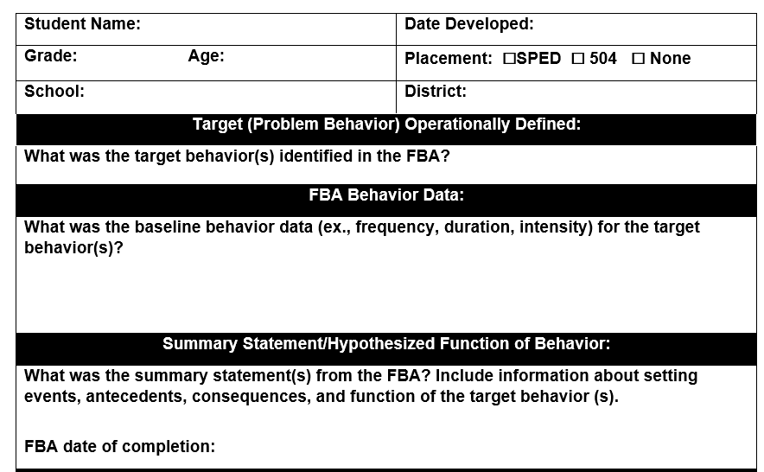
Blank BIP Template
Notes:
This form is provided in the Facilitator Guide.

Slide 14
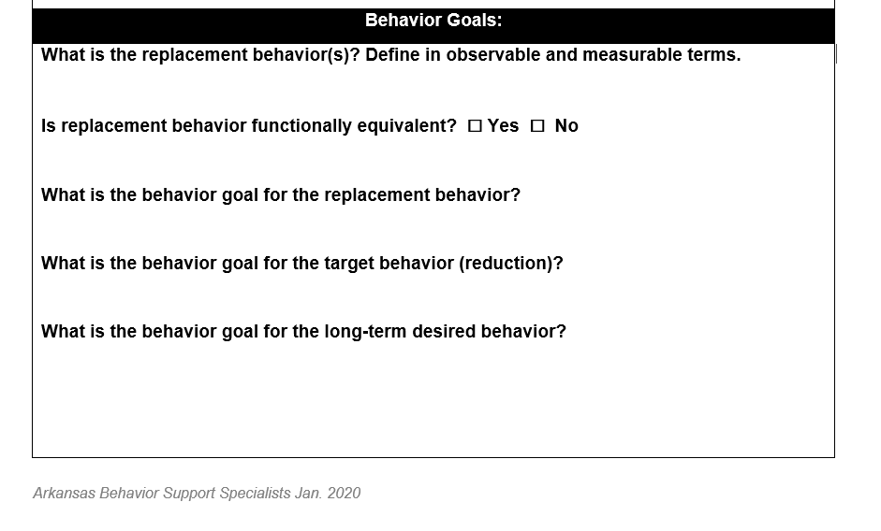
BIP Template

Slide 15
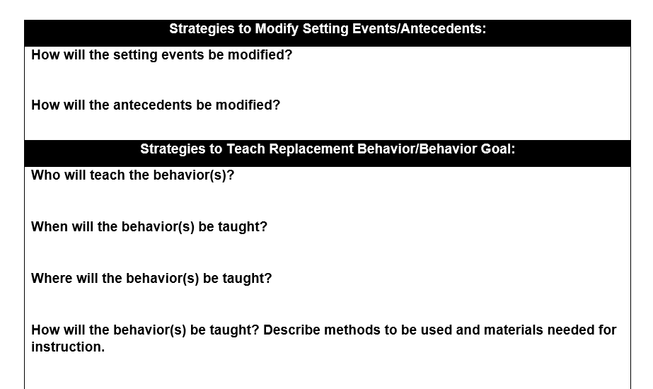
BIP Template

Slide 16
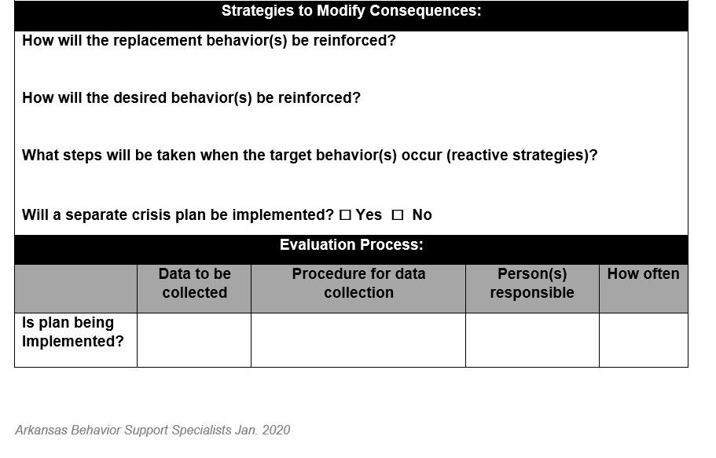
BIP Template

Slide 17
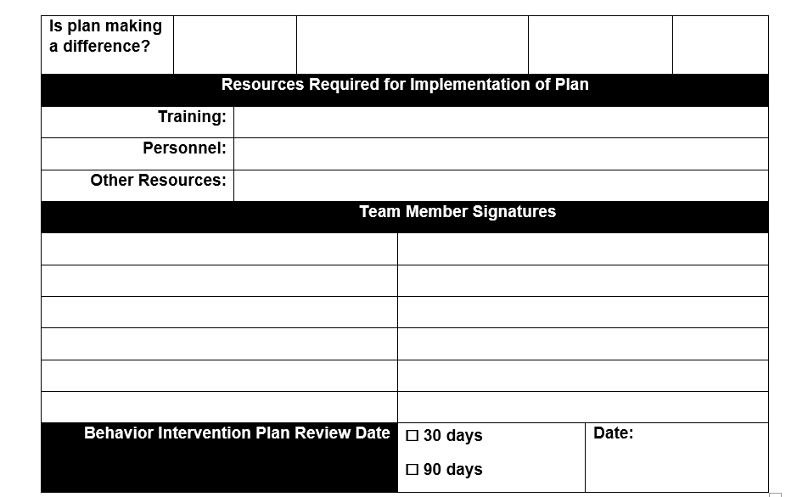
BIP Template

Slide 18
Setting Behavior Goals for the BIP

Slide 19
Goal of the BIP
Ultimately the goal is to move the student away from the undesirable behavior and towards meeting the school and classroom expectations.

Slide 20
Competing Behavior Pathway
Once a Summary Statement is developed, we can complete a competing behavior pathway:
Change the routines or environments to make the problem behavior less likely to occur
Identify a short-term alternative behavior that will move the student closer to the behavior we ultimately want
Determine a consequence that will make the alternative behavior more rewarding than the problem behavior
Notes:
The purpose of the competing behavior pathway is threefold:
Highlight the importance of building the behavior intervention plan around the summary statement.
Identify competing behavioral alternatives to the problem behavior
Determine strategies for making the problem behavior ineffective, inefficient or irrelevant through changes to the routine or environment. (Crone & Horner, 2003)

Slide 21
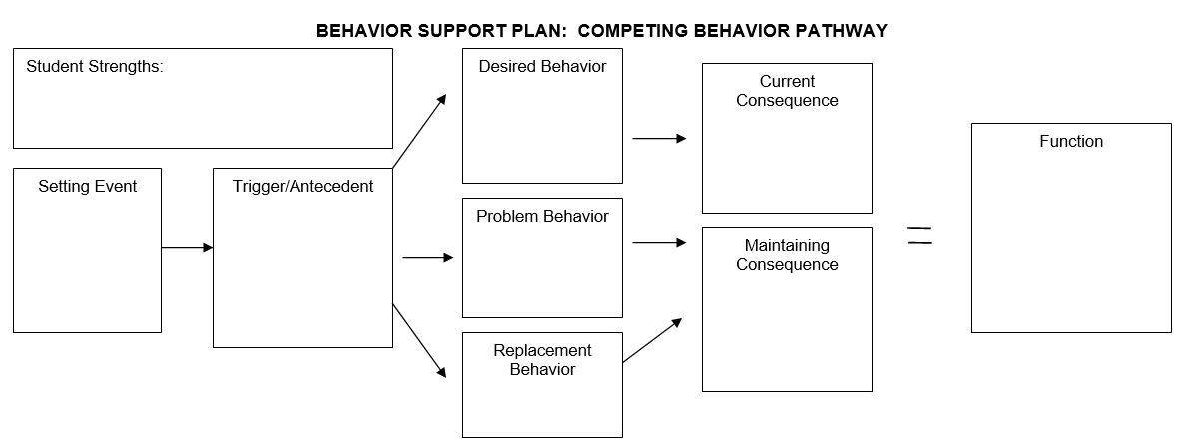
Template: Competing Behavior Pathway
Notes:
This template is available in the Facilitator Guide.
This template will help teams develop the competing behavior pathway.
This is a visual representation of the information on slide 14.

Slide 22
Create Behavior Goals
Set behavior goals…
for increasing the short-term replacement behavior
for reducing the target behavior
for reaching the long-term desired behavior
Define the short-term replacement behavior in observable and measurable terms and ensure that the replacement behavior is functionally equivalent to the target (problem) behavior.
Notes:
The competing behavior pathway defines a short-term replacement behavior that we can live with while the student works towards the long-term desired behavior.

Slide 23
Short-term Alternative Behavior
Actively begins breaking student’s habit of using problem behavior
Replaces target behavior with an acceptable alternative behavior
Meets the student’s needs (function of behavior)
Discontinued when student masters desired behavior
Notes:
The gap may be very wide between the desired behavior and what the student is currently doing. A short-term alternative behavior helps to move the student the correct direction by giving stepping stones to get there.
Short-term alternative behaviors will be discontinued once the student has mastered that step consistently and can be reasonably expected to perform the longer-term expectation.
When the student performs the desired replacement behavior, staff considers how the new behavior meets the student’s needs and how it will be reinforced.

Slide 24
Why Use a Short-term Alternative Behavior?
Reduces disruption and potentially dangerous behavior in the classroom
Serves the same function as the problem behavior
Is easier and more efficient than the problem behavior, and is socially acceptable
Provides quicker, more reliable access to desired outcomes than the problem behavior

Slide 25

Table Talk
What short-term alternative behaviors might you use for Aiden?
Aiden’s Summary Statement:
  “In unstructured settings, when a peer makes a direct comment to Aiden, Aiden will kick the peer in the shin, resulting in the teacher calling the counselor, who escorts Aiden out of the room, allowing him to escape social interactions with peers.

Slide 26
Long-term Desired Behavior
Using the FBA summary statement, identify the long-term desired behavior(s).
Desired behavior(s) should align with the school-wide behavior expectations and classroom expectations and rules.
Notes:
In schools that implement PBIS, the goal of all three tiers is to support students in meeting the school-wide expectations.

Slide 27
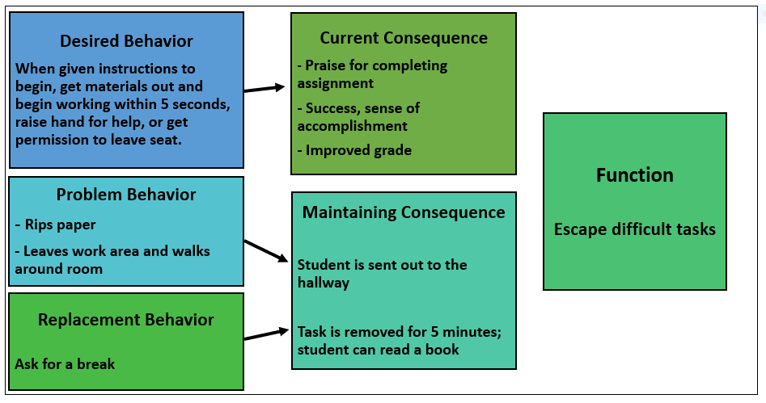
Example: Competing Behavior Pathway
Setting Event
Forgot math homework at home
Antecedent
Teacher asks students to begin a task that is difficult for this student
Notes:
There will be an activity in the Facilitator Guide to allow participants to practice completing this sequence with our case study, Aiden.
In this example, the student can remove themself from the difficult task with the short-term alternative behavior of asking for a break.
This breaks the cycle of the disruptive behavior but does not yet reach the desired behavior for the completed work.
The maintaining consequence reinforces the completed work and not the break.
The short-term alternate behavior DOES meet the function and therefore enables the student to have their need met in a more socially acceptable and less disruptive manner.
It should be noted that the maintaining consequence is only effective at reinforcing the desired replacement behavior if it is known to be motivating to the student.

Slide 28
Guiding Questions for Developing Outcome Measures
Which target behaviors do we want to increase – both desired and replacement? Can staff realistically measure these? How?
Which target behaviors do we want to decrease? Can staff realistically measure these? How?
What are present levels of performance of the behaviors above?
What are the desired (long-term) and acceptable (short-term) target goals and timelines?
Are outcome goals specific, measurable, and realistic?
Notes:
Which target behaviors do we want to increase – both desired and replacement? Can staff realistically measure these? How?
Which target behaviors do we want to decrease? Can staff realistically measure these? How?
What are present levels of performance of the behaviors above?
What are the desired (long-term) and acceptable (short-term) target goals and timelines?
Are outcome goals specific, measurable, and realistic?

Slide 29
Identifying Intervention Strategies

Slide 30
Identify Intervention Strategies
Develop intervention strategies that address the functions of the student’s problem behavior.
Intervention strategies will help to…
  Modify the setting event and antecedent of the behavior
  Teach the student appropriate replacement behaviors
  Modify consequences to strengthen replacement and desired behaviors
Notes:
The team should develop intervention strategies that address the functions of the student’s problem behavior: seeking attention, avoiding attention, avoiding situations/tasks.
The intervention strategies will help to…
Modify the setting event and antecedent of the behavior
Teach the student appropriate replacement behaviors
Modify consequences to strengthen the desired behavior

Slide 31
Modify the Antecedent
Teams can modify conditions that typically cause a behavior to occur.
These “antecedent strategies” help prevent the problem behavior.

Slide 32
Select Teaching Strategies
Teams select teaching strategies based on the student’s skill deficits.
Teaching strategies focus on teaching functionally equivalent replacement behaviors.

Slide 33
Select Consequence Strategies
Teams can develop consequence strategies that encourage students to use the replacement behavior instead of the targeted behavior, and still get the desired outcome.

Slide 34
Selecting Strategies
Strategies should be matched to the function of the student’s behavior:
  Sensory
  Escape/Avoid
  Attention
  Tangibles
Notes:
The following slides give examples of antecedent strategies that can be used to prevent behaviors that serve three main functions: seeking attention, avoiding attention, and avoiding tasks.

Slide 35
Intervention Strategies
Antecedent
Teaching
Consequence

Slide 36
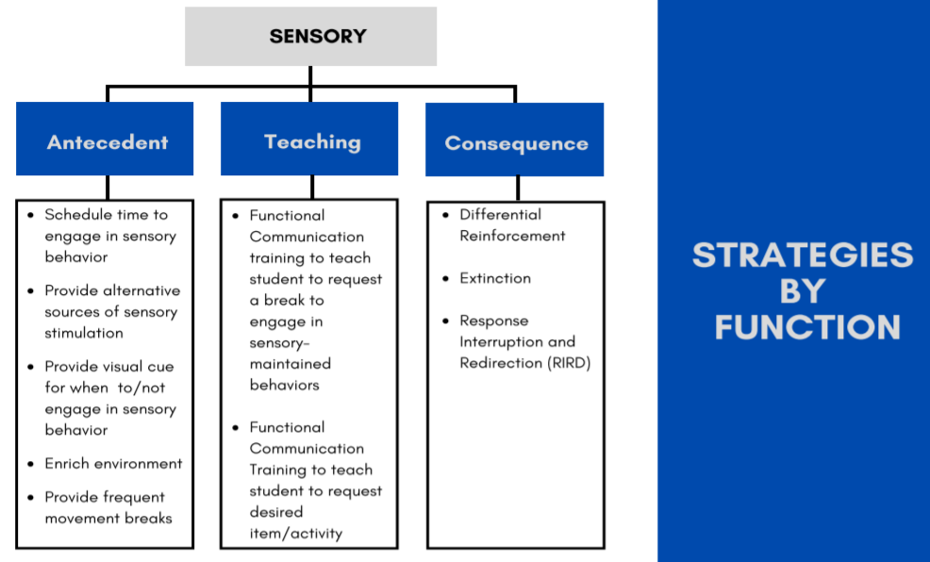
Notes:
Target behaviors may sometimes function to gain sensory stimulation.
This table provides some evidence-based strategies that may be used to address target behaviors serving this function, but does not provide an exhaustive list of strategies from the literature.
Strategies are divided into antecedent strategies, used to prevent occurrence of the target behavior, teaching strategies (focused on teaching functionally-equivalent replacement behaviors), and consequence strategies (focused on reinforcing replacement and desired behaviors, as well reducing occurrence of the target behavior).
Antecedent strategies will focus mainly on enriching the environment with appropriate items/activities, scheduling times to engage in safe sensory-maintained behaviors, and/or providing alternative forms of sensory stimulation. For example, a student who pinches their own arm might be taught to manipulate Playdoh or a stress ball. Or offer an iPad to a student to provide auditory or visual input.
Teaching replacement behaviors for a sensory function most often will involve teaching the student to request a break to engage in safe sensory behavior OR teaching the student to request a desired item to manipulate.
Review consequence strategies in the table.
For sensory behaviors, differential reinforcement might involve providing a desired item when requested, providing a break to engage in sensory behaviors when requested, or providing access to sensory behaviors when the student has refrained from engaging in these behaviors for a set amount of time.
Extinction for sensory behaviors is very difficult to implement and often not feasible. When using this strategy, consultation with a specialist may be needed to ensure safety for the student and/or others working with the student.
RIRD involves interrupting a repetitive sensory behavior and then redirecting the student to engage in a more appropriate behavior. For example, a student who repetitively chews on their fingernails or shirt sleeves might be redirected to chew gum.
Source for Examples:
Planning intensive interventions (tier 3) function based interventions (2014, April). Appendix A. National Center on Intensive Intervention at American Institute for Research, p. 1-20. Retrieved on December 9, 2023 from https://lawrencecountyesc.com/wp-content/uploads/2023/02/Planning-Intensive-Function-Based-Behavior-Interventions-AIR-CEC2014.pdf

Slide 37
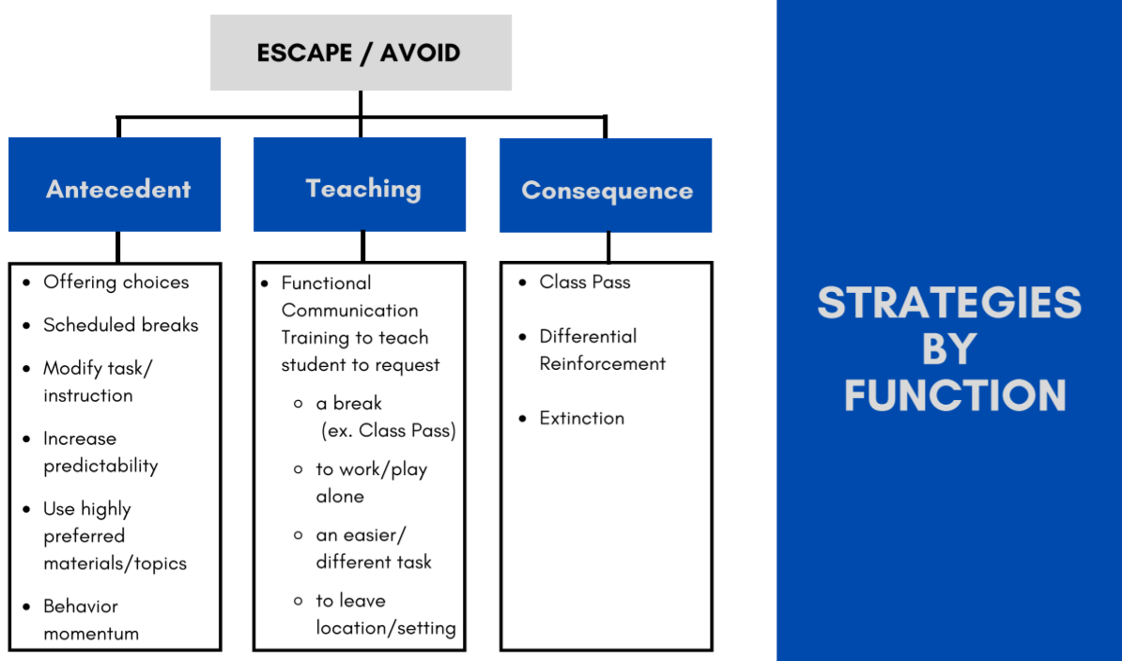
Notes:
Target behaviors may sometimes function to allow students to escape or avoid demands, tasks, social interaction, and/or a location/setting.
This table provides some evidence-based strategies that may be used to address target behaviors serving this function, but does not provide an exhaustive list of strategies from the literature.
Review antecedent strategies from the table. Examples/more details for each are provided below.
BEFORE the target behavior occurs discrete choices should be provided. For example, the student could be given a choice of a writing utensil, task order, location for completing task, when to complete a task, how to complete the task - type responses or write on paper, etc.
Scheduled breaks during which no demands and/or social interaction occurs may help reduce target behaviors that are maintained by escape or avoidance.
Modifying the task/instruction could include having the student work alone rather than with peers, reducing task difficulty and/or length, changing the words, facial expressions, and/or tone of voice you use to give instructions (ex. Saying, “Do this math worksheet now.” versus “It’s time to complete this math worksheet.”), changing the format or mode of output for the task, etc.
Use of a visual schedule or other visual cues may increase predictability for the student.
Incorporating student interests into tasks/activities can reduce escape behaviors. For example, if a student that is interested in Sponge Bob, you may have their essay topic involve Sponge Bob.
Behavior momentum involves providing an easy task/instruction prior to a more difficult task/instruction.
Teaching replacement behaviors for an escape/avoid function most often involves teaching the student to request a break, request to be alone, request to leave a location/setting, and/or request a different/easier task.
Review consequence strategies in the table.
Class pass involves providing the student a set number of break cards each day that can be handed in by the student to receive a break (inside or outside the classroom). Unused passes can be exchanged for access to preferred items/activities at a designated time. Class pass provides an example of a teaching strategy because the student is taught an appropriate break request. Class pass is also an example of a consequence strategy because requesting a break is reinforced by providing access to the break when requested. Also, saved passes (engaging in the desired behavior of participating in assigned tasks) is reinforced by access to preferred items/activities.
For escape/avoidance behaviors, differential reinforcement might involve providing a break from a task or social interaction or providing a different task when appropriately requested. This could also involve providing a break from tasks and/or social interaction when the student has refrained from engaging in the target behavior for a set amount of time.
Extinction for escape behaviors is very difficult to implement and often not feasible. This strategy involves keeping a demand/task in place until the student complies with the demand/task. When using this strategy, consultation with a specialist may be needed to ensure safety for the student and/or others working with the student.
Source for Examples:
Planning intensive interventions (tier 3) function based interventions (2014, April). Appendix A. National Center on Intensive Intervention at American Institute for Research, p. 1-20. Retrieved on December 9, 2023 from https://lawrencecountyesc.com/wp-content/uploads/2023/02/Planning-Intensive-Function-Based-Behavior-Interventions-AIR-CEC2014.pdf

Slide 38
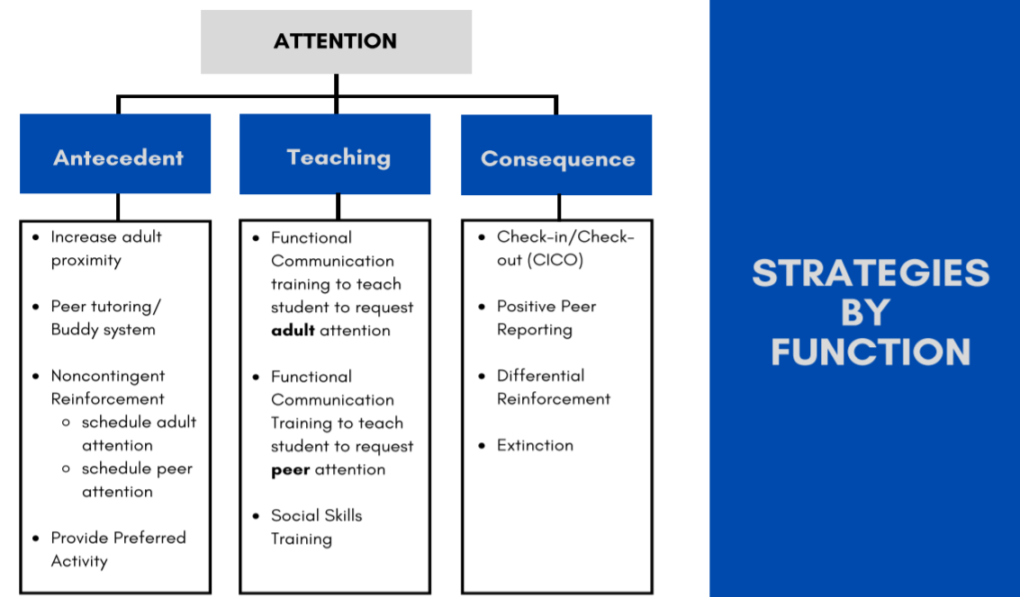
Notes:
Target behaviors sometimes allow the student to gain adult and/or peer attention.
This table provides examples of different types of interventions that may be most effective when the function of the target behavior is to gain attention.
This is not an exhaustive list of appropriate interventions for attention maintained behaviors, but provides several examples of evidence-based strategies.
Review list of antecedent strategies in table. Here are examples of how you might arrange some of these antecedent strategies in the classroom:
Have adult work with student
Have adult periodically provide attention
Increase positive interactions with student
Provide increased specific praise for appropriate behavior
Pair student with a peer
Use peer tutoring
Move seating arrangement
Periodically move about classroom
When adult is occupied and unable to provide attention, assign a more preferred activity
Review list of teaching strategies in table. The important thing here is to remember that any replacement behavior you teach needs to allow the student to gain peer and/or adult attention in a more socially appropriate way.
Review list of consequence strategies in table.
Positive peer reporting involves teaching students how to appropriately give praise to peers. The target student receives peer praise for appropriate behaviors.
Differential reinforcement involves providing attention only following appropriate behaviors.
Extinction would involve providing no attention when the target behavior occurs.
Source for Examples:
Planning intensive interventions (tier 3) function based interventions (2014, April). Appendix A. National Center on Intensive Intervention at American Institute for Research, p. 1-20. Retrieved on December 9, 2023 from https://lawrencecountyesc.com/wp-content/uploads/2023/02/Planning-Intensive-Function-Based-Behavior-Interventions-AIR-CEC2014.pdf

Slide 39
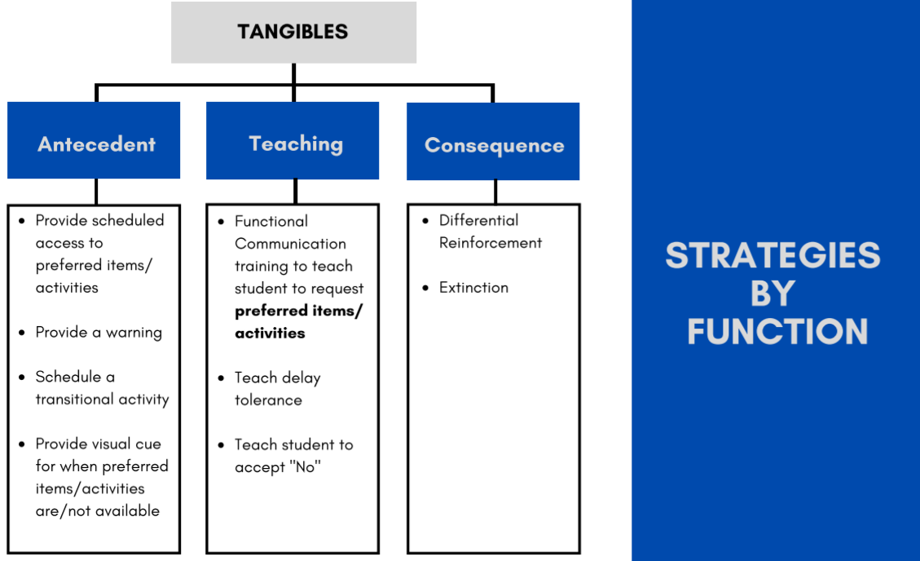
Notes:
Target behaviors may sometimes allow students to gain access to preferred items/activities.
This table provides some evidence-based strategies that may be used to address target behaviors serving this function, but does not provide an exhaustive list of strategies from the literature.
Review antecedent strategies from the table.
Schedule times throughout the day where the student is given access to preferred items/activities.
When a student has access to preferred items/activities, provide a verbal, auditory, or visual cue to warn the student that it will soon be time to end access to the preferred item/activity.
When transitioning from a preferred item/activity to a non-preferred activity, it can be beneficial to schedule a moderately preferred activity in the middle. For example, a student might be given the transitional activity of passing papers out to the class when transitioning from free time on the computer to writing an essay.
Proving a visual schedule or other visual cue to indicate when preferred items/activities are available and when they are not may be beneficial.
Teaching a replacement behavior for a tangible function involves teaching the student to request preferred items/activities. It is important to consider the student’s developmental level and overall language skills when determining the form the request will take. For example, many students can be taught vocal requests using words, but some students may need to be taught to point/gesture, exchange a picture, or use a sign to request a preferred item/activity.
After the student can consistently request preferred items/activities, they may need explicit instruction in tolerating a delay to access the requested item/activity, as well as explicit instruction in how to appropriately accept “no” in response to a request for a preferred item/activity.
Review consequence strategies in the table.
Differential reinforcement in this case will involve providing access to preferred items/activities when appropriate requests are made AND/OR when the student has refrained from engaging in the target behavior for a specified period of time.
Extinction can be implemented by ensuring that the student does not obtain access to the preferred items/activities following occurrence of the target behavior.
Source for Examples:
Planning intensive interventions (tier 3) function based interventions (2014, April). Appendix A. National Center on Intensive Intervention at American Institute for Research, p. 1-20. Retrieved on December 9, 2023 from https://lawrencecountyesc.com/wp-content/uploads/2023/02/Planning-Intensive-Function-Based-Behavior-Interventions-AIR-CEC2014.pdf

Slide 40
General Behavior Strategies
Antecedent Strategies
  Social Narratives
  Priming
  Premack Principle
Teaching Strategies
  Small Group Social Emotional Learning
Consequence Strategies
  Behavior Contract
  School-Home Note
  Self-Management; Self-Monitoring
Notes:
Some behavior interventions can be beneficial for any function of behavior.
These behavior interventions may be used at Tier 1 or Tier 2, or included as part of a comprehensive support plan for a student at Tier 3.
Antecedent strategies may increase the likelihood of desired behaviors and/or decrease the likelihood of the target behavior.
Teaching and consequence strategies may focus on teaching and reinforcing desired (long-term goal) behaviors.
Some of these consequence strategies may also be used to reinforce replacement behaviors (such as behavior contract or school-home note).
For instructional modules (including implementation checklists) for each of these general behavior strategies, visit AIM (https://autisminternetmodules.org/), AFIRM (https://afirm.fpg.unc.edu/), or ARBSS (https://arbss.org/courses-2/).

Slide 41
Considerations for Limiting Problem Behavior
Work towards extinction: systematically avoid previously used consequences that reinforced the target behavior.
If it’s not possible or practical to completely avoid a reinforcing consequence, use strategies that limit the quality of reinforcement.
Notes:
Quality can refer to type of, frequency of, immediacy of, or duration of reinforcer; amount of time since student has had access to the reinforcer; etc.

Slide 42
Table Talk
What antecedent strategies could you use to help move Aiden towards his replacement behavior goals?
Aiden’s Summary Statement:
  “In unstructured settings, when a peer makes a direct comment to Aiden, Aiden will kick the peer in the shin, resulting in the teacher calling the counselor, who escorts Aiden out of the room, allowing him to escape social interactions with peers.

Slide 43
Implementing and Evaluating the BIP

Slide 44
Guiding Questions for Implementation
Who will implement each BIP component?
  What are the specific tasks and resources (e.g., time, training, coaching, materials) required to embed the BIP into daily routines?
Who will collect data?
What criteria will determine mastery of skills?
How often will data for each measure need to be collected?
Which existing procedures and resources for data collection are available?
What are the back-up plans when tasks can’t be done?

Slide 45
Fidelity of Implementation
To ensure fidelity of implementation, make sure staff…
  Are adhering to the BIP exactly as it is written
  Have all the training they need
  Have all the resources they need
  Are responding to any necessary changes
Notes:
Questions to consider when developing fidelity measures for BIP:
What are the critical BIP components most likely to impact student behavior?
How will staff measure fidelity of these components?
What level of fidelity is considered acceptable and when should this goal be met?
How will staff let us know when and how they’ve had difficulty implementing the plan?
Are fidelity goals specific, measurable, and realistic?

Slide 46
Evaluating a BIP
In order to evaluate a BIP, these questions need to be answered:
Is the BIP being implemented as it was intended?
    This question speaks to the fidelity of implementation.
    If the answer is no, changes need to be made so that all components of the BIP are being implemented as written.
Is the BIP making a difference in the students’ behavior?
    This question speaks to the appropriateness of the strategies chosen.
    If the answer is no, different strategies need to be put in place.
Notes:
There are Tier III fidelity tools available. Here are some examples:
BIP-IT from Missouri: https://pbismissouri.org/wp-content/uploads/2020/09/BIP-IT_6.1.zip
I-SWIS from PBISApps: https://www.pbisapps.org/products/i-swis

Slide 47
Student Response to the Intervention(s)
To measure the student’s response to the intervention, make sure staff…
  Set a goal that is specific and measurable so that data can be collected
  Are collecting the data needed to determine whether the intervention is working
Notes:
For a student who avoids tasks and fails to complete independent work tasks, an example of a measurable behavior goal would be “During independent work time, Glenn will complete shortened assignments within the allotted time frame 4 out of 5 days per week”.
Data are collected by the classroom teacher assigning the task by evidence of completed work with a notation of time spent on the task or time needed to complete. Example: notation on assignment assigned at 10:25 completed at 10:50 allotted 30. 10:25/10:50/30 or entered into a documentation log.

Slide 48
Other Evaluation Considerations
Another question that needs to be part of the BIP evaluation is whether it has Social Validity. To measure this, staff need to ask…
  Whether the goals are acceptable, socially relevant, and useful to the student and the student’s family
  Whether the staff implementing the BIP have established a relationship with the student
  Whether any improvements are needed

Slide 49
To Achieve Generalization and Maintenance
Plan to continue teaching the skill for a sufficient amount of time for the student to achieve mastery.
Provide multiple examples of the new skill with variations.
Ensure multiple opportunities for the student to display and receive recognition for use of the new skills.
Determine whether the student is using the new skills in more than one environment.
Notes:
Students can demonstrate the ability to perform a new behavioral skill under controlled conditions, but for the skill to reach mastery it must be demonstrated in various environments and situations.
Once mastery criteria have been reached, the new skill can be maintained by giving the student self-management and self-monitoring opportunities.
The student may use self-management forms or eventually given reflection surveys and compare with observational data from staff.
Peers may be used in this stage as appropriate with positive peer reporting or class wide supports.

Slide 50
Table Talk
Using the strategies you brainstormed for Aiden, how would you evaluate Aiden’s Behavior Intervention Plan?
Aiden’s info:
  makes inappropriate comments to his peers (e.g., “You are stupid!”) in the cafeteria
  refuses to sit in his seat on the bus
  observed being alone in these settings
  function of behavior: escape from social interactions in unstructured settings with peers

Slide 51
Case Study

Slide 52

Review: Aiden
Seven-year-old 2nd grade student
Referred to the behavior support team for Tier III intervention by his classroom teacher, Mr. Jones, for continued disruptive and disrespectful behavior in the classroom, cafeteria and school bus.
Receiving social skills through Big Buddy mentoring with improvement in his core classes.
After interviewing Mr. Jones and conducting several observations of Aiden, the team determined that during unstructured settings Aiden is unable to follow expectations and engage in appropriate interactions with his peers.
He shouts inappropriate comments to his peers (e.g., “You are stupid!”), cusses at his teacher, and throws classroom materials.
Based on the data collected, the team agreed that the function of Aiden’s behavior is to escape from social interactions in unstructured settings with peers.
Notes:
We have been following Aiden’s journey throughout the Tier III modules.
Aiden is a 7-year-old 2nd grader at University Heights Elementary School who was first identified for interventions due to aggressive behaviors and disengagement in the classroom. Aiden’s behaviors: throwing classroom materials, cussing at teacher, and shouting at peers.
Due to the severity of the behavior problems Aiden displayed, he was referred to the school building level committee for Tier II interventions.
Based on data decision rules, Aiden met the threshold for Tier II supports.
After looking at data and doing observations to determine the function of behavior, it was decided by the team that Aiden would begin Big Buddy mentors for three days per week for social skills training.
After six weeks of participating in this training, Aiden continued to display the same behaviors, and the classroom behaviors generalized and intensified to the cafeteria, school bus, and at home.
The Team reviewed the data and determined Aiden met the criteria for Tier III interventions.
An Action Team was formed to gather observational and interview data to be used in conducting a Functional Behavior Assessment.
Based on the data, the team determined that the Function of Aiden’s behavior was to avoid unstructured settings with peers.
The team will now use this hypothesis about the function of Aiden’s behavior to write and implement a Behavior Intervention Plan.

Slide 53
Action Team BIP Meeting 1
Team met to review the Summary Statement from the FBA and determined that a BIP is needed for Aiden.
They begin by creating a short-term alternate behavior goal to move Aiden closer to the desired behavior: Aiden will request to sit alone for brief amounts of time when he becomes frustrated with his peers.
They create a long-term behavior goal for Aiden: Aiden will engage appropriately with his peers in unstructured settings.
Notes:
Here is a sample document used for developing a BIP: https://dese.mo.gov/media/pdf/fba-pt-3-blank-behavior-intervention-plan-exp-2

Slide 54
Action Team BIP Meeting 2
During this meeting, the team develops intervention strategies for Aiden. These strategies fall into 3 categories:
Antecedent Strategies (e.g., offer Aiden a preferred activity during unstructured classroom times (e.g., before class starts))
Teaching Strategies (e.g., teach Aiden to appropriately request a break from sitting / engaging with peers in the classroom)
Consequence Strategies (e.g., if Aiden engages successfully with peers for a specified time in the cafeteria, he can choose to spend the remainder of lunch eating separate from his peers)
Notes:
Note that the team needs to make sure those who are responsible for implementing these strategies have all the training they need, and they develop a data collection plan so they will be able to evaluate whether the strategies are working.

Slide 55
Implementing the BIP
Professional development is provided to staff that will be supporting Aiden’s BIP. This includes fidelity of implementation and use of data collection forms.
The strategies developed by the team are implemented in the cafeteria and in the classroom.
The data are collected daily, and the data manager reviews trends weekly.

Slide 56
Action Team BIP Meeting 3
Aiden’s interventions have now been in place for a month. The team meets to evaluate whether the BIP is working.
They review the data (number of times Aiden has engaged in problem behavior, number of times Aiden has been observed practicing his new skills, etc.).
Aiden’s behavior has shown some improvement. A fidelity check was done to make sure the interventions are being implemented correctly before modifying the strategies to target additional improvements.
The data reveal that the new consequences were not applied consistently. They provide training to correct the inconsistency.

Slide 57
Two Months Later…
Aiden has now been receiving interventions for 12 weeks.
Now that the plan is being implemented with fidelity, Aiden has shown great improvement. He is beginning to generalize the long-term desired behavior.
The team decides to interview Aiden and his homeroom teacher to check the social validity of the interventions.

Slide 58
Do It With Fidelity!
Tiered Fidelity Inventory (TFI)
Section 3.11: Comprehensive Support
Section 3.15: Data-based Decision Making
Notes:
Have attendees review TFI Items 3.11 and 3.15 and assess where they are right now. Record any actions that need to be taken to improve their score for each item.

Slide 59
3.11 Comprehensive Support
Feature | Data Sources | Scoring Criteria
 |  | 0 = Not implemented 1 = Partially implemented 2 = Fully implemented
Comprehensive Support: Behavior support plans include or consider (a) prevention strategies, (b) teaching strategies, (c) strategies for removing rewards for problem behavior, (d) specific rewards for desired behavior, (e) safety elements where needed, (f) a systematic process for assessing fidelity and impact, and (g) the action plan for putting the support plan in place. | Three randomly selected Tier 3 behavior support plans created in the last 12 months (see TFI Tier 3 Support Plan Worksheet) | 0 = No plans include all seven core support plan features, or there are no Tier 3 support plans. 1 = One or two plans include all seven core support plan features. 2 = All plans include all seven core support plan features.
Main Idea: Individualized interventions need specific components in order to be most effective.

Slide 60
3.15 Data-based Decision Making
Feature | Data Sources | Scoring Criteria
 |  | 0 = Not implemented 1 = Partially implemented 2 = Fully implemented
Data-based Decision Making: Each student’s individual support team meets at least monthly (or more frequently if needed) and uses data to modify the support plan to improve fidelity of plan implementation and impact on quality of life, academic, and behavior outcomes. | Three randomly selected Tier 3 behavior support plans created in the last 12 months (see TFI Tier 3 Support Plan Worksheet) | 0 = Student individual support teams do not review plans or use data. 1 = Each student’s individual support team reviews plan, but fidelity and outcome data are not both used for decision making or not all teams review plans. 2 = Each student’s individual support team continuously monitors data and reviews the plan at least monthly, using both fidelity and outcome data for decision making.
Main Idea: Teams need to regularly review fidelity and outcome data to identify how Tier 3 supports should be altered.

Slide 61
Resources
School Wide Tiered Fidelity PBIS Training Deck: https://www.pbisapps.org/resource/tfi-training-slide-deck-tier-3
National Center on PBIS: http://www.pbis.org/
National Center on Intensive Intervention: https://intensiveintervention.org/
Missouri SW-PBIS Tier III Team Workbook: https://pbismissouri.org/tier-3-workbook-resources/

