Slide 1
Developing PBIS Behavioral Expectations
Module 5
Notes:
Images in this module were obtained at google.com/images unless otherwise specified.
Trainer Notes:
In general, the purpose of PBIS is to provide systems of supports for improving social, emotional, and academic outcomes for ALL students. This module will go through the process of developing common behavioral expectations. These become the foundation for building systems for teaching and acknowledging the expected behaviors.

Slide 2
Behavioral Expectations
PBIS is about cultural change.
Cultural change occurs through behavior change.
  Not random individual behaviors
  Behaviors that reflect values
Values reflected in small number of behavioral expectations
Notes:
Cultural change has to be systematic, focusing on the critical values first. Behavioral expectations are three to five brief, positively stated values that exemplify the type of behavior schools want to see everyone displaying in the school. They are generally broad statements that reflect the values or behavioral concepts that are held as important to a school and its community. These expectations say, “This is what we value and strive to reach on a daily basis.”

Slide 3
Purpose Of Expectations
Express beliefs/vision/mission of your school.
Define how everyone should treat each other.
Establish a basis for teaching behavior.
Notes:
The school’s mission statement typically outlines goals for student achievement and how the school will help students meet those goals. Behavioral expectations give schools a highly visual reminder of their common goals and the types of behavior that will be conducive to meeting those goals. They will guide schools in defining the specific behaviors they would like everyone in the school to use, and they will be the foundation for developing a plan for teaching students’ behavior.

Slide 4
Without Clear Behavioral Expectations…
Teachers individually determine acceptable social behavior.
There is inconsistent teaching and monitoring.
Cannot teach correct behavior without clear, consistent expectations
Notes:
Without a behavior curriculum or roadmap to follow, it is typically up to the individual teacher to determine what behavior is encouraged and allowed, and this determination is primarily made based upon personal levels of tolerance. As a result, there are wide variations of acceptable behavior throughout a building. Inconsistency in our response to student behavior is understandably very confusing for students. Establishing school-wide behavioral expectations in a school serves as a roadmap to follow for consistency and giving students a clear and consistent picture of which behavior is acceptable and which is not.

Slide 5
Start By Making A Commitment To:
Address school-wide issues
Develop specific, positively stated values
  Proactive/preventive discipline
  Common language
Create predictable environment
Ensure support from administration
Notes:
In order to begin developing the behavioral support systems that schools would like to see, it is important for everyone across the school, in all areas of the school, to be committed to a common discipline philosophy. Everyone needs to be on the same page. Once everyone is on board with a proactive, preventive philosophy, schools can create an environment where everyone understands the language and knows what to do. Before you can expect students to change their behavior, adults need to change the way they approach and respond to student behavior.

Slide 6
Critical Considerations
Your school’s mission or vision
Your school’s values
Your school culture and climate
Your students’ behavior
Notes:
It’s important to consider several critical factors when determining what behaviors will be expected of your students and staff. This has to be personal to your school or district.

Slide 7
What Are Your School’s Values?
Based on your school’s mission or vision statement, what values are most important?
Notes:
Ask teams to look at their mission statement or vision statement and highlight some key words that could define overarching goals for behavior.

Slide 8
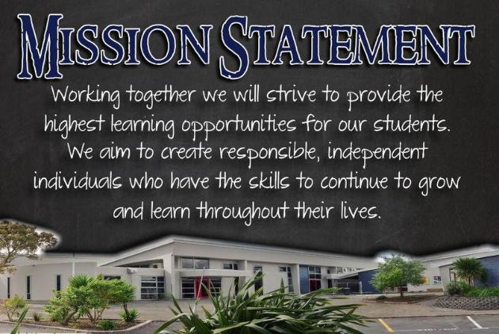
Examples
Notes:
In this example, we pulled out some values: working together, providing learning opportunities, creating responsible, independent individuals, and giving students skills to be life-long learners. Behavior expectations will be for EVERYONE at the school, not just students.

Slide 9
From The Example
Values are clear.
  Responsible
  Independent
  Skillful
  Growth Oriented
  Learning Oriented
Notes:
From these, a subset of values or behavioral expectations can be selected.

Slide 10
Think About Your School Environment
Do students know what to do in every setting?
Do physical or scheduling situations disrupt the flow?
Do teachers consistently enforce rules and procedures?
Are all children treated the same way?
Notes:
These are some good questions to get teams thinking about their current environment. PBIS starts with changing adult behavior by creating consistency in how adults interact with students and address student behavior.

Slide 11
How Is Behavior In Your School?
What are the most common classroom misbehaviors?
What are the most common office referrals?
Notes:
Another consideration in developing behavioral expectations is to think about what behaviors you would NOT like to see anymore, and work on teaching students a desirable replacement behavior (expected behavior). For instance, if students are often sent to the office for disruption, you might want to work to replace that behavior with “be respectful”. Have teams look at past data for things that stand out.

Slide 12
Guiding Questions
On what three to five general behavioral expectations do you want to focus?
Do those expectations fit with your mission?
Do they compete with unwanted behaviors?
Notes:
Have teams look at their list of values and behaviors that they would like to see in their school, using these guiding questions to refine the list.

Slide 13
Examples Of Expectations
Be responsible
Be respectful
Be prepared
Be safe
Be accountable
Participate
Cooperate
Be productive
Have integrity
Be proud
Be kind
Be caring
Make wise choices
Be positive
Make an effort
Be dependable
Notes:
Here are some examples of overarching behavior goals. Share with teams to help them in framing their expectations.

Slide 14
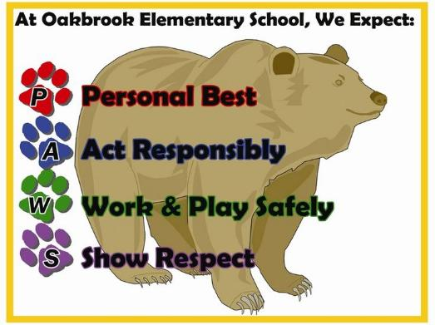
Examples
Be creative!
Use your school colors,
school mascot, or some
other easily identifiable
theme.
Notes:
Here is an example of a set of expectations that a school chose and how they incorporated their school mascot. Teams can be creative! Encourage them to keep it simple and something that will be easy for everyone to remember, but also stay true to the school’s values and the behaviors that they want to see in their school.

Slide 15
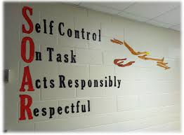
Notes:
Here is an example of a high school building’s four school-wide expectations.

Slide 16
Collaborate!
Include all staff in developing expectations
Share data, discuss mission statement
Offer a list of choices of expectations
Take a vote!
Surveys are available on the web.
Notes:
Because the expectations will be reflecting the beliefs and values of the school community, it is important to include all staff in the decision-making process. Once the team has studied the school’s mission statement and discipline data, they should share these with the entire staff and give them an opportunity to vote which enhances buy-in. The team can use the results of the vote to make the final decision on what the three to five expectations will be.

Slide 17
Turning Expectations Into Behaviors
What does it look like to “be responsible” or “be respectful”?
  What does it look like to be responsible in the hallway?
  What does it look like to be respectful in the bathroom?
  What does it look like in different classrooms (e.g., band room vs. the science lab)?
Notes:
The next step is to define expectations so that students know what to do. The desired behaviors may look different in different settings. For example, being respectful on the playground will look very different than being respectful in the cafeteria. On the playground, it might involve sharing equipment, while in the cafeteria it may be things like throwing away trash. From classroom to classroom, teachers may have different behaviors that reflect the expectations (although some consistency is important). Classroom teachers will need to think about settings and transitions within the classroom that will require different behaviors.

Slide 18
Expectations vs. Behavior Rules
Expectations
    Three to five overarching school-wide expectations
Behavior Rules
    Specific tasks students are to do to achieve school-wide expectations
Notes:
Once you have your expectations, it’s time to define what they look like in various settings by creating a behavior matrix that includes specific behavior rules for each setting. Behavior rules tell students specifically what to do in order to meet the behavior expectation in each setting. For instance, if the behavior expectation is “be responsible”, the behavior matrix may include “arrive on time” as a behavior rule for being responsible in the classroom.

Slide 19
Guidelines For Defining Behaviors
Use POSITIVE language (what to do).
Be brief.
Use simple language.
Use pictures for very young children.
Use STUDENT VOICE (in secondary).
  Definition needs to be observable and measurable.
Notes:
These are guidelines to remember when turning your school-wide expectations into behaviors. The behavior rules need to be short, positively stated, observable, and measurable.

Slide 20
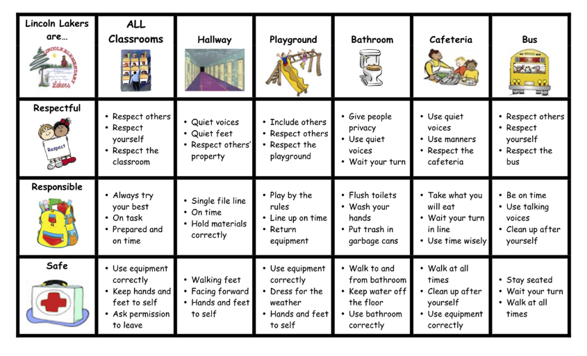
School-wide Matrix
Notes:
These are guidelines to remember when turning your school-wide expectations into behaviors. The behavior rules need to be short, positively stated, observable, and measurable.

Slide 21
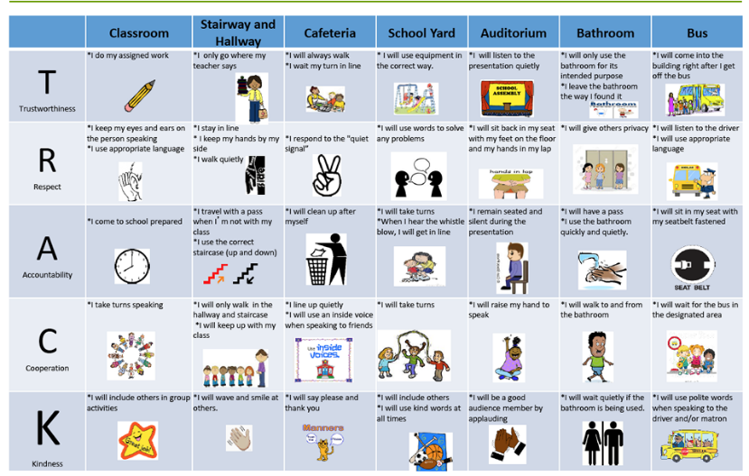
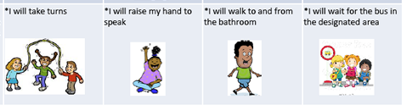
Notes:
Here is another school example with some different areas highlighted. Again, these are very brief, positive, and simple definitions of what behaviors are expected. It’s also important to note that each cell uses “I will” statements.

Slide 22

Cafeteria Expectations
Be Respectful | Be Responsible | Be Safe
Only eat the food on your plate | Wait your turn in line | Leave space between you and others (in line)
Clean up your area table and floor | All food and drink stays in eating areas | Walk at all times
Listen to adults | Pick up trash around you – even if left by others | Keep all food off the floor
Notes:
This is an example of what it looks like to be respectful, responsible, and safe in a cafeteria. Note how the behavior rules are short, positively stated, measurable, and observable.

Slide 23
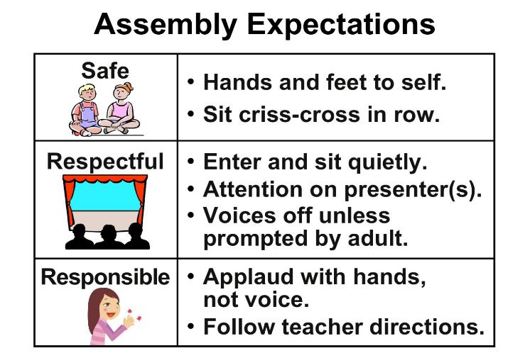
Notes:
Here is another example of how expectations are defined. This time they are specific to a setting instead of geographical part of the school. Students will know exactly what behavior is expected when they attend an assembly. Even here there could be greater positivity.

Slide 24
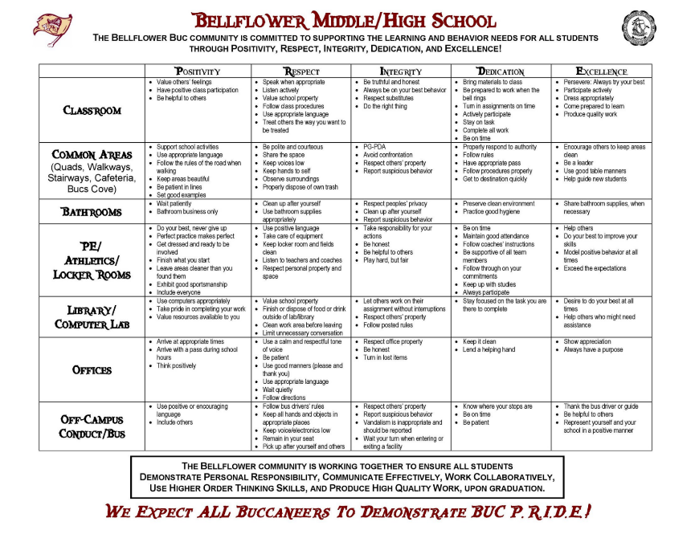
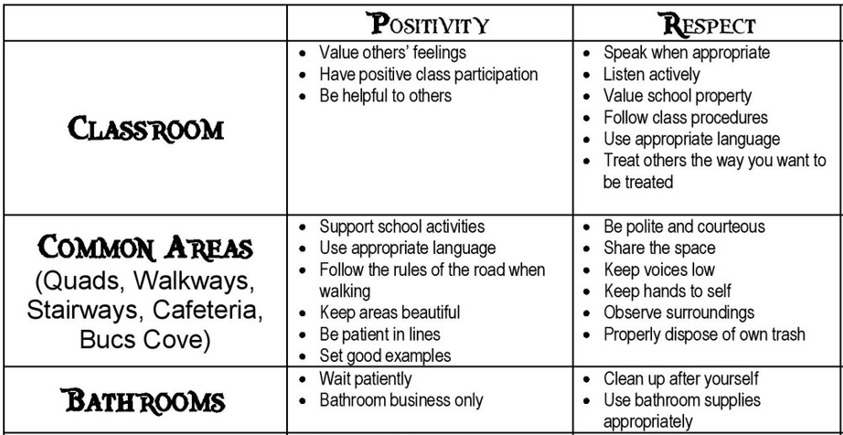
Notes:
This is an example of a high school behavior matrix.

Slide 25
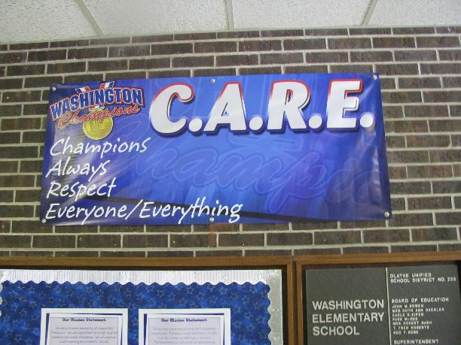
Use Lots Of Visual Displays!
Notes:
These next few slides are some examples of visual displays at various schools around the country. Expectations need to be highly visible. The idea is to work towards having the expectations and behavior become an inherent part of the school.

Slide 26
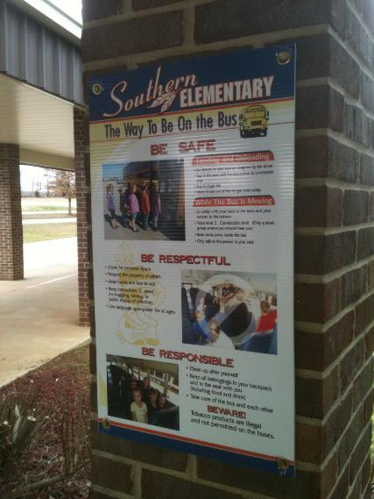
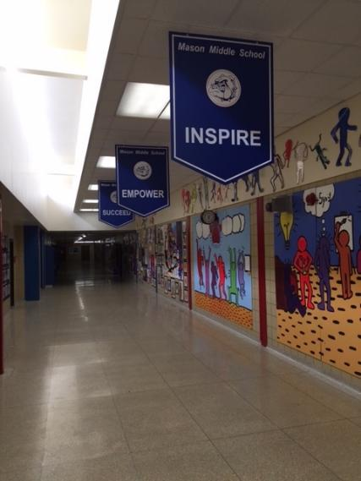
Notes:
Here are some more examples. The photo on the left shows bus expectations displayed in the bus pick-up and drop-off area. The banners on the right are very powerful visuals that show what values are really important to the school.

Slide 27
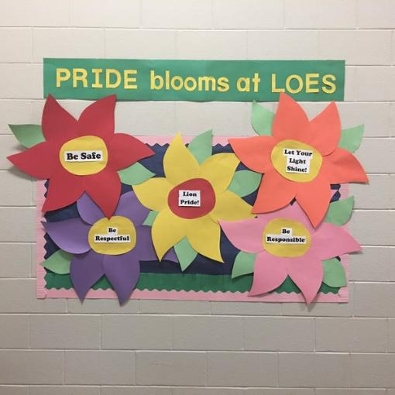
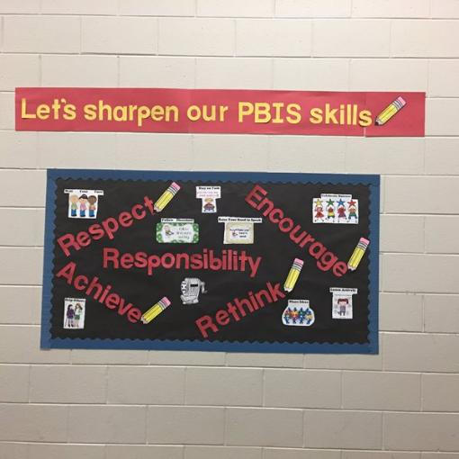
Notes:
Finally, here are some hallway reminders. These displays are very creative and stand out well so that passers-by will notice them.

Slide 28
Do It With Fidelity!
Tiered Fidelity Inventory (TFI)
Efficient, valid index of extent to which PBIS core features are in place
Section 1.3 Behavioral Expectations
Notes:
The TFI is an important tool in the PBIS implementation process. It can be used in the development stage, and then used in an ongoing manner to ensure all core features are in place. The TFI highlights each critical component of PBIS. Section 1.3 of the TFI covers behavioral expectations. See next slide.

Slide 29
1.3 Behavioral Expectations
Subscale: Implementation
Feature | Data Sources | Scoring Criteria
 |  | 0 = Not implemented 1 = Partially implemented 2 = Fully implemented
1.3 Behavioral Expectations: School has five or fewer positively stated behavioral expectations and examples by setting/location for student and staff behaviors (i.e., school teaching matrix) defined and in place. | TFI walkthrough tool Staff handbook Student handbook | 0 = Behavioral expectations have not been identified, are not all positive, or are more than five in number. 1 = Behavioral expectations identified but may not include a matrix or be posted. 2 = Five or fewer behavioral expectations exist that are positive, posted, and identified for specific settings (i.e., matrix) AND at least 90% of staff can list at least 67% of the expectations.
Main Idea: Having school-wide, positive expectations is among the best ways to establish a positive social culture.
Notes:
This is the section of the TFI that measures the fidelity of implementation of behavioral expectations. At this stage, teams can use this as a guide to inform their implementation.

Slide 30
Summary
Make a commitment to proactive/preventive discipline.
Assess your current situation.
Assess student behavioral data.
Collaborate to determine behavior goals.
Choose three to five overarching behavioral expectations.
Create behavioral rules for all settings.
Create visual displays throughout school.
Use TFI to measure fidelity.
Notes:
Here is a summary of what we highlighted. The main idea is to develop overarching behavior expectations that fit the school’s needs and values, and then define them in simple terms so that everyone in the school will know what behavior is expected from them. This is an important first step, as the expectations will be the foundation for teaching and reinforcing behavior.

