Slide 1
Teaching Behavioral Expectations
Module 6
Notes:
Images in this module were obtained at google.com/images unless otherwise specified.
Trainer Notes:
It is important that schools and teams have developed school-wide behavior expectations before implementing this component.

Slide 2
Context
Logic for teaching behavior
System for teaching behavior
  Developing lesson plans
  Kick-off planning
  Yearly planning
Notes:
PBIS has to fit into district plans, initiatives, systems, and structures. There has to be district oversight for how PBIS is initiated, implemented, and sustained, and there needs to be a team led by a champion with some authority and backing.

Slide 3
Logic for Teaching Behavior

Slide 4
Why Teach Behavior?
Not all students know the appropriate behavior.
Behaviors are prerequisites for academics.
Procedures and routines create structure.
Repetition is key to learning new skills.
Notes:
Remember that each family has its own rules and expectations—functionally its own culture. That means students have varied knowledge and skills. For students to start adopting the desired behaviors, schools will need to invest time in teaching them the behaviors. By making this investment and creating a more structured environment, teachers will face less disruption and have more time for teaching academics.

Slide 5
Misbehavior Often Occurs Because Students…
do not have appropriate skills.
do not know when to use skills.
have not been taught classroom procedures and routines.
are not taught skills in context.
Notes:
Students and parents are often given a student handbook and must try to figure out what behavior is acceptable. They often tell students what NOT to do. This leaves a wide opening for students to make their own interpretations on what is acceptable behavior, and it also gives the adults in the building the ability to decide what they think is appropriate behavior. By creating consistency and teaching students what is expected in different areas of the school and different settings, they will be more likely to use these behaviors.

Slide 6
How Behavioral Errors Are Different
“If a child doesn’t know how to read, we teach.”
“If a child doesn’t know how to swim, we teach.”
“If a child doesn’t know how to multiply, we teach.”
“If a child doesn’t know how to drive, we teach.”
“If a child doesn’t know how to behave, we…
…teach? …punish?”
“Why can’t we finish the last sentence as automatically as we do the others?”
John Herner (Counterpoint 1998, p. 2)
Notes:
Some staff may have resistance to “why” behavior must be taught and may think that “students should just know how to behave”. When children come to our schools without skills to read, multiply, etc., we teach. Teaching behavior skills is just as important.

Slide 7
A Comparison Of Approaches
ACADEMIC PROBLEMS
We assume:
  Student learned it wrong
  Student was (inadvertently) taught it the wrong way
SOCIAL PROBLEMS
We assume:
  Student refuses to cooperate
  Student knows what is right and has been told often
Colvin, 1998
Notes:
Have teams think about how their school approaches academic problems as opposed to how they approach social and behavioral problems. With academics, there is always a core, universal curriculum taught and if students don’t show understanding, we try to identify why and help them understand. We often have to re-teach in a different manner, give students feedback, and give them time to practice their new skills. What about with behavior? Are students explicitly taught behavior? Do we take the time to understand why the student did something we find inappropriate? This slide and the next two show the differences in how we often address academic versus social problems.

Slide 8
A Comparison Of Approaches
ACADEMIC PROBLEMS
Next we:
  Diagnose the problem
  Identify the misrule and reteach
  Adjust presentation
  Focus on the rule
  Provide feedback
  Provide practice and review
SOCIAL PROBLEMS
Next we:
  Provide a “punishment”
  Withdraw student from normal social context
  Maintain student removal from normal context

Slide 9
A Comparison Of Approaches
ACADEMIC PROBLEMS
Finally we assume:
  Student has been taught skill
  Will perform correctly in future
SOCIAL PROBLEMS
Finally we assume:
  Student has “learned” lesson and will behave in future

Slide 10
Making Assumptions
We can no longer assume:
Students know appropriate behavior.
Students will learn behavior quickly without consistent practice and modeling.
We must assume:
Students will require different curricula, instructional tools, etc. to learn appropriate behavior.
We need to teach expectations, rules, procedures, and appropriate behaviors as effectively as we teach academics.
Notes:
In our previous modules, we talked about committing to a new philosophy on discipline. Part of this new philosophy involves not making assumptions about student behavior. We need to make sure that students are taught behavior like they are taught any other subject.

Slide 11
System for Teaching Behavior

Slide 12
Why Develop A System For Teaching Behavior?
Need common “norms” for behavior
Teaching must be universal and consistent.
Spend less time correcting!
Notes:
School communities need an agreed upon set of expectations and procedures to make things function better. Taking the time to teach all the students these expectations and procedures will cut down on confusion, and most students will learn these quickly. In order to be effective, ALL students need to be taught consistently and systematically. Once the majority of students begin following the expectations and procedures, it becomes easier to identify the students that need additional support. This is what we would do in academic subjects, so why not behavior?

Slide 13
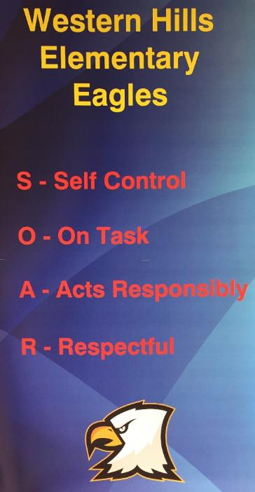
Behavioral Expectations
Specific, positively stated values
Address school-wide issues
Defined in all settings
Taught directly to students
Western Hills Elementary
Little Rock, AR
Notes:
Behavioral expectations are three to five brief, positively stated values that exemplify the type of behavior schools want to see everyone displaying in the school. They are generally broad statements that reflect the values or behavioral concepts that are held as important to a school and its community. Previously, teams developed and defined behavioral expectations for their school settings. This training will guide teams through the process of developing a plan for teaching the behavior expectations directly to students.

Slide 14
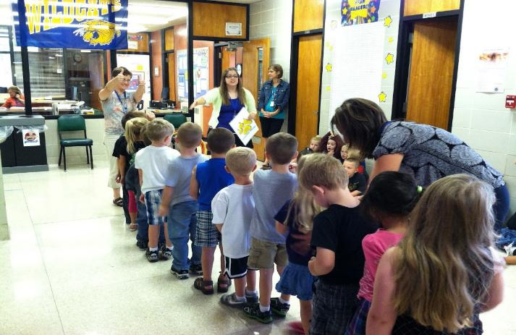
Teaching Behaviors From Expectations
The process:
Define expectations simply
Model the behavior
Let students practice
Give students feedback
Notes:
If we truly want students to model the behaviors we have decided are important and we want to see, we need to take the time to make sure they understand what we expect of them. The basic process is to give the students a simple definition of the behavior, model the behavior for them, give them a chance to practice, and then give them feedback on how they are doing.

Slide 15
Teaching Expected Behavior
Define Simply
Model
Adjust for Efficiency
Practice in Setting
Monitor and Acknowledge Continuously
Notes:
This graphic shows the teaching cycle, similar to the approach to academic subjects. The cycle is ongoing as we check for understanding and make adjustments as needed.

Slide 16
Developing Lesson Plans
Concepts
Understand expectations
Applicable to all settings
Skills
Observable behaviors
Rules for specific settings
Teach lessons in each setting.
Notes:
There are two instructional components that should be embedded- concepts and skills. Concept components involve broader understanding of the expectations, including defining expectations through examples and non-examples. Skill components include the teaching of specific, observable behaviors, put into context or setting, related to the concepts.

Slide 17
The Behavior Lesson Plan
Select the skill to teach
Take directly from the behavioral matrix
Use trends in your data
Write the lesson plan
Name the skill & school-wide expectation
  Explain why skill is important
Introduce the skill
  Give examples & non-examples
Demonstrate the skill
  Role play, practice
Provide acknowledgment and feedback
Notes:
These are the steps to developing behavior lesson plans. The work to develop lesson plans can take some time, and it is recommended to have all staff involved in the creation of the plans. These behavior lesson plans will provide consistent language and teaching across the school. There are several examples of elementary, middle, and high school behavior lesson plans available online. Remind teams that their behavior matrix is generated to reflect the skills that are expected in their school or community, and they will want to personalize their lesson plans to reflect their school’s needs.

Slide 18

Putting Your Plan Into Action
Provide teachers with a lesson format.
Expand lesson plan ideas throughout the year.
Teach behaviors in settings where behaviors occur.
Notes:
Earlier we talked about creating a teaching system. We’ve discussed: creating lesson plans, ongoing direct teaching, looking for ways to provide additional prompts and reminders throughout the day, and embedding behavior in other lessons. Now, it’s time to plan and get the system running. Teams need to make sure teachers have a lesson plan format so that there will be consistency in how behavior lessons are taught. Even if they create a large bank of standard lesson plans at the beginning of the year, there may be new situations that arise during the year that will require some new lessons.

Slide 19
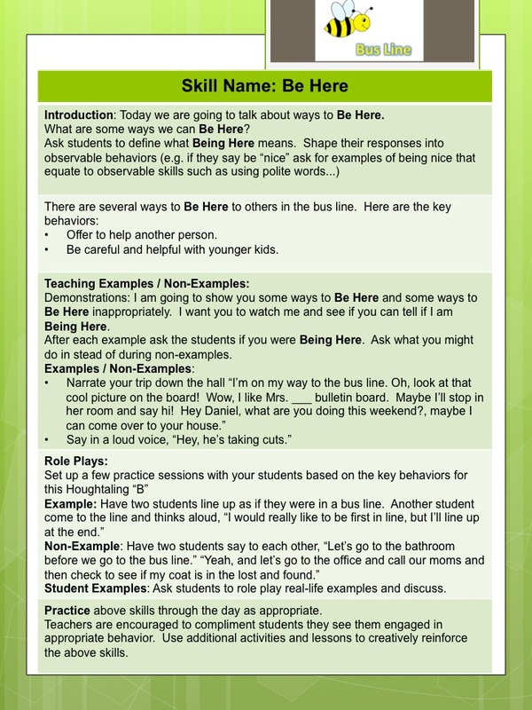
Example: Elementary Lesson Plan – Bus
Teacher checks for understanding in multiple ways
Students are given opportunities to practice
Notes:
Here is an example of how you might develop a lesson plan. It’s important to keep the lesson plan simple and focused on making sure the students understand the skill, and that they have time to practice and get feedback (refer to previous slides for the desired components of a lesson plan).

Slide 20
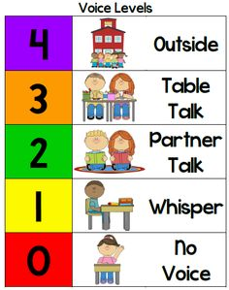
Example Of Voice Level Chart
Notes:
As an example of training, an easy way to help students with knowing what voice level to use in different settings is to create a chart and have students practice changing their voice levels according to different situations throughout the school and the day.

Slide 21
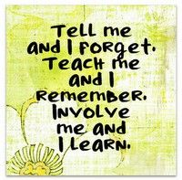
Teaching Opportunities
Kick-off or roll-out at beginning of year
    Teach all school expectations and rules
Ongoing direct instruction
    Specially designed lessons
Embed in other curriculum
Booster trainings after long breaks
Keep it out there!
    Visual displays – posters, agenda covers
    Daily announcements
Notes:
Teaching behavior needs to be an ongoing process, with students needing regular reminders and prompts. In the data-based decision making module, we will discuss looking at data to see what behaviors need to be addressed and teams will come up with a plan that will often involve some re-teaching. Teachers can also look for ways to embed behavior and character education in other subjects.

Slide 22
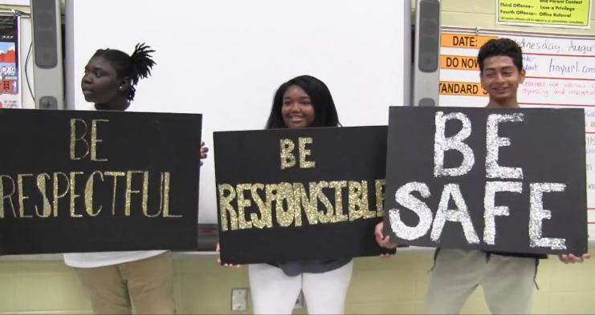
Introductory Events
All faculty, staff, and students participate
Decide on method that will be most effective for your school
Activity/event should be given a high priority
Notes:
When schools initially teach the behavior expectations to students at the beginning of the year, they should try to schedule it so that everyone in the school can participate. The kick-off event can involve an assembly, groups of students, or individual classroom teachers introducing the expectations. This will vary by grade level. The main idea is to make sure that students understand the behaviors in context. For example, in elementary schools, it is useful for students to be taken to all of the areas where they have defined expectations and given a chance to practice the newly learned skills. Classroom teachers will need to help students understand the expectations for different transition times and settings within the classroom, such as working in groups or transitioning to a new subject.

Slide 23
Kick-off
Staff kick-off
  Conduct during staff in-service days
  Communicate implementation steps
  Demonstrate behavioral lesson plans to staff
Student kick-off
  Conduct at the beginning of school year
  Create “rotation stations”
  Have celebrations
Notes:
23
It is suggested that there are school-wide “kick-offs” for staff and family, as well as students. Many schools have devoted time to creating teaching videos to share with students or families during the kick-off. Some schools have videotaped the kick-off at the beginning to have as a reference for any new students entering the school after the kick-off. Some schools have created a video to use as a welcome and to orient new students. Another consideration is having something for new or substitute teachers. We will go through kick-offs in more depth in a later module.

Slide 24
Kick-off
Family/community kick-off
  Encourage participation of family/community members.
  Inform at the beginning of school
  Provide learning opportunities/courses on PBIS.
    Example: show how to adapt school-wide expectations to the home.
Notes:
The more students are exposed to expectations and being reminded of the expected behaviors, the more successful they will be. Encourage families to learn about PBIS so that they will be able to ask and remind the kids about the expectations, and maybe even use expectations at home.

Slide 25
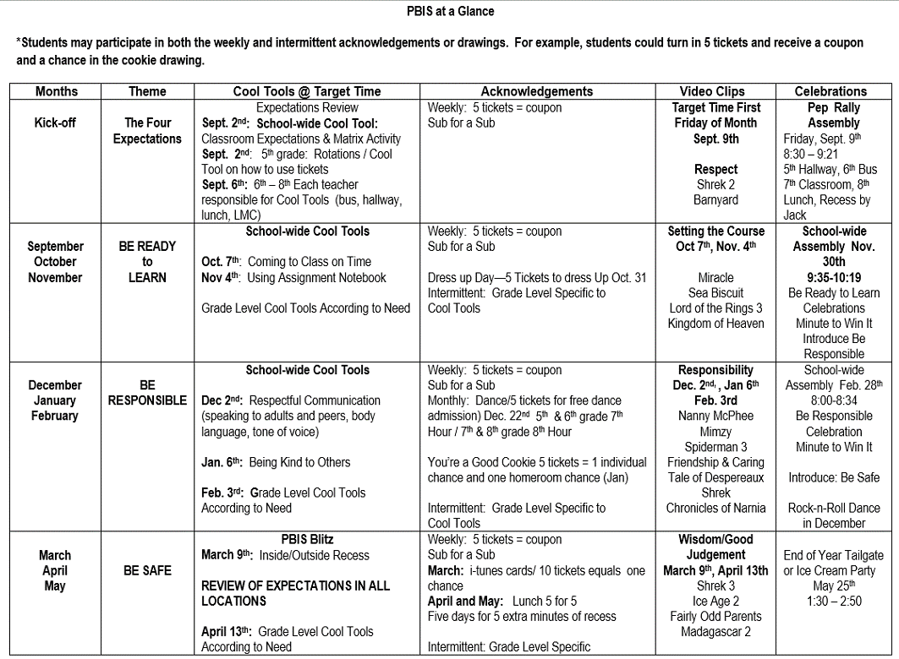
Yearly Planning Example
Notes:
This is an example of a yearly plan. The team can design a plan that works for their particular situation. This example emphasizes different expectations during different months. “Cool Tools” are what they call their lesson plans. As we get through the other modules in this series, teams will be creating a yearly plan for all systems. We will provide templates to help them plan their year.

Slide 26
Some Creative Ideas
Provide students with a script (actions and words).
Classes compete to come up with unique ideas, such as student projects, bulletin boards, skits, songs, etc.
Recognize staff for creative activities.
Create videos of students role-playing to teach expectations and rules.
Notes:
Here are some ideas. Teams may want to incorporate some of these into their teaching system.

Slide 27
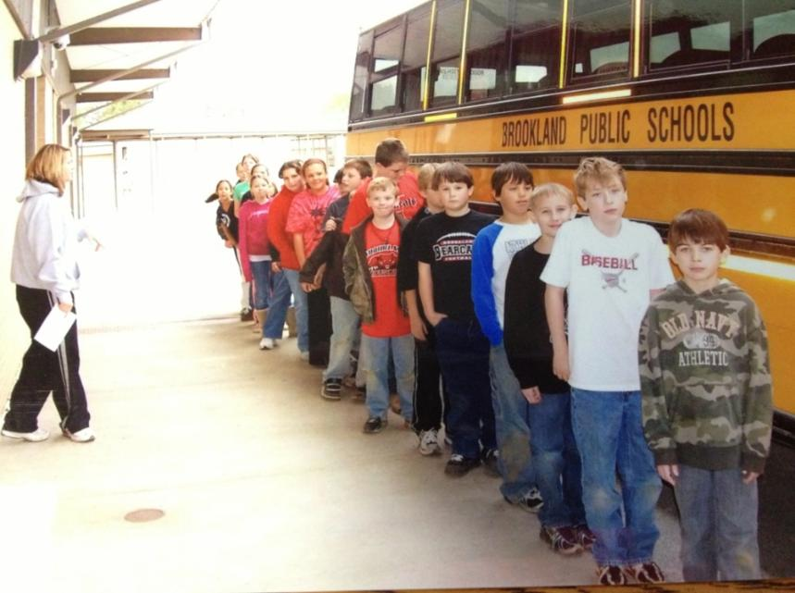
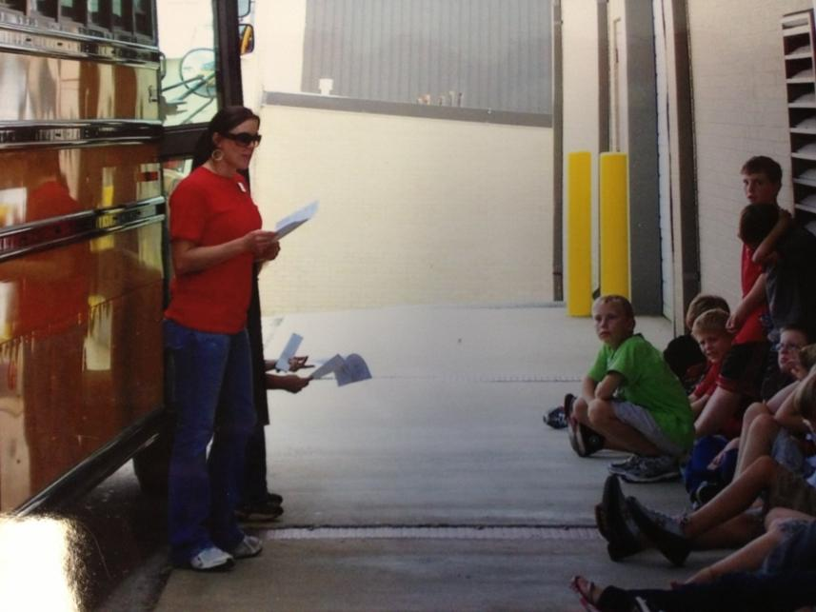
Brookland Middle School
Notes:
Here are some pictures taken during a kick-off event for middle school students in Brookland School District. These are pictures of students learning the expectations for riding the buses. Some of the bus drivers taught the students the expected behavior.

Slide 28

PBIS Bathroom Expectations
Notes:
https://www.youtube.com/watch?v=13gK7KNc8UI

Slide 29
Guiding Questions
Who can/will/should teach the expectations?
  Teachers, staff, bus drivers, cafeteria personnel…?
  Ideally everyone teaches!
What method or means will you use?
  Lesson plans, videos, announcements…?
Where will you teach the expectations?
  In assemblies, in each area of school, in classrooms…?
When will you teach expectations?
  Kick-off, beginning of day/week, every day, once a week…?
Notes:
Here are some guiding questions to help team’s complete plans for teaching behavior. Remind them to answer the “who, what, where, and when” questions.

Slide 30
Do It With Fidelity!
Tiered Fidelity Inventory (TFI)
Efficient, valid index of extent to which PBIS core features are in place
Section 1.4 Teaching Expectations
Notes:
The TFI is an important tool in the PBIS implementation process. It can be used in the development stage, and then used in an ongoing manner to ensure all core features are in place. The TFI highlights each critical component of PBIS. Section 1.4 covers teaching expectations. See next slide.

Slide 31
1.4 Teaching Expectations
Subscale: Implementation
Feature | Data Sources | Scoring Criteria
 |  | 0 = Not implemented 1 = Partially implemented 2 = Fully implemented
1.4 Teaching Expectations: Expected academic and social behaviors are taught directly to all students in classrooms and across other campus settings/locations. | TFI walkthrough tool Professional development calendar Lesson plans Informal walkthroughs | 0 = Expected behaviors are not taught. 1 = Expected behaviors are taught informally or inconsistently. 2 = Formal system with written schedules is used to teach expected behaviors directly to students across classroom and campus settings AND at least 70% of students can list at least 67% of the expectations.
Main Idea: Behavioral expectations need to be taught to all students in order to be effective.

Slide 32
Summary
Describe observable behaviors for each expectation.
Model the desired behaviors.
Give students written and graphic cues in-setting.
Plan to re-teach and restructure teaching.
Ask students to participate in the process.
Use “teachable” moments.
Notes:
In summary, the teaching system needs to fit each school’s needs. Have teams make sure that whatever means they use to teach is being delivered to ALL students, and that they check for understanding. Show students what to do – be their model. Give them lots of prompts and cues. Thank the staff for their hard work and even include students, especially older students, in the process. They can help create videos, or maybe they can even help teach some of the lessons. Always be looking for ways to turn a situation into a teaching moment.

Slide 33
Resources
Florida PBIS Project
https://flpbis.cbcs.usf.edu/tiers/tier1.html
Missouri School-wide PBIS
http://pbismissouri.org/tier-1-workbook-resources
Notes:
https://wisconsinrticenter.org/resources/
http://pbismissouri.org/tier-1-workbook-resources

