Slide 1
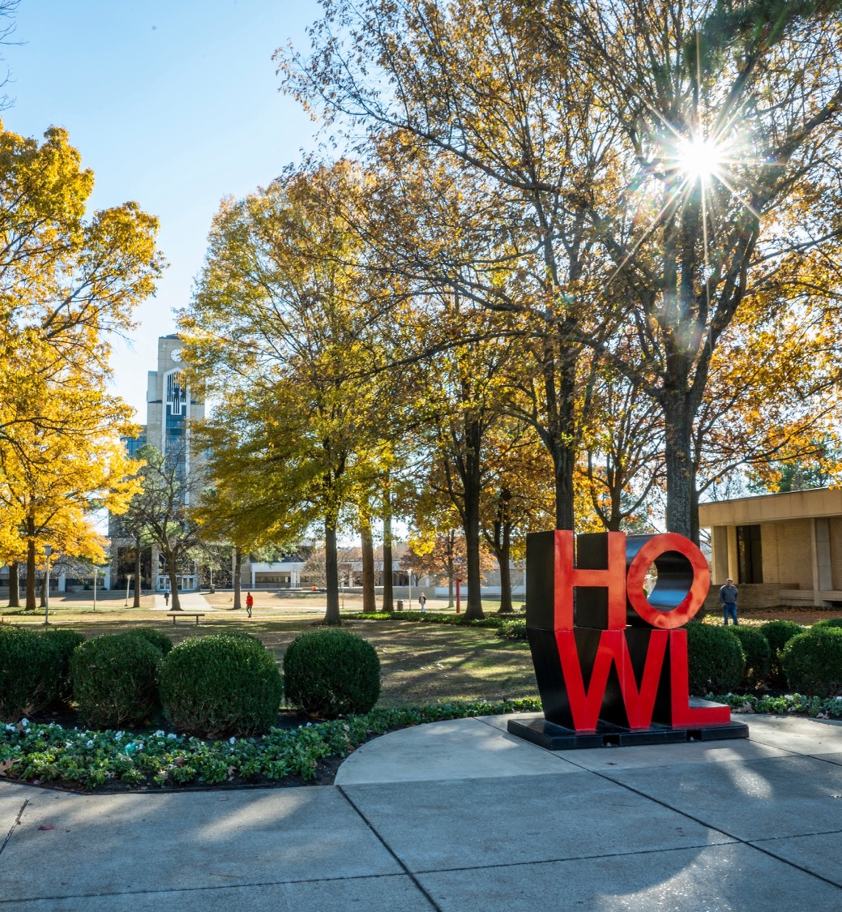
Thesis/Diss Title
Your name
[university][details of your degree]
[name of advisor or list of committee members]
Email address

Slide 2
Introduction
Topic
Question
Findings
What is the topic or area you are investigating?
What are the specific research questions/objectives that you set out to answer?
Why is this important to answer?
What did you learn?
Why is this important?

Slide 3
Literature Review
Relevant research that is close to your topic
Theories that may apply to your specific area of research
Areas of weakness that are currently highlighted

Slide 4
Methodology
Make sure to include information about
  The type of study you have conducted: qualitative, quantitative, or mixed
  The methods that you chose and why
  Details of population, sampling methods, and other related information
  Provide information regarding how you analyzed data that you collected.

Slide 5
Steps for Completing a
Thesis or Dissertation:
3. Submit Your Document
Once your document has been approved, your advisor/chair must complete the “Thesis/dissertation Defense Form”
You are ready to submit your document once all forms and approvals have been given
You will create an account on the ProQuest ETD Website (linked in format guide)
Please save/convert your document to a PDF file

Slide 6
Agree to the ProQuest publishing agreement
Pay fees
  Copyright fee, if you choose
  Fees for required printed copies (varies by program)
Upload your PDF file
Wait!

Slide 7
I will email you asking for:
  A word doc version of your document
  The month/year you will graduate
Your document will be checked against the format guidelines
  Expect at least 2-3 revisions
  Grad School focuses on title page, margins, table of contents, and appendices
Once your document matches the guidelines, it will be approved by the Graduate School
  you will receive an email verifying this, along with your chair and your program director

Slide 8

Questions?

