Slide 1
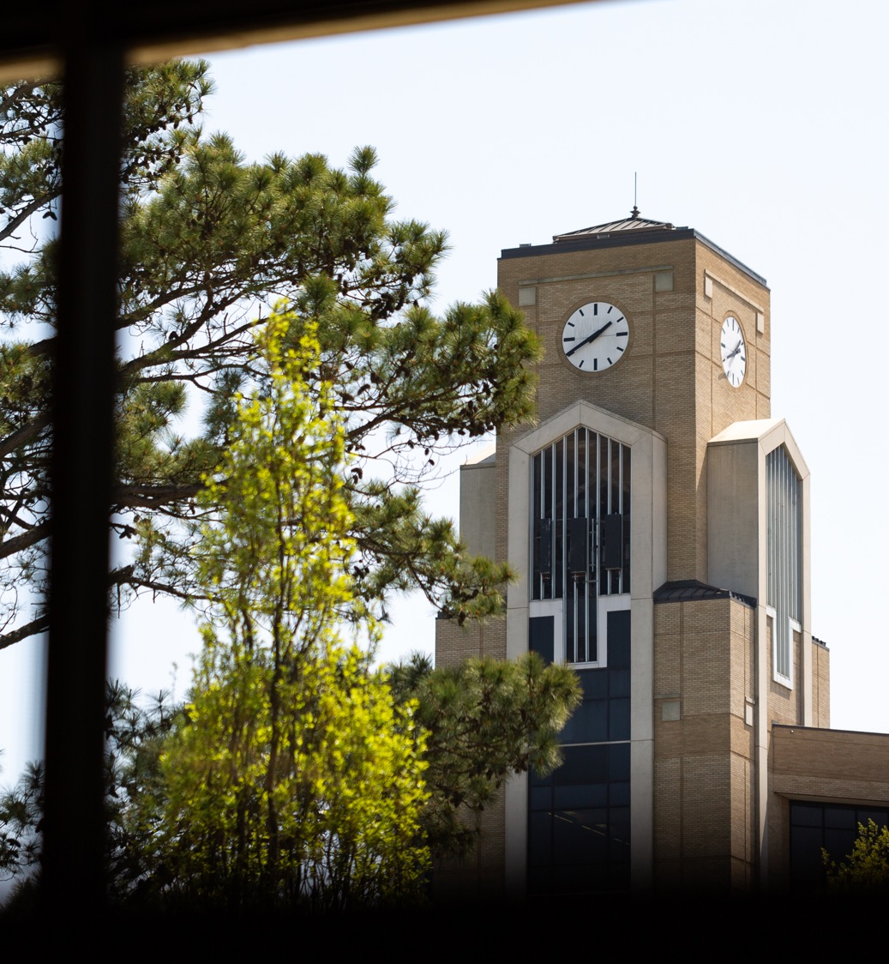
SURF Workshop
Office of Student Research and Scholarship

Slide 2
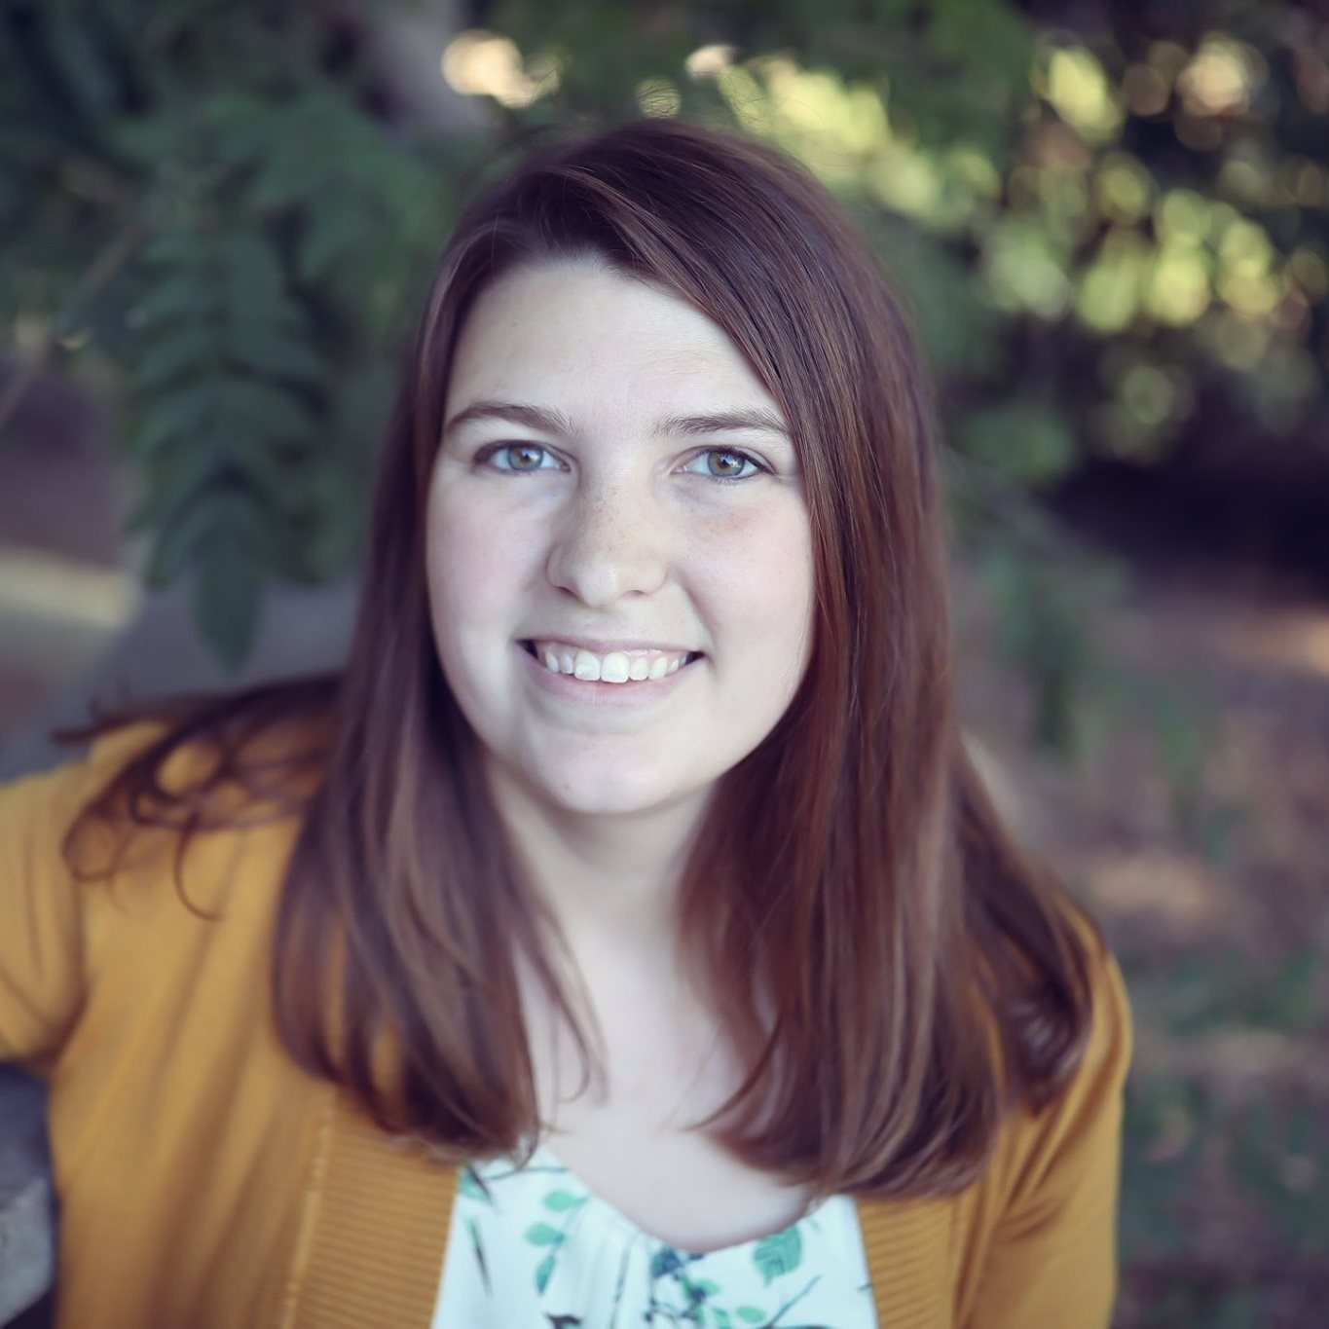
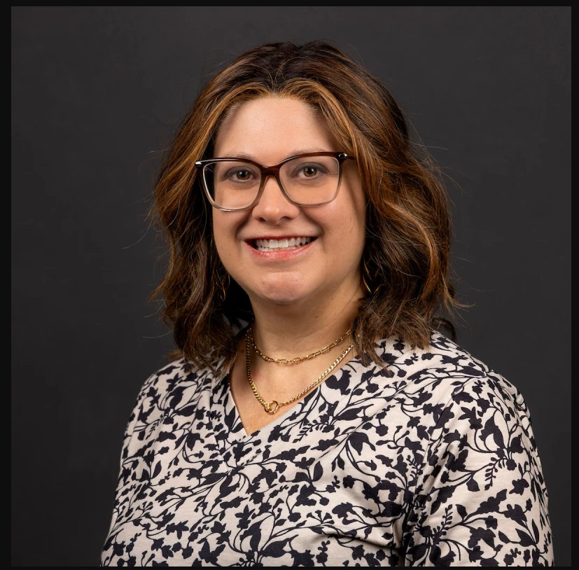
Meet Your Presenters
Dr. Kari Harris
Ms. Jennifer Salo
Director, Office of Student Research and Scholarship
Coordinator of Competitive Scholarships and Fellowships
Office of Student Research and Scholarship

Slide 3
Student Undergraduate Research Fellowship (SURF) – Overview
Funded by ADHE (Arkansas Department of Higher Education)
Open to undergraduate students in Arkansas who meet these requirements:
  US citizen or permanent resident alien
  Enrolled full-time
  Will complete minimum of 30 semester hours before funds are awarded
  Has a minimum 3.25 cumulative GPA
  Is supported by a tenured or full-time faculty member
A-State funds a small number of competitive awards for students who
  Meet all above ADHE SURF requirements EXCEPT citizenship (internal awards are open to international students)
  Submit a complete ADHE SURF application to the Office of Student Research and Scholarship by the internal deadline
  Are not awarded by ADHE

Slide 4
Student Undergraduate Research Fellowship (SURF) – Funding
As a fellowship, the SURF budget is typically insufficient to support the research project itself.
Standard budget includes:
  $750 in faculty support funds: supplies, travel, salary + fringe (frowned upon)
  $750 in student travel funds (mandatory)
Remaining budget depends on whether this is a full-year award or single-semester award (e.g., for a senior graduating in May)
  $2500 stipend for full-year awards
  $1250 stipend for single-semester awards

Slide 5
Student Undergraduate Research Fellowship (SURF) – Submission Process
Submitted internally to OSRS by October 19th EOD
Fill out application on InfoReady
Scored on a rubric, faculty mentor documents count toward total score (important to show your capacity to mentor)
***Begin your draft application EARLY and request recommendation letters directly through InfoReady***

Slide 6
Strengthening your application
Resume/CV
Student Form
Proposal summary
Proposal Description
Budget and Budget Justification

Slide 7
Resume/CV
2 pages max
Make sure it’s formatted and looks good (ask us for a template if you don’t have one)
Include relevant information, experiences, scholarships, and education. It’s great if you have publications or presentations to share, but you can still put together a great resume without them.

Slide 8
Student Form
Use provided template
For #3, try to add something compelling that makes YOU stand out. Why do you, personally, want to do this research? How is this project going to support your education and career goals?
  If you need additional paper for this statement, type it out in 1 page or less in Microsoft Word. Save the file and email it to kharris@astate.edu labeled as Student Form Additional Page_Your Name

Slide 9
Proposal Summary
1 Page Only
Use the provided template
Make sure this is relevant, compelling, and highlights the best part of your proposed research project

Slide 10
Proposal Description
Review guide/ template provided on InfoReady
Must include Description of Proposed Research, Introduction, Background, and Research Plan
References can be included and do not count toward your 5-page maximum
Must include a timeline – how will you accomplish this project in the amount of time proposed?
  Break it down weekly – how many hrs/week? What tasks will you complete each week?
  Be general, but make sure major parts of the work are accounted for
  Charts can be very effective

Slide 11
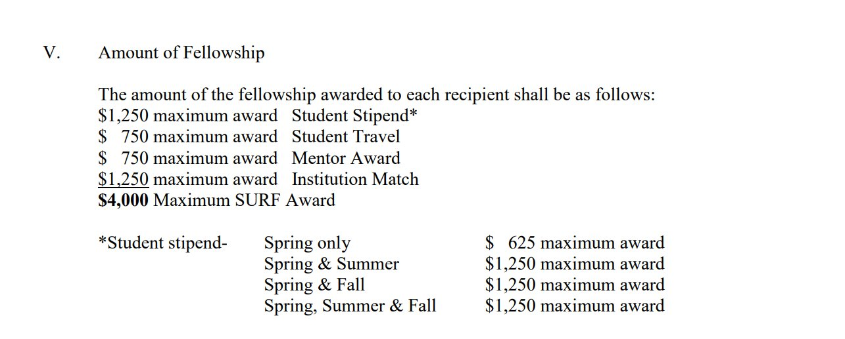
Budget and Budget Justification

Slide 12
Budget and Budget Justification
Don’t worry too much about the budget. If you need help, ask us!
Ask for the full amount allowed in each section
Include general expenses and estimated costs (round up), these do not have to be specific/exact
Include travel cost
  Ask your mentor for potential conferences you may attend
  The conference does not have to be exact, can be changed later

Slide 13
Strengthening the mentor side of the application (students, share this part with your mentor!)
Resume/CV
Mentor Statement
Mentor Letter of Support

Slide 14
Strengthening the mentor side of the application
Resume/CV
  No more than 2 pages
  Include relevant, representative publications; extensive publication list and lengthy details are not necessary
  Examples of sections you might include in a 2-page CV,
  space permitting:
    Professional Appointments, Research Interests, Selected Publications, Courses Taught, Grant Activity, Invited Presentations, Honors and Awards, Professional Capabilities, Professional Service

Slide 15
Strengthening the mentor side of the application
Mentor Statement
    No more than 2 pages
    Page 1: fillable PDF form; page 2 (if needed): additional sheet with mentored students and projects, if it will not fit in the text box
  Question 1: Include a brief statement of research/scholarly interests. If not included in the CV, list recent pertinent publications/scholarly work.
      Please make sure the response fits in the box
      Faculty recently beginning involvement in research are urged to apply; you can describe the reasons for wanting to be involved in research
  Question 2: List the undergraduate students with titles of projects you have directed in research/other scholarly activity during the last five years

Slide 16
Strengthening the mentor side of the application
Mentor Letter of Support
1 to 2 pages
Address letter to ADHE SURF Selection Committee
Make sure letter is on university letterhead, dated and signed
    Contact your department office for official letterhead
Submit through InfoReady

Slide 17
Strengthening the mentor side of the application
Mentor Letter of Support – strong letters will:
Address student's academic (especially research) abilities and performance
Indicate student's ability to complete the project
Comment on student's ability to meet the schedule and to live up to commitments
Outline significance of the student's project
Outline mentor's advisory role
Outline appropriateness of mentor’s previous experience for the proposed project
Explain what mentor brings to the project, mentor’s relevant research/work, etc.
Describe mentor’s prior experience supervising students in research, if any

Slide 18
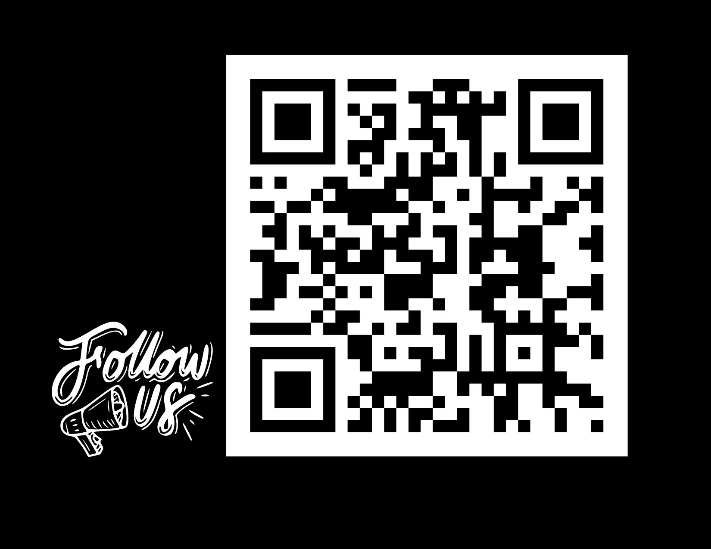
Contact Us!
We have examples for many of these sections we would love to share with you.
Reach out to us early and often, we are happy to help you prepare your application!
Office of Student Research and Scholarship
Email: kharris@astate.edu or jsalo@astate.edu
Phone: 870-972-2694
Location: 6th Floor, Dean B. Ellis Library, Suite 613
Knowledge Base: https://kb.astate.edu/shelves/a-state-office-of-student-research-and-scholarship-osrs

